Slide 1

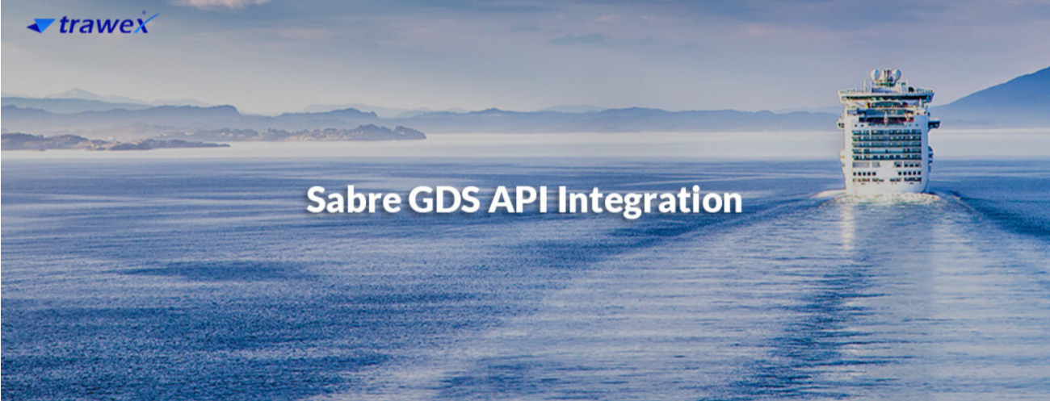
Sabre Cruises API
Email id : contact@trawex.com

Slide 2
Get a Sabre Cruise API for your Travel Agency
For cruise booking agencies that require flexible cruise shopping and booking capabilities with the best experience, Sabre Cruises API provide the industry's first cruise facilitated APIs, which not only provide better cruise offerings with additional capabilities but also allow for faster integration with the minimal development effort.
Sabre Cruise APIs provide enhanced offerings with additional capabilities to meet traveler needs at a low development cost. With leading Sabre cruise API, you can access over 30,000 cruise itineraries, including ship descriptions, detailed cabin information, and images.
Trawex offers Sabre Cruise API Integration, allowing travelers to search for and book cruises in real-time. We provide cruise providers on a single platform to which travel agents can gain access via the Cruise API to make simple online cruise bookings. When accessing cruise booking software, the API connects the cruise supplier and online travel agencies, allowing these OTAs to view their live, real-time inventory and availability.
Any Travel Business needs to connect to the GDS (Global Distribution System) to source Global Cruise Content, and when it comes to GDS, Sabre needs no introduction as one of the industry leaders in Aviation, Hospitality, and Travel.
It is a global business-to-business travel marketplace used by travel suppliers such as approximately 400 airlines, 175.000 hotel properties, 200 tour operators, 50 rail carriers, 40 car rental outlets, and 17 cruise lines to promote, customize and sell their products to travel management companies, corporate travel departments, and approximately 425,000 travel agents worldwide.

Slide 3
Sabre Cruises API - One Connection, Endless Possibilities
Sabre GDS provides real-time access to cruise information. Every major travel and cruise booking portal that is linked to the Sabre GDS has access to global inventory as well as published rates/packages.
With over 100.000 portals and 600.000 travel agents connected to the Sabre GDS system, this is the most dependable system for a cruise's online market exposure.
Trawex's Sabre GDS networks provide the necessary global recognition to boost a cruise's worldwide sales. Furthermore, the system expands a cruise's regional and local presence.
Ready for your customers to book their cruises through your website? With Sabre Cruises your agency can now sell cruises through its website. This industry-leading online cruise booking system provides your customers with full content from 16 cruise lines- the same inventory as Sabre Cruises API
Incorporate content from multiple cruise lines, add your markups and sell it online using our booking engine. With our cruise shopping and booking tool. you can save time.
Travel agents and end-users can use cruise booking software to search for and book cruise deals online In the form of cruise XML it can be linked to a comprehensive inventory of cruise suppliers (such as MSC Princess, and Carnival) for travel agents and tour operators.
The cruise online booking engine enables browsers to check online cruise availability examine deck plans, cabin inventories and eventually operate user-friendly online booking.

Slide 4
We provide APIs with content, prices, and booking capabilities to multiple cruise lines for agencies or corporations looking to build their search and booking platforms.
Trawex provides end-to-end turnkey technological solutions for the cruise industry that are highly scalable. We collaborate with cruise lines, travel websites, OTAs, and GDS to improve cruising by the use of cutting-edge technology.
As a pioneering enterprise, Trawex assists our customers with a powerful online distribution potential. It is regarded as a highly dynamic and user-friendly API for cruises, destinations, and activities. We assure our customers that they have chosen the right API for their travel website by providing the best cruise API integration services.
Sabre Travel Network, the world's largest and most rewarding marketplace for buying and selling travel, launch Sabre Cruises, a new cruise shopping and booking tool with expanded and improved functionality, as the latest addition to its end-to-end leisure collection.
When shopping and booking cruises, travel agents will have access to a browser-based booking engine with expanded functionality and rich graphical content with the innovative Sabre Cruises. The enhanced functionality of Sabre Cruises will enable agents to save time, increase revenue, and book the best cruises for their customers.
Our Web-based tool provides a single source for shopping and booking cruises, allowing online access to cruise line inventory during peak seasons, 24/7
Sabre Cruises' automated shopping and booking capabilities reduce research time by giving travel agents complete access to cruise line content. fares, commissions, rates, and more.

Slide 5
How Sabre Cruises API beneficial for travel agents and tour operators?
Do you want your customers to be able to book their cruises on your website? With Our Cruise APIs, your agency can now sell cruises through your website. Our online cruise booking system provides your customers with full content from 1t6 cruise lines, as well as the ability to search and compare prices across multiple sailings.
Trawex, the best cruise API provider, can assist you in providing better cruise service to your customers, resulting in a more complete and enjoyable travel experience.
The online cruise portal, which is powered by an easy-to-use, point-and-click interface and is supported by real-time reservation information, allow you to respond to your customers quickly. You can view multiple cruise offers - such as cabin information, dining, pre-and post-package availability, and itinerary - all on one dashboard.
Our Cruise Booking System provides your customers, sub-agents, and travel partners with real-time online quotations and booking services. Our Cruise Booking System is based on the innovative low-cost principles required for a profitable operation.
The most prominent feature of Sabre API is its great stability and flexibility. It is the most key aspect in the travel industry because it evolves and develops to increase sales.
With Sabre GDS API Integration on the cruise portal, booking of ancillary services is easily done with an automation booking format with a single transaction that allows performing book and price checks at the same time, saving time and effort.

Slide 6
Why You Should Choose Trawex For Sabre Cruises API?
Trawex is a well-known brand that provides best-in-class Sabre cruises API for travel agents, allowing them to easily book cruises online.
Our API integration services provide an interface between cruise suppliers and online travel agencies, allowing online travel agents to view real-time inventory and availability via B2B or B2C sales channels.
Trawex provides API integration services for Global Distribution Systems (GDS) and OTAs for Cruise Booking, as well as individual Cruise Line Integration.
API Integration service requires specialized skill sets, and Trawex is dedicated to the seamless integration of Sabre API in any format. We have a dedicated team of expert developers who are well-versed in Sabre Cruises API consumption and integration.
By allowing your programmers to integrate shipping functionality directly into your business systems or e-commerce websites, our software provides greater flexibility.
Trawex, a leading Sabre Cruise API provider, provides you with an interface to connect with cruise suppliers all over the world. Our expanded reach now includes the major cruise lines.
Trawex, a well-known brand, and provider of ultimate cruise API. assists travel companies with seamless cruise booking.

Slide 7
Through our API solution, we have developed a platform that offers an opportunity to travel agents to establish strong connections with cruise suppliers.
Using cruise booking software, travel companies can get the most up-to-date inventory and presence details.
We've gathered all of the major cruise lines on a single platform. Our cruise API assists travel agencies in collecting information and completing reservations.
As a pioneering organization, we provide our clients with extensive online distribution capabilities. It is considered a highly dynamic user-friendly API for cruises aircraft destinations, and events.
We provide our clients with the assurance that they have chosen the best cruise API integration services for their travel website.
We provide you with a wide range of opportunities and possibilities that you can take advantage of during our experience and expertise.
From open solutions that allow you to connect directly to the cruise line company and build your search and cruise booking engine, to integrated solutions that are quick and simple to implement.
We will assist you in increasing your profitability by selling cruises from the beginning. Through the integration of state-of-the-art technologies, Trawex will focus on improving the online presence of your cruise line through effortless updates from all Cruise Line APIs.

Slide 8
Benefits We Offer Through Our Sabre Cruises API:
Assists in increasing sales through online distribution channels
Reduce your dependence on other distribution channels .
Facilitate an online platform for faster cruise reservation
Extend your reach to a large inventory
Facilitate continuous evaluation
Provide a 360-degree view feature to help you plan your cruise ahead of time
Provide a selection of cruises that are enriched with luxury and lifestyle
Assist with real-time customer support
Assists in increasing sales through online distribution channels
Create an online platform to allow for faster cruise booking
Our Cruise API provides the highest return on investment in the shortest amount of time
Provide a platform for you to create your packages

Slide 9
Features We Offer Through Our Sabre Cruises API:
Instant online cruise booking
Best fares & commissions
User registration and validation module
Payment gateway integration
Manage all financial transactions easily
Real-time inventory of all major players
Luxury and lifestyle cruises
Deck plans, cabin layout of the cruise is available
24*7*365 booking support available
Our API supports B2C/B2B/B2E modules
Enhance the admin console
Provide payment gateway options
Provide a platform for you to create your packages
Offer an interface that can be modified from time to time
Maximize the profit to a large extent
Give you access to a massive amount of travel content
Provide constant inventory availability

Slide 10
Contact Us
For more details, Please visit our website:
https://www.trawex.com/sabre-cruises-api.php
Email id : contact@trawex.com

