Slide 1


Welcom To Chef Scripts
Chef Scripts is a luxury catering company bringing exceptional service and modern approach that has set a new standard in Bespoke Catering. We proudly hold an ISO 22000 Certification along with a strict HACCP Certificate of Compliance and a mandatory FSSAI License.
No.1 Corporate Catering Company in Delhi NCR

Slide 2
About Chef Scripts
CHEF SCRIPTS is a luxury catering company bringing exceptional service and modern approach that has set a new standard in Bespoke Catering. We proudly hold an ISO 22000 Certification along with a strict HACCP Certificate of Compliance and a mandatory FSSAI License.
Under the leadership of Chef Sarneet Singh, Co-founder and CEO of Chef Scripts, our team works round-the-clock, ensure your event stands-out par excellence.
Chef Sarneet Singh completed his Culinary Arts from IHM Aurangabad and Certificate III, IV and Advance Diploma from Meridian International Hotel School, Melbourne, Australia. Chef Sarneet Singh has been very successfully handling the under mentioned clients till now which will be a part of CHEFSCRIPTS:
GMR (New Udaan Bhawan), Lemon Tree Hotel (Secto-60, Udhyog Vihar & Sector-68), Holiday Inn Express (Sector 50), AB Mauri, Sumitocorp, Doosan, Kia Motors, Mckinsey & Company, American Express, Gartner, Philips, Luminious, UChicago University, Indigo Airlines, Software One
To be a food catering company that provides the best catering services in Delhi NCR takes a lot more than just the fundamentals. Chef Scripts has worked its way up among the leading catering companies steadily and consistently through its “Passion to Serve”.

Slide 3
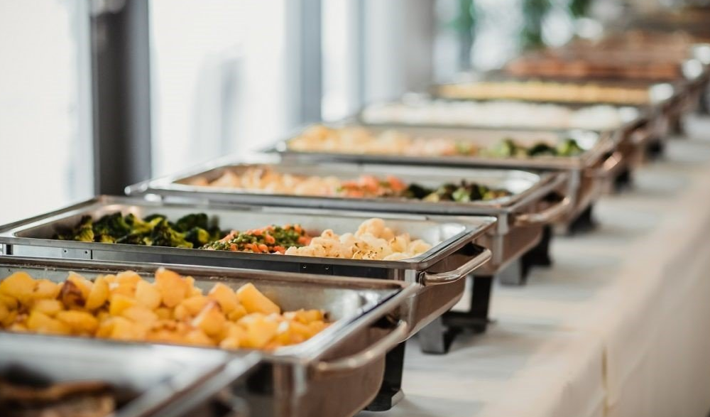

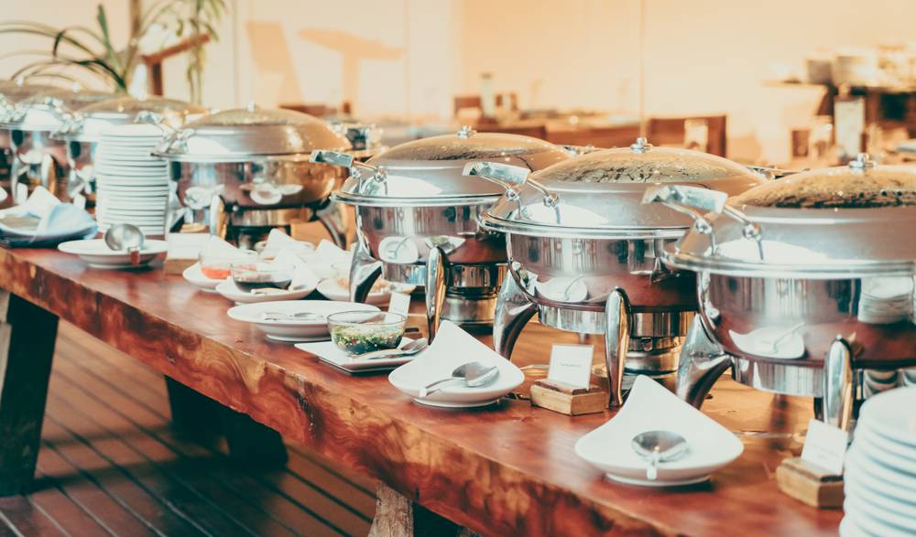
Best Services - Party
Private Catering
Corporate Catering
Outdoor Catering
Event Catering & Office Party
Live Station Catering
Birthday Party Catering
Corporate Catering in Gurgaon

Slide 4


Slide 5

Our Services

Slide 6
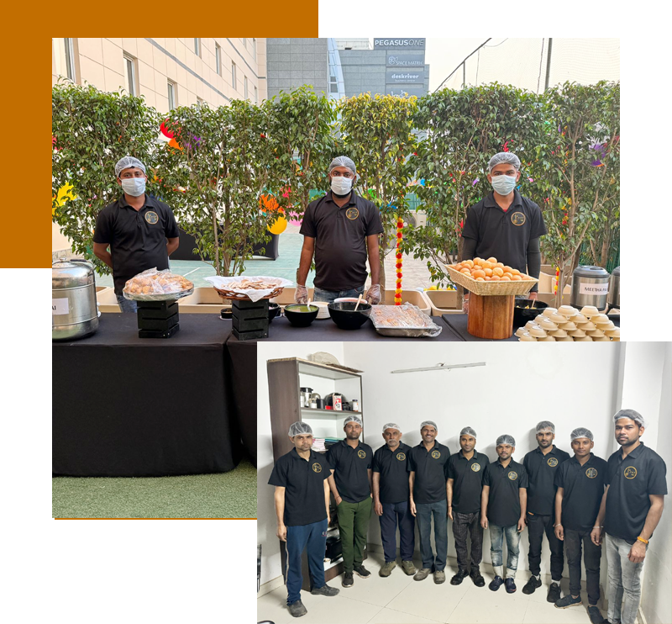
Click Links See All Services
Private Catering
Corporate Catering
Outdoor Catering
Wedding Catering
Live Station Catering
Birthday Party Catering
Corporate Catering in Gurgaon
Connect with our Expert Team for Assistance

Slide 7

Our Valuable Clients

Slide 8


Slide 9
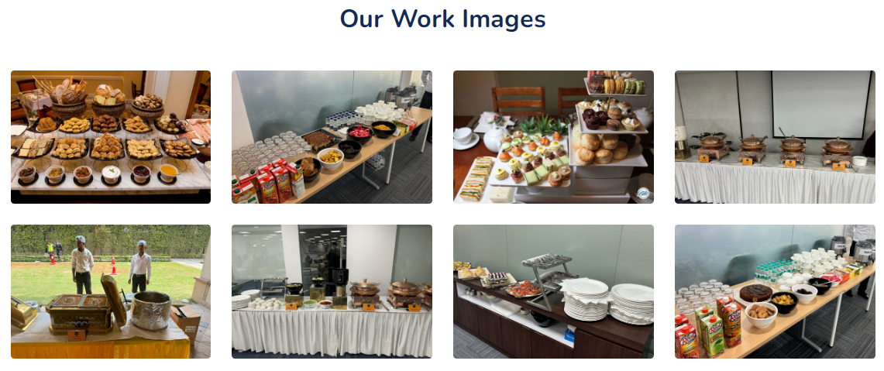
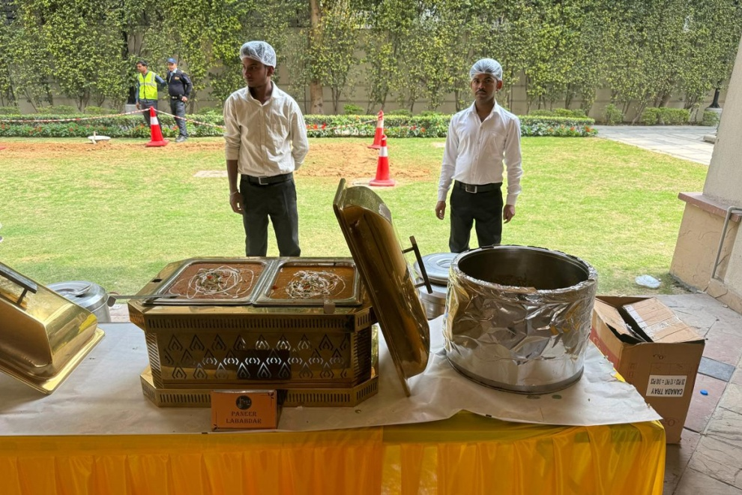
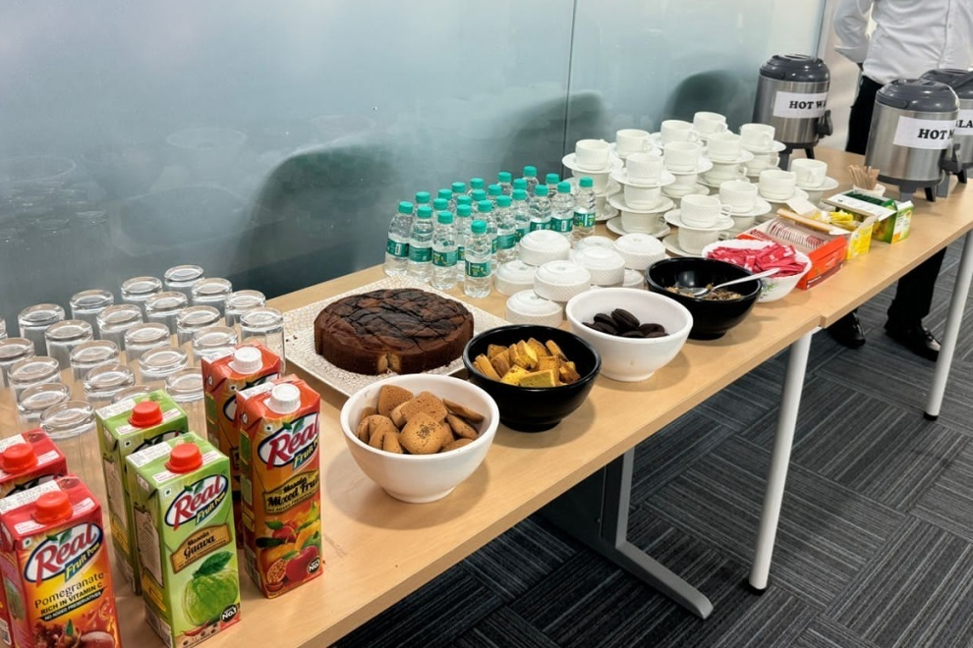

Slide 10
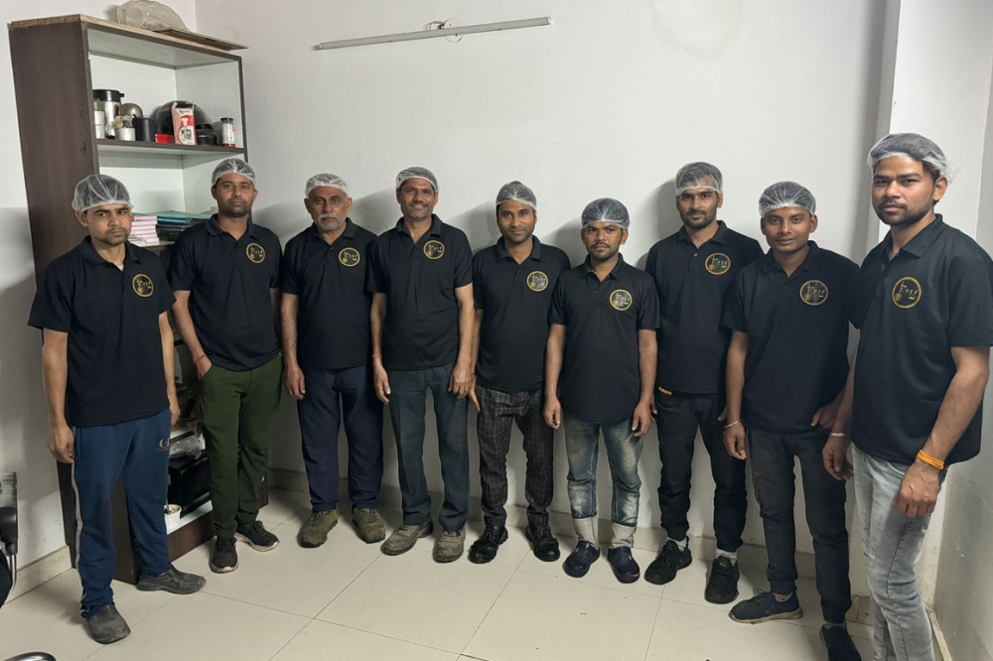
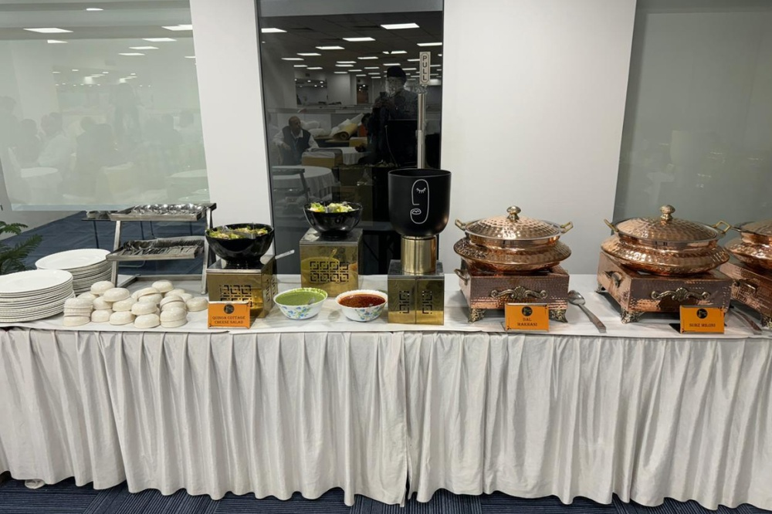
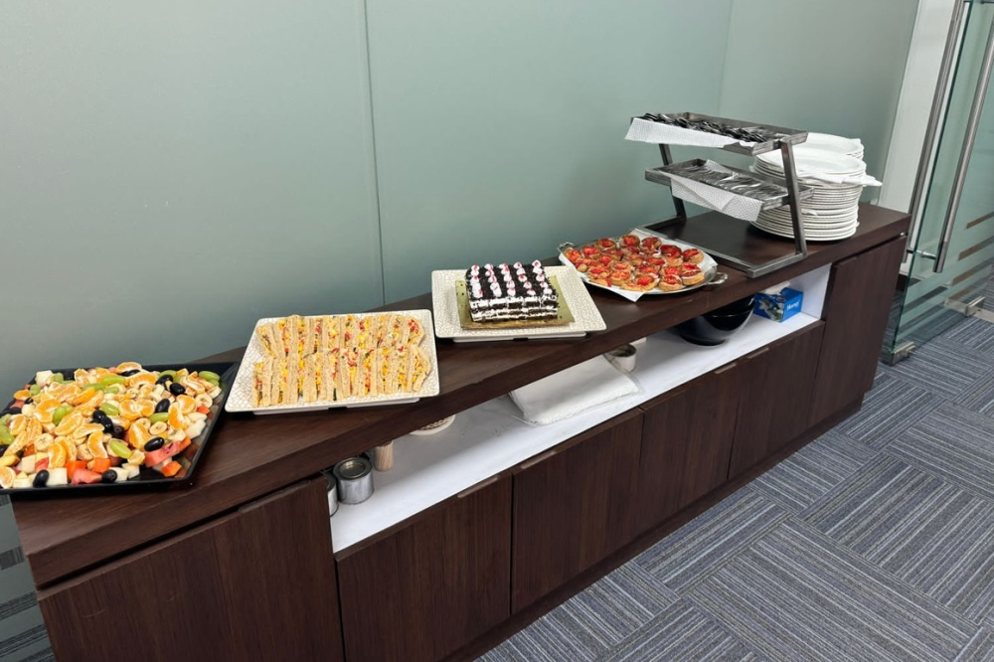

Slide 11
Contact Us
Address : Plot No-21, Killa No-3, CRPF Road Sector 62, Village Ullawas, Gurgaon, Haryana, 122001
Mobile No : +91-98919 13030
Email Id :
info@chefscripts.in | chefscripts@gmail.com
Website : www.chefscripts.in

