Slide 1
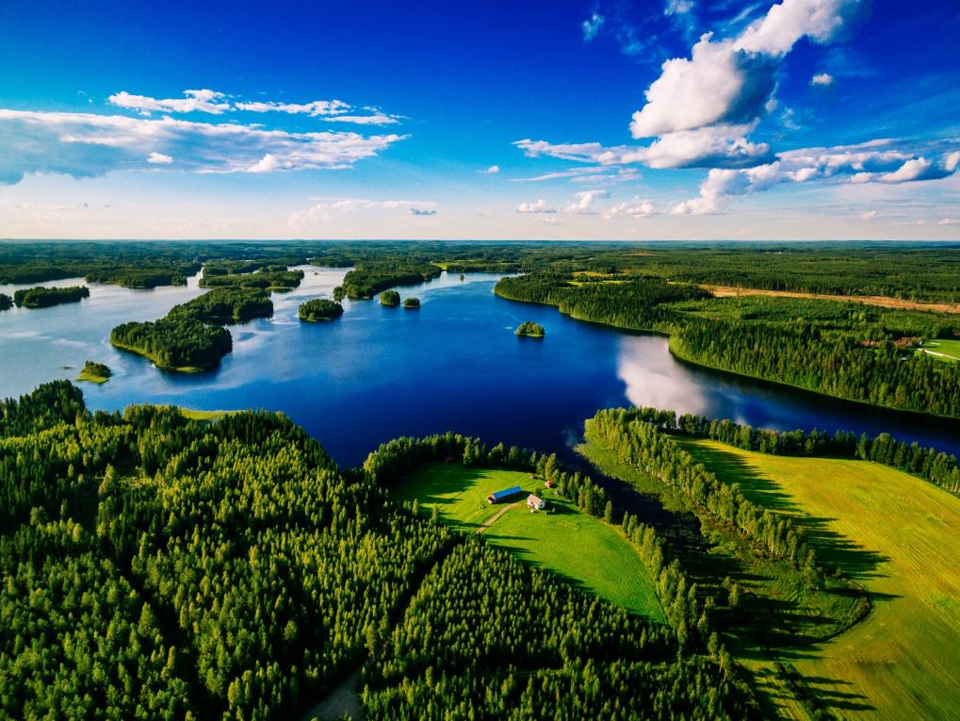



MARKETOFY
ULTIMATE POWERPOINT TEMPLATE
BELARUS
new destination
for MICE
www.belarusprimetour.com | www.miceinbelarus.com
© 2009-2019. All rights reserved.

Slide 2

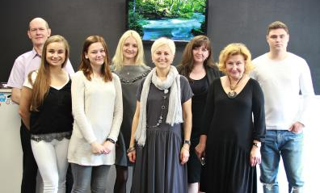
2
Open Belarus. Open Soul.
WE BRING EMOTIONS
«Our primary mission is to attract more visitors and to give them full comfort and satisfaction while travelling around the country called Belarus».
Natalia Lisovskaya, Vice President & CEO
Who we are?
Prime Tour is one of the leading incoming travel companies with long track records in Belarus. We capture all areas of tourism: natural, cultural, historic tours, leisure, business and MICE arrangements. We do our best to analyze the tourist market and feedback from our clients to customize tours in accordance with the requirements of our guests from all over the world.
www.belarusprimetour.com | www.miceinbelarus.com
© 2009-2019. All rights reserved.

Slide 3
3
Company’s history
2010
foundation of MICE department
2015
purchasing
our own office
2018
annual participants
of 7 international
MICE & tourism exhibitions
foundation
MICE department
partners
office
guarantee tours
exhibitions
2009
foundation of
Prime Tour LTD
2014
over than 100 partner companies
2016
launching of guarantee tours
www.belarusprimetour.com | www.miceinbelarus.com
© 2009-2019. All rights reserved.

Slide 4






4
50%
Our clients
Europe
3%
Russia
12%
35%
USA
Latin America
Asia
www.belarusprimetour.com | www.miceinbelarus.com
© 2009-2019. All rights reserved.

Slide 5
5
Clients from Europe
Germany | 33%
UK | 22%
Netherland | 15%
Sweden | 10%
Spain | 8%
Others | 12%
www.belarusprimetour.com | www.miceinbelarus.com
© 2009-2019. All rights reserved.

Slide 6
6
What we do?
Our services include everything related with tourism, such as design and full implementation of group and FIT tours, events, activities and programmes logistics.
Visa support
MICE
Transport service
All necessary documents for applying for Belarusian visa.
More than 40 events and meetings every year. .
We could kindly provide our guests with modern coaches, minibuses, minivans, cars.
Accommodation
Guides & interpreters
Restaurants
More then 300 hotels all over Belarus.
Highly-professional and experienced guides and interpreters
Wide choice of restaurants, presenting various cuisine.
www.belarusprimetour.com | www.miceinbelarus.com
© 2009-2019. All rights reserved.

Slide 7
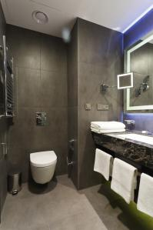
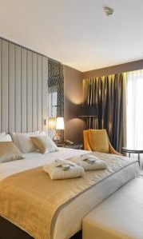
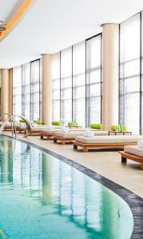




7
Accommodation
Prime Tour’s special hotel rates, presenting up to 50% discount from rack rate.
1
International hotel chains
2
Boutique-hotels
3
Club-hotels
4
Hotels 3-5*
www.belarusprimetour.com | www.miceinbelarus.com
© 2009-2019. All rights reserved.

Slide 8






8
Guides & interpreters
01
Highly-professional and experienced guides and interpreters
02
More than 10 languages (English, German, Spanish, Japanese, French, Swedish, Chinese and other foreign languages)
03
Qualified interpreters for conferences and seminars
www.belarusprimetour.com | www.miceinbelarus.com
© 2009-2019. All rights reserved.

Slide 9

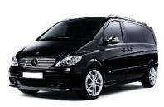
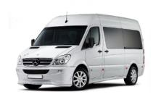
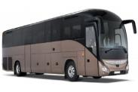
9
Transport
Prime Tour LTD will be pleased to provide You with transport services and transfers for travel in Belarus and beyond the country.
For a long-distance travel in Belarus, for meetings and departures at the airport, railway- and bus stations, for all kinds of transfers (both in Belarus and beyond the country) Prime Tour LTD offers different types of vehicles.
Sedan
Minivan
Minibus
Big coach
airport transfer from 30 EUR
Minsk city tour from 45 EUR
extra hour from 15 EUR
airport transfer from 40 EUR
Minsk city tour from 55 EUR
extra hour from 20 EUR
airport transfer from 80 EUR
Minsk city tour from 80 EUR
extra hour from 30 EUR
airport transfer from 170 EUR
Minsk city tour from 180 EUR
extra hour from 45 EUR
Buying and selling a product lorem service.
www.belarusprimetour.com | www.miceinbelarus.com
© 2009-2019. All rights reserved.

Slide 10
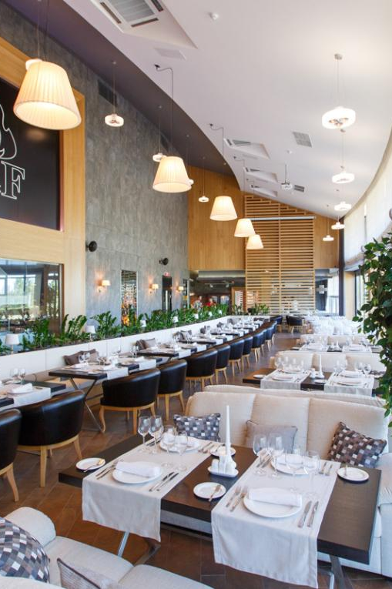
10
Restaurants
wide choice of restaurants, presenting various cuisine: national Belarusian, European, Italian, French, Japanese, Chinese etc.
all levels of restaurants and cafes: tourist class, business class, “de-luxe”
special offers for group and corporate reservations: folklore shows, live music performances, various degustations etc.
.
Traditional
restaurants
European
restaurants
VIP
restaurants
Asian
restaurants
Brewery
restaurants
Out-of-town
restaurants
www.belarusprimetour.com | www.miceinbelarus.com
© 2009-2019. All rights reserved.

Slide 11
11
Belarus – new destination for MICE
Conferences
Services for meetings, conferences, seminars, exhibitions, incentives :
Incentive
1
Wide choice of hotels in Minsk and all over Belarus, various venues perfectly equipped for events of any level
2
Catering at different restaurants in Minsk and all over Belarus, gala dinners
Events
3
Professional interpreters, assistants, guides
Meeting
All possible extra services (entertainment programs, team-building, excursions, visits to enterprises and interchange-of-experience projects etc.)
4
MICE
www.belarusprimetour.com | www.miceinbelarus.com
© 2009-2019. All rights reserved.

Slide 12
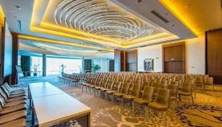
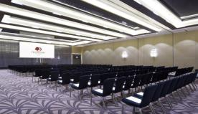
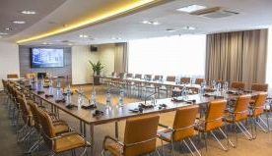
12
Venues for MICE
Renaissance Minsk Hotel
Double Tree by Hilton
Victoria Olymp Hotel
OPTION B
3 km from the city center, Marriott chain hotel
located in the city center, Hilton chain hotel
7 km from the city center,
Victory chain hotel
OPTION C
quantity of rooms: 193
quantity of rooms: 267
quantity of rooms: 238
3 conference rooms +
3 meeting rooms
3 conference rooms +
2 meeting rooms
11 conference rooms
2 restaurants
1 restaurant + Sky Bar
3 restaurants
www.belarusprimetour.com | www.miceinbelarus.com
© 2009-2019. All rights reserved.

Slide 13
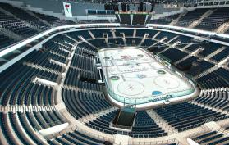
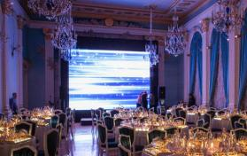
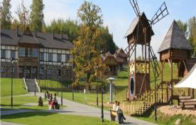
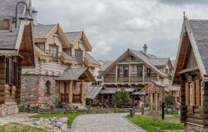
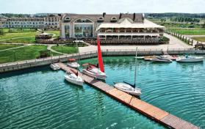
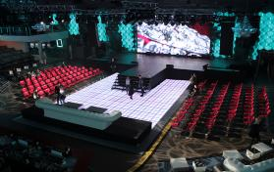
13
More Venues in Minsk…
Minsk-Arena
(capacity up to 15000 pax)
Dipservice Hall
(capacity up to 400 pax)
Sports Complex Logoysk
(capacity up to 200 pax)
Agro-tourist Complex Nanosy
(capacity up to 50 pax)
Robinson Club
(capacity up to 200 pax)
Prime Hall
(capacity up to 1600 pax)
www.belarusprimetour.com | www.miceinbelarus.com
© 2009-2019. All rights reserved.

Slide 14
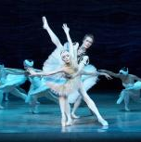
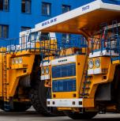
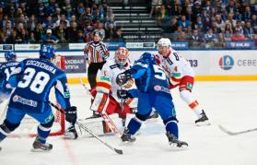

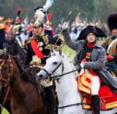
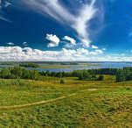
14
Incentive ideas
Culinary
Arts Programs
Military
tours
Eco
tours
Cultural programs
Industrial
programs
Sports and entertainment ideas
www.belarusprimetour.com | www.miceinbelarus.com
© 2009-2019. All rights reserved.

Slide 15
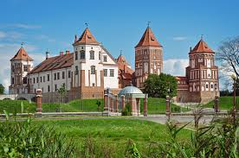
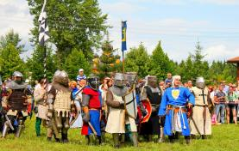
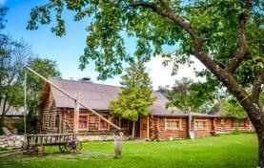
15
Cultural programs
14
Sightseeing program (animated sightseeing tour «Minsk – the capital of Belarus», museum complex of traditional crafts and technologies
«Dudutki», «Vitebsk – the city of Marc Chagall», etc.
Castles and farmsteads (quest «Secrets and mysteries of the Radziwill Palace», Medieval tournament at Mir Castle, Folk festivals and amusement at the Belarusian farmsteads, etcc.)
The guest nights and balls (Grand Ball at the Bolshoi Theater of Opera and Ballet, Costume Party at the National Art Museum, etc.)
Folk arts and craft programs (Master classes in folk arts and crafts, tasting the national cuisine, folk performances, national dance master class, accommodation at Belarusian farmstead, etc.)
www.belarusprimetour.com | www.miceinbelarus.com
© 2009-2019. All rights reserved.
www.belarusprimetour.com | www.miceinbelarus.com
© 2009-2019. All rights reserved.

Slide 16
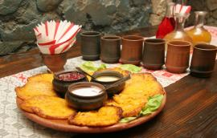
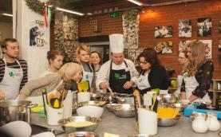
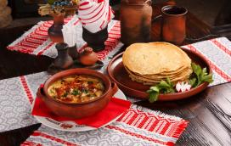
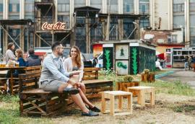
16
Culinary Arts Programs
Culinary quests
Master class on the art of cooking of traditional dishes
Tasting the national cuisine (dishes & beverages)
Visiting the Komarovsky market (the main food market in Minsk)
Culinary festivals, etc.
www.belarusprimetour.com | www.miceinbelarus.com
© 2009-2019. All rights reserved.

Slide 17
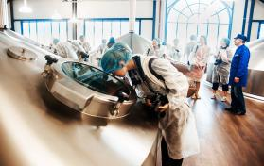
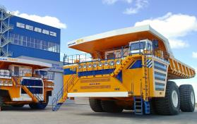
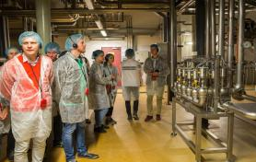
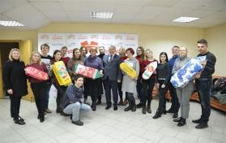
17
Industrial Programs
Automobile factory «Belaz»
Beer factory «Аlivaria»
Confectionery factory «Кommunarka»
Household appliances plant «Аtlant»
Glassworks «Neman», etc.
www.belarusprimetour.com | www.miceinbelarus.com
© 2009-2019. All rights reserved.

Slide 18
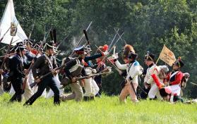
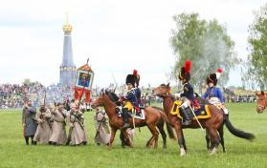
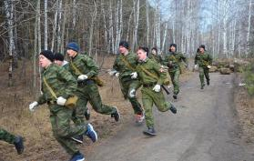
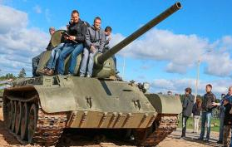
18
Military Tours
Military-sports game «Zarnitsa»
Animation program «The Stalin Line»
Military historical quest «The Guerrilla Camp»
Animation program «Unknown Pages of the War of 1812“, etc.
www.belarusprimetour.com | www.miceinbelarus.com
© 2009-2019. All rights reserved.

Slide 19
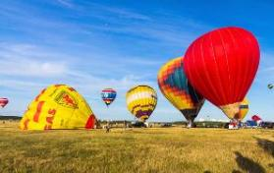
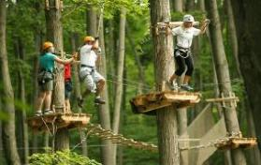
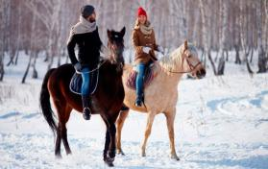
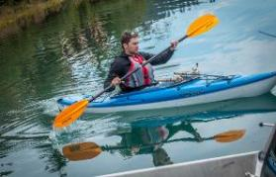
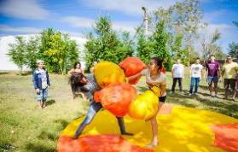
19
Sports and Entertainment Ideas
Ballooning
Rope Town
Horse Riding
Winter Sports
Kayaking
Teambuilding
www.belarusprimetour.com | www.miceinbelarus.com
© 2009-2019. All rights reserved.

Slide 20
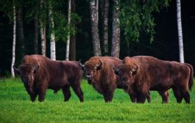
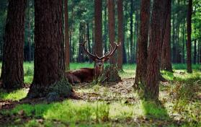
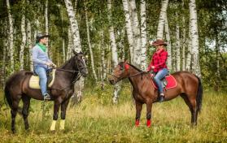
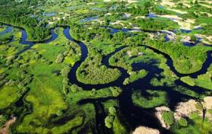
20
Eco tours
National park «Belovezhskaya pushcha»
National park «Pripyatsky»
Berezinsky Biosphere Reserve
National park «Braclav lakes»
National park «Naroch»
www.belarusprimetour.com | www.miceinbelarus.com
© 2009-2019. All rights reserved.

Slide 21


21
Event list
Event | Date
«Kalyady» (summer solstice festival) | December-January
«Maslenitsa» (farewell to winter – welcome to spring festival) | March
Television projects of the ONT channel «Musical Evenings at the Mir Castle» | June
Opera and ballet festival «Great theater evenings at the Radziwill Palace» | June
Festival-reconstruction «The Golden Spur 1812» | June
Saturdays’ musical evenings at the Liberty square | July-August
International Festival of Arts «Slavic Bazaar» in Vitebsk | July
International festival of medieval culture and music «Our Grunwald» | July
«Alexandria meets friends» (midsummer night festival «Kupalie») | August
International sports and music festival «Viva Braslav» | August
Festival of hops, malt and spring water «Lidbeer» (beer festival) | September
Folk festival «Kamianitsa» | September
History and cultury festival «The old Minsk» | September
1
www.belarusprimetour.com | www.miceinbelarus.com
© 2009-2019. All rights reserved.

Slide 22
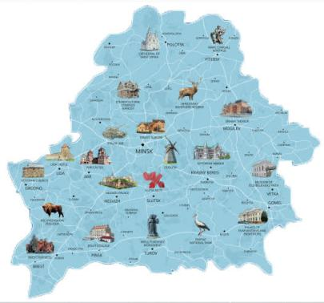
22
10 reasons visit Belarus
1
Take a ride on BELAZ dump truck in Zhodino
Get warm with krambabulya drink in Sula park
Spend a night on hayloft in Belarusian village
See a herd of European bisons in their natural habitat
Try on bog shoes and walk though a swamp
Meet the ghost in the corridors of a medieval castle
Participate in potato harvesting
Take a tank ride in the homeland of the legendary
“World of Tanks” game
Take part in knight tournament in Dudutki Folk Museum
Learn to “extract” birch sap
The activities of a company associated with buying and selling a product or service. It includes advertising, selling and delivering products to people. People who work in marketing departments.
2
3
4
02
5
6
7
8
Be the best marketing company
9
10
www.belarusprimetour.com | www.miceinbelarus.com
© 2009-2019. All rights reserved.

Slide 23
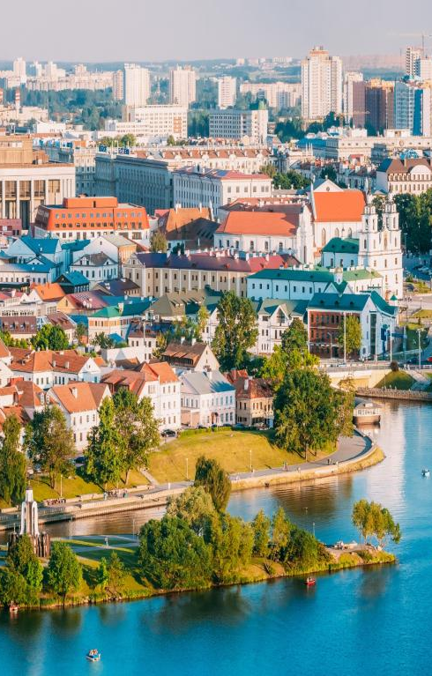
23
Why Prime Tour?
Experience
We have been working for more than 10 years in a tourism business and we are always ready to any kind of requests or eventualities.
Relationship
We deliberately choose the best partners to work with and constantly update our suppliers’ network.
Knowledge
We are proud of our expertise of the country and carefully select our guides to make all tours thrilling and spectacular.
Flexibility
Prime Tour is highly qualified and experienced personnel, individual approach to every request.
www.belarusprimetour.com | www.miceinbelarus.com
© 2009-2019. All rights reserved.

Slide 24

24
Contact us
Business hours
Our support is available 24 Hours a day: +375 (29) 162 62 70
Monday – Friday: 9am to 6pm
Building address
Office 22, 4 Zybitskaya str.
Email
incoming@belarusprimetour.com
Telephone
+375 (17) 302 34 02
+375 (17) 302 34 01 (fax)
www.belarusprimetour.com | www.miceinbelarus.com
© 2009-2019. All rights reserved.

