Slide 1

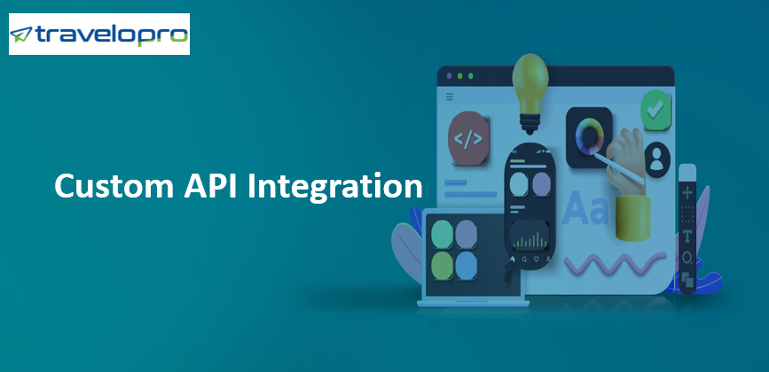
Custom API Integration
Email id : contact@travelopro.com
Phone No : 98455 66441

Slide 2
Travel API substantially packages of online services to achievement travel offers from different travel service providers throughout the world. Travel API integration services for flights, and GDS integration, etc are applied by travel companies to gain the travel attempt online.
Travel API integrations provide you accessible and transparent approach to thousands of third-party travels offers. This is your convenience to become the online destination of preference for travellers and partners by providing a deep selection of travel products as separate services or packages.
Travel API is web services deliver together best travel deals and content from global travel suppliers such as Hotel API, Flight API, Car API, Transfer API, and Package API for travel agents, tour operators, and travel company to contribute their customers with best travel options to accept from and book their dream travel.

Slide 3
Travelopro, a leading travel technology company, contributes travel API integration services (JSON / XML / REST) to global travel companies, DMCs and TMCs.
We integrate the travel APIs / XMLs from all the wholesalers, aggregators and XML API providers to develop best in class B2C / B2B / Corporate travel portals and online travel booking engines.
Multiple travel API XML integration services grant end users to find the most competitive rates and better opportunity for any specific sector.

Slide 4
What exactly is Custom Travel API Integration and why your business needs it?
Travelopro is the pioneer in contributing Travel API Integration to all Travel Businesses and renowned to provide travel API XML Integration with brilliant team of qualified professionals. Our team assure deep assistance and logical quality with variety of service providers all across the global travel market.
Along with the brilliant XML provider support, we render full support and help in deploying XML functionality of the travel portal. The brilliant travel portal development that we contribute ensures complete efficiency and compatibility in API XML Integration.

Slide 5
We have a team of brightly skilled expert who are armed with stellar insights and knowledge to develop and create effective Travel API Integration solutions for your business be it Hotel Booking API, Travel API, flight API Provider, etc.
Not just this, our database is linked and identify with the particular travel service provider across the world, collecting data, organizing the data, and third-party API makes the process of transmitting pretty simple. All the much-needed assistance, a user-friendly interface to transact, consultation and handling is provided to you in the best way that advance your business and adds to the value in the best conceivable way

Slide 6
Benefits of Web Services / XML / API Integration and Usage in Travel Trade
As above, if the travel content is defined via XML Web Services / API and when industry standards are predefined, the development is quick, accessible to maintain and the obligation of fulfilment resides with the inventory provider. i.e., for Travel Business who wish to sell the travel content online or OTA’s it is very essential that all the bookings etc are done online mode and instant acceptance and acknowledgement is done for which it is essential to have live interaction with the inventory owner in real time (for flights, hotels, car etc) where the inventory is limited.

Slide 7
One of the biggest advantage visible in the travel trade is that with the encourage of such integrations, an OTA can sell any content sourced from any partner without revealing the actual content seller’s identity, which increase the opportunity to retain customers, increase revenues and margins.
API/XML integrations entrust the travel business to get into real time selling of the content/travel inventory which is an essential for the sellers. Most of the Consolidators and Travel Content Providers prove the content over API or Web Services XML/JSON feed which can be utilized by the Online Travel Business to integrate on to their booking engine to sell the relevant travel products to their clients.

Slide 8
Which are key benefits of Travel API for Travel Business?
Travelopro is leading Travel API Provider offers best Travel API Benefits:
Convenient Dashboard
Flexible travel search of Hotels, Flights, Tour and Transfers in one platform.
Fast way to Book Hotels, Flights, Tour and Transfers in one platform.
Grant Third Party Integration.
Robust and Predictable.
Real Time System.

Slide 9
Maximize Travel Bookings.
Travel Booking API has multiple options.
Reduce Operational Costs.
Add product markup for end-customers.
Payment comes directly from customers.
Best online travel portal to manage profits.
Long-term Business Profitability.

Slide 10
Travelopro Travel API Integration
Travelopro is an outstanding company across the world to cater to all your business obligation under one umbrella to encourage you on your journey to massive develop and success if you run a travel business or own the one.
Today, Travelopro is the name well renowned in the travel industry and has profitably helped companies to attain extensive expansion in a limited time period and double their profits, generate higher revenues, and increase returns manifold.

Slide 11
At Travelopro, we contribute end-to-end GDS integration and online travel agency solutions for different business models like B2B, B2C, B2G, etc. Our developers deploy the industry leading GDS development and integration services that would grant you to manage your travel business efficiently, reduce cost, and boost revenue.
Our GDS software development experts are highly experienced in developing web services such as booking engines, custom websites, front-office systems for travel agencies, and corporate self-booking tools.

Slide 12
Why Choose Us?
Travelopro comprehensive involvement in contribute API integration and development services that link software, applications, third-party apps, and websites through standard or custom APIs. Given our confirm expertise, we use the latest technologies to cancel redundancy, possible overlaps, and gaps within your business processes.
Travel Technology Solution contribute Travel API Integration for travel companies. This way our customer can benefit from the inventories and other travel API services provided by the third party, by having a quick and accessible API integration.

Slide 13
Extend your customers' choices to flight booking API, hotel API booking, car booking API, bus booking API, email API, and recharge API, Payment Gateway API, insurance and many more with approach to both GDS and external content with our XML/JSON integration white label services.
Increase your revenues and empower cross-selling with full content, mark-ups, negotiated fares, packaging features, service fees, agency defined air fare promotions, as well as optimizing and ranking empower to make the most out of search engines.
No need for you to make valuable investments in bespoke software developments with individual providers as Third-party XML API can be comfortably integrated to your existing system. This solution will be respectable and scalable to support your online business strategy.

Slide 14
TRAVEL PORTAL XML API INTEGRATION SERVICE: GET QUOTES FOR GDS | AMADEUS | SABRE | TBO API INTEGRATION SERVICE
We at Travelopro contribute adequate integration of third-party Web Services / XML API into your existing application.
As an API integration company, we are providing integration services for Flight booking, Hotel reservation, car rental reservation, bus booking, payment gateways and SMS gateways.
We provide hassle free integration of both SOAP and REST APIs Today Flight booking engine, Hotel booking engine or XML API Integration is an excellent choice for travel companies who wish to enhance their visibility & popularity.

Slide 15
Travelopro is top listed company for Travel Portal XML API Integration Service with endless experience in XML API Integration like GTA, Amadeus, Galileo, GDS, Amadeus, Sabre etc.
Today, the multilingual hotel booking engine or even the flight booking engine extensively adopt to have XML API integration solution.
Today, the multilingual hotel booking engine or even the flight booking engine extensively adopt to have XML API integration solution. The top-rated web application of hotel and travel booking engine comes in two modules- Business to Customers (B2C) and Business to Business (B2B).

Slide 16
Business to Business (B2B)
B2B module deals between company to client and grant clients for various types of services.
Client can upload a logo, create username and change password at their end without any difficult.
This featured XML integration B2B module makes the business more accessible for all non-expert clients also.
They can comfortably create, modify & cancel online reservations and hold a credit limit and check their deposit level.

Slide 17
Business to Customers (B2C)
Business to Customer (B2C) XML integration grant the user to book hotel and flight services self and view their booking, payment history and reprint e-tickets using credit/debit card or net banking.
Travelopro provides following XML integration services, for Travel and Tourism Industry

Slide 18
Cruise API Integration
Car Hire Booking API Integration
Payment Gateway Integration
Hotel API Integration
GDS Integration – Flights and Hotels
Flight XML Integration/ API Integration
Transfer XML Integration/ API Integration
Sightseeing XML Integration/ API Integration

Slide 19
XML API For Travel Portals
We have a separate team of adept developers who are seasoned experts when it comes to API consumption and integration. Whether it's a travel and hospitality API or a payment gateway API or a social media APIs (Facebook, Twitter, Google+ etc.), we are thoroughly experienced.
You can rest assured that with our experience and scale of operation, today we are in a position to provide you the best-in-class quality of solutions in a budget that is invincible and unheard of in the industry. We specialize in the following Bookings Engine using integration of domestic and International API partners for Middle East, Australia, North America, Europe and Africa:

Slide 20
We Integrate Travel APIs For
Online Travel Agencies
Travel Wholesalers
Tour Operators
Airlines and Cruise Companies
Business Travel Agencies
Destination Management Companies

Slide 21
What is Third party travel API Integration?
Third party API integration is essentially a document supplied by 3rd party software vendors. This document contains all of the technical details needed for programmers to integrate software into a custom application. With these services or integration, you can comfortably book tickets and hotels anywhere in the world.
Most of the travel websites are now integrating these services in order to enlarge the user’s involvement. Or in the accessible words, you can say that travel API is a set of web services to approach the travel deals from different travel consolidators.

Slide 22
CONTACT US:
For more details, please visit our website:
https://www.travelopro.com/custom-api-integration.php
Email id : contact@travelopro.com
Phone No : 98455 66441

