Slide 1

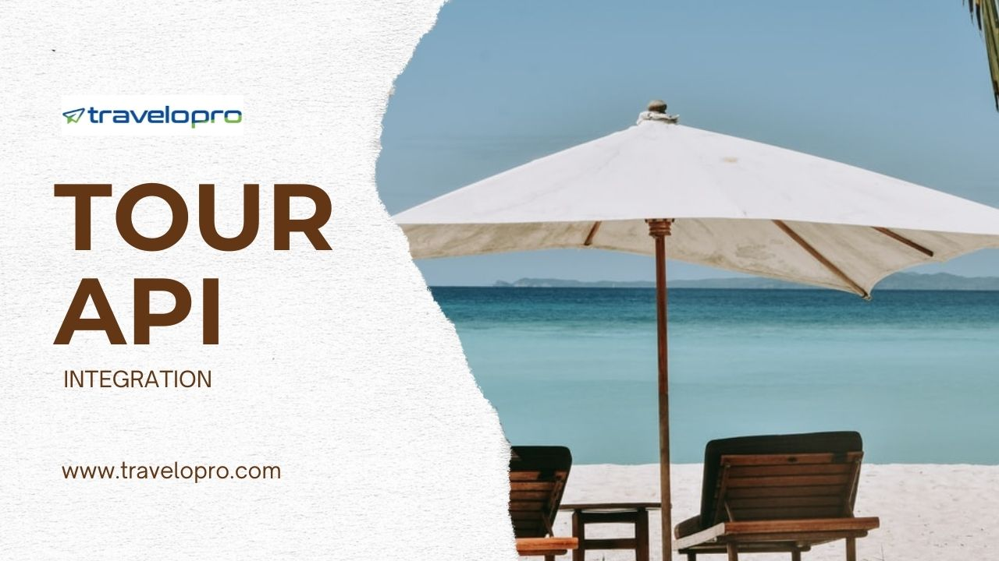
Tour API Integration
Email id : contact@travelopro.com
Phone No : 98455 66441

Slide 2
Tour API | Connect To The World
In the travel and tourism industry, the term "API" refers to the Application Programming Interface. APIs streamline data exchange and integrate various tourism-related systems, including booking platforms, content management systems, and customer relationship management (CRM) tools.
Tour APIs allow travel businesses to offer extra services such as tours, excursions, and local experiences. These APIs connect users to attractions and activities, providing necessary details such as availability, pricing, and customer reviews. By incorporating these APIs, companies can enhance their offerings, providing travelers with a complete itinerary for their journeys.

Slide 3
Online travel and tourism service providers can use several APIs to make their services more efficient. Sophisticated tour APIs let users track events, view data, and book them all in one comprehensive solution.
Travel agencies, hotels, tour operators, travel deal aggregators, car rental companies, and travel insurance providers can benefit from travel and tourism API integration. It enables them to improve their booking platforms and provide full travel services to customers.
Tour and Activity Services provide data and booking options for guided tours, excursions, activities, and attractions at multiple destinations. They offer a range of experiences, including city tours, adventure activities, cultural experiences, and more.

Slide 4
The tour API provides the best chances for OTAs and travel agents, as well as the worldwide travel suppliers, to build a powerful relationship to enhance the business by attracting more travelers to relish the tour and reserve their leisure activities from a single website or app with dynamic approaches with the best rates, according to modest travel companies.
Tour API empowers travel management companies to give users access to local tours, attractions, events, and other travel-related activities. These APIs are used to allow users to browse, book, and pay for tours and activities during their trip. Integrating these travel site APIs for tourist app development improves the user experience by providing extra travel services.
Travel companies can tap tour and activity APIs to showcase available attractions, tours, and events across destinations.

Slide 5
Travelopro : Your One-Stop Destination for the Best Tour API Integration
Wondering why choose Travelopro for your tour API integration needs? We at Travelopro provide the top tour API integration services, which help to allow sellers to list their packages. Our tour API comes with full technical support and supports both B2B and B2C travel businesses. Our tour API integrates with top global tour providers, enabling travel businesses and agents to access and book a wide range of tours and activities.
Our API can be used to access real-time product, booking, and customer data in real time. The API can be used by our Marketplace agents to access content from several of our tour operators or individual operators to access their own data.
These APIs help travel agencies provide enticing bundled travel deals apart from hotel, flight, and transfer services.

Slide 6
Customers can access tours and packages in real-time, which enables you to offer travelers better and more attractive and competitive offers.
There are a variety of APIs that tour operators can use, and we at Travelopro provide all leading APIs for online travel and tourism service providers. If you name a functionality, there are high chances that we probably have an API specifically for that functionality.
We will adapt our system to suit your brand and will give all the support to integrate your website with third-party tour and activity APIs. We aim to provide a new dimension of service concept and always strive to stay at the technological forefront at all times by offering the best solutions for the travel industry.
Our APIs enable agents/enterprises with worldwide inventory with simple to integrate and quick APIs. Agents/enterprises can save time and costs with real-time pricing and availability.

Slide 7
Committed API support team ready to assist agents/enterprises get started with the integration and be backup support throughout the process.
Our Tour Packages API allows travel businesses to offer a broad range of customizable tours with real-time updates, secure payment options, and global coverage. It’s designed for simple integration and provides a seamless booking experience for customers, helping businesses expand their offerings and increase revenue potential.
Our group tour and activity booking software simplifies the travel booking process for worldwide customers. By promising the best travel website design, we increase user engagement and conversion rates for tour operators.

Slide 8
Travelopro’s Sightseeing Tours and Activities API integration would advantage online travel agencies, travel management companies, and tour operators. Our activities API integration enables booking a wide range of sightseeing tours and other activities globally. Moreover, our API integration enables several travel and business operators worldwide to gain access to relevant content.
Our Tours Packages API allows you to easily integrate a wide range of tour packages into your website or app, offering real-time availability, pricing, and itineraries. With a simple setup, it enhances your travel platform by providing seamless booking options, helping you deliver an enriched travel experience to your customers.
Travelopro's Universal Tour API gives an access to a global tours database and functionality aggregated from various travel suppliers through a single unified API connection for OTA’s and Travel Agents.

Slide 9
At Travelopro, we provide advanced Tour Package API Integration services that enable travel businesses to enhance their platforms with a diverse range of tour packages. Our API solutions are designed to integrate seamlessly with your existing systems, offering your customers an effortless way to discover, book, and manage their travel experiences.
Through our best tour operator software, we speed up the operational efficiency of our customers. Furthermore, we allow them to invest in one of the best travel booking systems, Travelopro. It improves operational and cost efficiency; it offers multilingual and multi-currency support.

Slide 10
Key Benefits Of Tour API Integration
The key benefits of tour API integration software are various and impactful.
Firstly, it remarkably boosts efficiency by automating processes that were formerly manual, such as updating availability and processing bookings. This automation reduces human error and speeds up operations.
Secondly, it improves customer satisfaction by providing real-time information and smooth booking experiences. Users can book tours instantly and receive immediate confirmations, which establishes trust and reliability.
Thirdly, API integration enables improved data management. All user and booking data is centralized, making it simpler to examine and use for enhanced services.
Lastly, it offers scalability. As the travel business expands, API integration can effortlessly accommodate increased demand without major overhauls. These benefits greatly contribute to more efficient operations and an improved customer experience.

Slide 11
Features Of Tour API Integration
Customization Options
Customization options are a state-of-the-art feature of tour API integration software. These options enable tour operators to tailor the software to meet their specific needs and branding requirements.
For example, travel businesses can customize the customer interface to match their brand's look and feel, creating a cohesive and professional customer experience.
Moreover, tour operators can configure the API to include only the services and data points relevant to their offerings, ensuring a smooth and efficient system.

Slide 12
Customization also extends to user permissions and access controls, enabling businesses to define who can view or edit certain data.
Moreover, the ability to integrate with other software and tools means that the API can transform to existing workflows, reducing disruption and increasing productivity.
By providing immense customization options, adventure tours API integration software ensures that businesses can create a customized solution that perfectly aligns with their operational goals and customer expectations.

Slide 13
Real-time Data Access
Real-time data access is a crucial component of tour API integration software. It enables tour operators and travel agencies to access up-to-the-minute data on tour availability, pricing, and scheduling. This immediacy is essential in the fast-paced travel sector, where conditions and customer demands can change quickly.
With real-time data, travel businesses can make well-informed decisions swiftly, modify their offers as necessary, and give accurate data to customers. This leads to fewer booking errors and overbookings, enriching the overall customer experience. Moreover, real-time data enables dynamic pricing tactics, enabling operators to adjust prices based on demand and availability directly. This feature not only increases operational efficiency but also helps in increasing revenue. Essentially, real-time data access ensures that tour operators stay flexible and responsive in a competitive market.

Slide 14
Seamless Booking Process
A seamless booking process is an essential component of tour API integration software. This functionality streamlines the overall booking journey, from choosing a tour to finalizing the payment. For customers, it means a hassle-free experience where they can quickly explore various tours, check real-time availability, and book their chosen options without leaving the platform. This reduces the friction often associated with traditional booking techniques, such as phone calls or emails.
For operators, a smooth booking process minimizes the risk of double bookings and errors, guaranteeing that every reservation is accurately recorded and handled. Additionally, it allows for immediate confirmations and automated updates, keeping customers informed at every stage. By offering a seamless and effective booking experience, travel businesses can increase customer satisfaction, foster loyalty, and encourage repeat bookings. This feature is essential for maintaining a competitive edge in the travel industry.

Slide 15
Multi-Language Support
Our tour booking software offers support for multiple languages, enabling users from several countries to easily use the platform.
Customers can view and book travel arrangements for destinations all over the world, making it easy to plan international trips.

Slide 16
Mobile Compatibility
Our tour booking software is designed to be compatible with mobile devices, enabling customers to book and manage their travel plans on the go. The software is also designed to be accessible to customers with disabilities, with features such as accessibility keyboard support and screen reader support. This mobile compatibility and accessibility make our travel booking software accessible to a broader range of customers.
Enhanced User Experience
Our tour booking software provides customers with a user-friendly interface that is easy to navigate and use. Customers can receive real-time alerts and notifications for flight delays, gate changes, or other important updates.

Slide 17
Cost-Effective and Budget-Friendly
Customers can set their budget preferences and receive recommendations for flights, hotels, and activities that meet their budget requirements.
Personalized and Tailored
The software allows customers to create and manage profiles, providing a personalized experience for each customer.

Slide 18
Which Businesses Can Benefit From Tour API Integration ?
Online travel agencies (OTAs), tour operators, travel agencies, destination management companies (DMCs), travel consolidators, travel meta search engines, travel aggregators, vacation rental websites, and activity providers can benefit from travel API integration.
It enables them to enhance their booking platforms and provide comprehensive travel services to customers.

Slide 19
Online Travel Agencies (OTAs)
Integrate tour and activity bookings into existing platforms
Expand product offerings and increase revenue
Enhance customer experience with diverse travel options
Tour Operators
Automate booking processes and reduce manual errors
Increase online visibility and reach new customers
Improve operational efficiency and reduce costs

Slide 20
Travel Agencies
Offer clients a wider range of travel experiences
Streamline booking processes and reduce administrative tasks
Increase customer satisfaction and loyalty
Destination Management Companies (DMCs)
Automate booking processes for local tours and activities
Increase efficiency and reduce costs
Enhance customer experience with personalized travel options

Slide 21
Travel Consolidators
Keeping rates competitive
Monitor inventory in real-time
Seamless API Integration
Dynamic Pricing and Mark-ups
Travel Meta Search Engines
Integrate tour and activity bookings into search results
Provide users with comprehensive travel options
Increase revenue through affiliate marketing

Slide 22
Activity And Attraction Providers
Increase online visibility and reach new customers
Automate booking processes and reduce administrative tasks
Improve operational efficiency and reduce costs
Travel Comparison Websites
Compare prices and options for tours and activities
Help users make informed travel decisions
Increase revenue through affiliate marketing

Slide 23
Vacation Rental Websites
Offer guests additional travel experiences and activities
Increase revenue through commission-based bookings
Enhance guest experience and loyalty
Travel Technology Companies
Develop innovative travel solutions integrating tour APIs
Enhance customer experience with personalized travel options
Increase revenue through commission-based bookings

Slide 24
CONTACT US:
For more details, please visit our website:
https://www.travelopro.com/tour-api-integration.php
Email id : contact@travelopro.com
Phone No : 98455 66441

