Slide 1

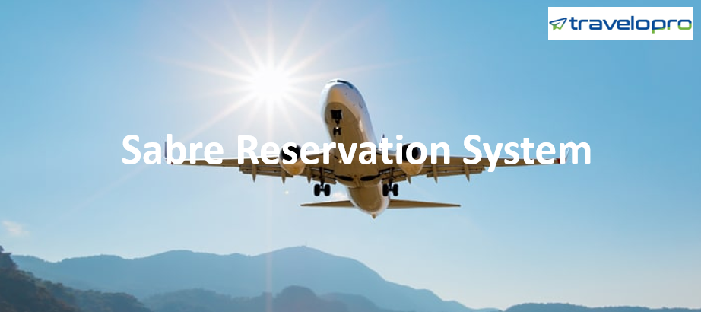
Sabre Reservation System
Email id : contact@travelopro.com
Phone No : 98455 66441

Slide 2
The most innovative Sabre Reservation System solutions are developed by our certified developers to help you manage every aspect of your business.
Travelopro is world’s leading travel portal development company, offers pre-integrated sabre reservation system for airline, hotel, car rental, transfer and other travel services all over the world.
Travelopro platform pre integrated with Sabre Airline Reservation System that offers a broad range of software and data solutions to help airlines market themselves, sell products, serve customers and operate more efficiently.
Features include schedules, pricing, availability, reservation and ticketing info.
Travelopro Airline Reservation Software is connected to Sabre GDS which enables travel agents to book airline tickets online.

Slide 3
The Sabre GDS system enables companies such as travel agents to search, price, book, and ticket travel services provided by airlines, hotels, car rental companies and tour operators.
Through the Sabre travel marketplace you can access more than 400 airlines, 750,000 hotel properties and 36 car rental brands.
Travelopro provides Sabre GDS Integration that helps the travel business to grow and also to achieve the best profit in the market.
Get Sabre API Integration solution for your travel portal at best prices. We provide Sabre API Integration solutions which is one of the most trusted and reliable software solution for the travel website.

Slide 4
Sabre GDS System for Your Travel Application
Travelopro is a leading travel portal company in Asia and Europe countries.
We have integrated Sabre GDS solutions for Airlines, Travel agents, hotels and travel companies.
We have a professional team in travel technology in the development department. Sabre is a computer reservation system or Global Distribution System; through this system, we can arrange schedules, fares, policies, rules and availability at the booking system.
Sabre provides a seamless travel data solution that makes finance and accounting very easy.

Slide 5
Sabre provides a seamless travel data solution that makes finance and accounting very easy.
Sabre’s end-to-end travel and expense integration bring all aspects of travel—reservation, itinerary, travel risk management, and expense—into one seamless traveler experience.
The solution captures transactions throughout the traveler experience and offers that data to certified expense integration partners.
Its rich travel expense data helps clients analyze and manage costs, resulting in high-cost control, high compliance and high client satisfaction.

Slide 6
What Is the Sabre Reservation System?
The Sabre Travel network offers a great solution for the travel sector.
Sabre Reservation system provides businesses such as travel agencies, airline, hospitality, car rental, and travel executors.
The travel agencies can use it to explore, rate and booking. Sabre provides a wide variety of Sabre solutions to assist airlines to serve their customers effectively and market themselves.
Sabre travel is a useful and price-efficient distribution channel that encourages Sabre airlines to expand their business reach to holiday and business travelers.

Slide 7
Sabre airline software is giving accessibility to over 3, 50,000 travel agents and new travel companies globally
Sabre software for travel agents let them broaden their business beyond the regional market
Sabre ticketing system helps in selling a number of seats frequently
Sabre flight search provides real-time information concerning seats available and price revisions

Slide 8
Sabre technologies assist in practical decision making along with appropriate information.
Sabre flight booking provides constant income generation ways.
Sabre airline reservation system empowers your company to run easily.
Sabre Air APIs contain the seats available and flight timings, cheap flights, cost revision, and online booking. Sabre flight API provides everything that requires real-time flight booking. The Sabre online login is serving Sabre global clients with real-time assistance.

Slide 9
Sabre Air APIs shows the availability of seats and flight schedules, cheap flights, fare changes, and online bookings.
Sabre Airline API provides all you need from shopping to booking of flights. In an era of refreshing profitability, airlines must leverage every tool available to manage daily operations while also jumping on the best opportunities for growth.
Technology plays a critical role in running an airline, both from an operational perspective and a predictive analysis view.
Data, disruptions and rising traveler trends are three areas of interest for our airline's coverage. Sabre GDS system develops power travel applications by providing comprehensive end-to-end services to the developers.
It permits the growth of your business by the implementation of the most relevant technological expertise. It gives access to flexible and various services. It allows the developers to develop and test the applications using Sabre APIs.

Slide 10
Sabre GDS system will help you to connect with a worldwide network of more than 4, 25,000 travel agents in 140+ countries.
There are more than a million travel reservation transactions are happening through Sabre GDS software.
Our GDS system will let you build the connection between the buyers and sellers. Sabre GDS is an Online booking system - CRS also known as Global Distribution System- GDS.
Sabre as a company developed its booking platform through which travel & tourism professionals’ access & book travel suppliers’ inventories for their customers.
Our Sabre GDS System builds power travel applications by providing comprehensive end-to-end services to the developers. It helps you in growing your business by the implementation of the most relevant technological expertise.

Slide 11
It gives access to flexible and various services. Travelopro can easily integrate into the Amadeus, Galileo, and Sabre GDS and extend your travel offerings allowing your business to grow.
Sabre GDS is a well-known and cost-effective distribution channel that helps airlines, car rental companies, Airlines to increase their market reach.
Travelopro provides sabre GDS, Sabre GDS software, sabre GDS system, Sabre XML API Integration, sabre GDS travel software development services.
We at Travelopro provide the best Sabre GDS integration services to travel agents and tour operators.
We are specialized in travel portal development, travel software development, travel website development, travel API & GDS integration and much more! Sabre Flights Module of Travelopro helps to search and reserve accommodations through API of GDS Sabre.

Slide 12
Our company stands out from its competitors, providing lower costs and a well-developed alliance with many established companies.
Up to 70% of total reservations in the world's major travel companies are being performed via GDS Sabre.
Sabre GDS commands take care of nearly millions of Sabre bookings per minute during the season.
Sabre GDS tutorial guide will help a travel assistant to understand how sabre can be used. Assistance can be done with the help of online chat, phone or email.
Sabre travel portal for B2B and B2C organizations are rising high in different countries.
Sabre provides a wide variety of Sabre solutions to assist airlines to serve their clients effectively and vend themselves.

Slide 13
Sabre travel is a useful and price-efficient distribution channel that encourages sabre airlines to expand their business reach to holiday and business travelers.
Sabre Air APIs contain the seats available and flight timings, cheap fare flights, cost revision, and online ticketing.
Sabre flight API offers everything that requires real-time flight booking.
The Sabre online login is serving Sabre global clients with real-time assistance 24/7.

Slide 14
How Sabre GDS Marketplace Is Changing The Travel Industry?
Travelopro is a preeminent Travel Technology Company that offers Travel Technology Solutions to the travel industry. Our Travel Technology Software will help you to get armed your pioneering plans and vision.
We are the adept travel software company that is skilled in with GDS Integration like Amadeus, Travelport and Sabre to provide your users a comprehensive spectrum of travel outputs with 24/7hours presence, information, tariffs, laws, and policies. Sabre API integration is, previously recognized as Sabre web services.
This gives smooth, faster and more enhanced access to the Sabre system. The Sabre XML API integration helps you to merge their services to your applications and databases.
APIs are perfect for developers who aspire to develop or renew a personalized Sabre online reservation tool. Sabre login grants you to access their content to apply that in other applications.

Slide 15
It can be seen in their services that what Sabre is. Its data-rich software allows airlines to make smarter operational decisions, customize and retail their products to travelers.
Airline Solutions help nearly 200+ airlines containing network carriers, combinations, and cheap fare shippers.
The organization helping 700 different consumers which involve runways, cargo and charter flights, business flotillas, authorities and tourism committees.
The customer complete flying experience: Our entirely integrated solution gives entree to similar data across all points of transaction and service.
This ensures excellent service to your consumers. Travelopro facilitates your online booking engine, customer center, inventory management, support system, etc. Also, the information repository and flight departure charge, offering you the ability to broaden your business.

Slide 16
We have a unit of technology and performance specialists working on the movement plan.
This assures the current airline reservations system passes a really customized travel experience.
Our goal is to offer a comfortable travel experience for our clients while attaining price effectiveness and greater management of our inner passenger service systems.
Sabre GDS system is an association among travelers and marketers. Sabre GDS is sustained by larger than 400 flight carriers, 125000 inns, 200 travel executives and different automobile and voyage providers.
The Sabre application system is associated to higher than 4 lakhs travel operators around the world.

Slide 17
The companies are helping their end-user using the Sabre platform.
Sabre GDS commands take care of nearly millions of Sabre bookings per minute during the season.
Sabre GDS tutorial guide will help the travel operator easily understand how sabre can be used.
Assistance can be through the forms of Sabre web chat, voice and email assistance.
Sabre travel portal for B2B and B2C organizations are rising high in different countries.
Also, Sabre integration applied to sabre booking engine provides enhanced services.

Slide 18
Benefits of Travelopro Online Reservation System
Easy connectivity
Customized web applications
Gives access to flexible and various services
Connection of web services for B2B and B2C modules
Improve productivity through instant access to agent tools
Provides single point of access to the Sabre system
Enhance sales skills with relevant content delivered at the right time
Improves your booking process with fast, reliable technology and integrated content

Slide 19
With Travelopro Online Reservation System, we offer following:
Airline Reservation System
Hotel Booking System
Car Rental Software
Tour Booking System

Slide 20
CONTACT US:
For more details, please visit our website:
https://www.travelopro.com/sabre-reservation-system.php
Email id : contact@travelopro.com
Phone No : 98455 66441

