Slide 1

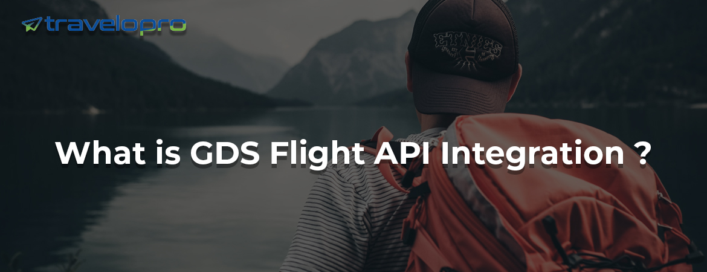

GDS Flight API Integration

Slide 2
What is GDS Flight API Integration?
GDS Flight API integration is a powerful tool that enables travel agents to access a vast array of flight information and services. With GDS Flight API integration, travel agents can easily search, compare, and book flights from multiple airlines, all from a single platform.
This integration ensures that travel agents have access to the most up-to-date flight information, including fares, availability, and schedules, giving them the ability to offer their customers the best possible options for their travel needs. GDS Flight API integration is a must-have for any travel agency looking to streamline their flight booking process and provide superior service to their customers.

Slide 3
With the API integration, travel agents can compare flight options across multiple airlines, filter searches by various criteria such as price, flight time, and airline, and book flights directly from their own system. Additionally, the GDS Flight API supports the management of bookings and itineraries, as well as the ability to modify or cancel bookings when necessary.
Displays global hotel, car, and airline inventory.
B2B and B2C services are available.
GDS allows you to book the best available seats and services.
Increase your reach by working with travel companies and agents.
Interface in a single window
Quick and easy connectivity
Offering the best prices and commissions to all travel firms and agents.

Slide 4
GDS simplifies information maintenance.
Easier connection and mapping of content Exposure of inventory on new distribution channels
Travel agents and agencies may view inventory at any time from any location!
Book the most suited seats instantly through the booking portal
Provides the best support 24/7
Secured multiple payment gateways
Single window interface
Flexible and user-friend booking engine
Simplify the information maintaining with GDS

Slide 5
Boost Your Travel Business with Our GDS Flight API Integration
Our Flight API provides authorized travel agencies, travel businesses, and tour operators access to global flight savings as well as information such as round-trip, on-the-way, multi-city, and group booking possibilities.
We help travel management companies and travel providers connect to major airlines via Flight API and market their enormous inventory. Our goal has been to help online travel agencies expand their global market, increase revenues, and streamline their day-to-day operations in line with modern travel trends.

Slide 6
Our GDS Flight API Integration offers robust, top-tier travel systems and web services XML for the global travel business. We provide your travel business with access to a wide range of online sales channels and travel merchandise, therefore increasing your online sales strategy. It will help you develop and exploit new market opportunities in real-time while lowering your running costs. We integrate Flight API for small and medium-sized travel agencies, allowing them to sell a large inventory of flights on their website with ease.
We work with both IATA-certified agents and non-IATA consolidators. Along with Flight API, we have API/XML suites for flight API, hotel API, transfer API, API testing, and more. At Travelopro, we have an online API integration team with comprehensive API integration assistance and live certification expertise.
Our flight booking engine portal offers the most competitive rates. It is defined as an application that assists the travel and tourist business in making easy airline reservations. This booking engine allows users to book domestic and international flights and other services online.

Slide 7
How Does GDS Flight API Integration Help Travel Agents?
The Flights API will assist your travel agency in expanding its inventory and providing a comprehensive set of services to travelers. Increase your revenue by offering flight reservation services from world-renowned GDSs, consolidators, and low-cost carriers. Provide reasonable prices and the best flight schedules.
The powerful Flights API Integration enables travel agents and customers to purchase flight tickets online using your B2B, B2C, and Corporate Booking Systems. With technological improvements and increased demand for flight API providers, the flight API has become a vital component of the travel business. The service providers are professionals in everything from selling flight tickets to designing visually appealing map-based tour itineraries.

Slide 8
Travelopro, a prominent travel technology company, provides the GDS Flight API Integration for travel agencies.
Our dynamic and dependable online air ticket booking system streamlines the flight booking procedure for B2B and B2C clients.
Our flight booking system, with its comprehensive features and quote system, is a significant tech solution for travel agents in the business.
Integration of flight modules such as flight booking quotation, reservation, API interface, schedules, and more improves the system's attractiveness and enables travel agents to provide top-tier services to their clients.

Slide 9
We provide online flight reservations and inventory management systems, as well as flight schedules, flight rates, fare tariffs, seat availability, passenger reservations, and records of flight ticket bookings on our travel website.
Our GDS flight API Integration may help your company boost income by automating operations that minimize the time and energy required to execute an airline ticket.
Our Flight Booking Engine includes advanced features and functionalities such as third-party supplier integration, GDS connectivity, inventory management, quotation management, b2b/b2c booking engine, one-way, round-trip, multi-city search option, reservation management, reporting, customer management, customized design and layout, multi-language, multi-currency, payment gateway integration, and more.

Slide 10
Why Choose Travelopro?
Looking to expand your business in the travel industry? We are here to assist you! Our team of experts can create the best flight booking system with advanced flight module features that will elevate your business to the next level.
Travel agencies benefit from our highly efficient flight booking software, which is easily connected with different GDS systems and third-party APIs.
Travel agents can now efficiently search for flights, choose seats, check real-time prices, complete the booking, and provide consumers with safe online payment alternatives.

Slide 11
Travelopro is a Travel Software Company that provides the best flight booking engine for travel companies to automate the flight booking process with numerous flight suppliers integration and quick confirmation to let end users find and purchase airline/flight tickets in worldwide destinations. Our Flight Module Professionals provide customized Flight Booking Systems for the travel sector, including a complete Flight Booking IT Solution.
Our Flight API integration services are intended for Online Travel Agencies (OTAs), travel agencies, tour operators, Corporate Online Booking Tools (OBTs), Travel Management Companies (TMCs), Distribution management companies, and tour management organizations. We offer dependable integration to several GDSs (Global Distribution Systems), flight consolidators, and low-cost carriers. Our flights XML API Integration connects your travel agencies and passengers to all major airlines.

Slide 12
The Importance of GDS Flight API Integration for Small Travel Businesses
Understanding Global Distribution Systems (GDS) is essential for travel agents and online travel agencies (OTAs). These platforms function as go-betweens for travel providers and brokers, allowing them to access a vast inventory of flights, hotels, car rentals, and other services.
The travel business is rapidly expanding, and the implementation of GDS software maximizes its contribution to GDP. GDS software, often known as an Automated Reservations System, provides real-time inventory to travel firms and agents.
We take care of every aspect when building a travel technology solution for our clients, from traveler management to revenue maximization. GDSs are becoming essential in the travel industry since they provide a consolidated platform for accessing and booking travel services.

Slide 13
Travel agencies can provide a seamless and complete booking experience to their consumers by using the potential of GDS integration, thereby boosting their business's success. Our Flight API integration gives complete information about Airlines, such as time, cost, fare restrictions, seat availability, and so on, on a single platform, assisting passengers in finding the most convenient deals.
At Travelopro, we offer the best GDS Flight API integration services that deliver outstanding client satisfaction to many clients in the travel industry. With our years of experience, we can analyze your company's exact needs. Our GDS connection solution provides a user-friendly platform for travel firms to manage reservations.
We provide a platform for B2C and B2B clients to access global content on any device via our GDS Flight API integration services. We provide a platform that is interoperable with all devices. We have connected Amadeus, Sabre, and Travelport API for our numerous clients throughout the years. Our GDS software enables travel service providers to submit their data into GDS and offers travel businesses access to utilize it for reservations.

Slide 14
Here's a list of GDS.
Travelport Galileo
Galileo is a prominent CRS (Computer Reservation System) operated by Travelport. Apart from airlines, Galileo collects content regarding car rentals and hotel rooms, including availability of seats, rooms, and real-time rates. Galileo Flight API connects multiple airlines worldwide, offering their clients more competitive flight pricing options.
Most travel agencies choose Galileo GDS to access online travel inventory like airlines, hotels, and other value-added services. Every day, Galileo GDS handles the most transactions.
Galileo is the most highly recommended travel solution for increasing visibility and distribution among travelers worldwide. Galileo GDS is now the world's leading GDS system and travel content aggregator. Its key features include

Slide 15
Get detailed flight fare information.
Stay informed about luggage allowances.
Choose your preferred seat with ease.
Participate in Frequent Flier Programs
Get instant updates on PNR status
Confirm your ticket instantly
Search for One Way, Return, or Multi-City flights
Access multiple airlines with ease
Utilize advanced search filters for customized results
View flight details, including flight name, number, departure and arrival times, number of stops, and flight duration

Slide 16
Amadeus
Amadeus GDS is a popular GDS system among travel brokers and agencies that gives discounts and commissions on flights, hotels, transfers, and sightseeing. Amadeus GDS processes the most transactions per day. Integrating the Amadeus GDS system can elevate your travel agency since it will have access to a vast number of travel inventory provided by Amadeus GDS.
The Amadeus booking system offers a comprehensive solution, from the initial search to the fulfilment of the booking. Amadeus Flights integration offers online flight ticket reservations to GDS Amadeus through XML API.

Slide 17
Integration of the Amadeus GDS API streamlines the booking process, increases efficiency and accuracy, and ultimately leads to satisfied customers and revenue for businesses. The Amadeus flight API gives you access to the content of over 400 airlines, 130 low-cost carriers, and 150 auxiliary businesses.
Amadeus API is beneficial for both B2B and B2C flight booking engines. Users may now quickly plan a trip utilizing flight booking mobile applications after comparing costs from several airlines.
It offers a variety of airline, car, and hotel bargains.
It allows instant access to the booking procedure.
It connects you to airline, hotel, and travel web services.
It gives you complete inventory and booking management control.
Choose your airline/hotel for each inventory.
Dependability, Connectivity, and Maintenance

Slide 18
Sabre
Sabre GDS Flight API Integration enables travel agencies access to the best flight inventory, such as flight seat availability, airline schedules, lowest flight price, and online flight ticket booking, allowing them to optimize flight booking revenues. Sabre GDS API integration is an excellent solution for hotel and airline reservations. We are experts in Sabre GDS API Integration, whether it be XML or Sabre White Label API.
Integrating GDS provides access to the latest airline fares, allowing them to better offer their clients. Sabre GDS API integration allows airlines to access more business and leisure travelers. Airlines store their data on the GDS, while travel businesses link the GDS to their booking system.

Slide 19
As a result, Sabre GDS integration creates a win-win situation for travel providers and airlines. Developers may use Sabre GDS Flight API Integration to obtain flight inventory, including:
Flight seat availability
Flight schedules
Lowest flight fares
Online flight ticket reservation
Determine the best GDS service for your goals and budget based on factors such as your target market and the kinds of flights you want to provide.
Experts at Travelopro will happily assist you in analyzing your needs and budget in order to match you with the best flight booking API provider. Let's discuss your project and how we can help you optimize revenue by integrating a GDS Flight API into your travel website.

Slide 20
Advantages of Integrating GDS Flight API Integration
You may search through thousands of available flights offered by hundreds of different airlines.
Data is synchronized in real-time, so users always have access to the most recent flight details.
Features like seat selection, luggage tracking, and loyalty programs are all available as optional add-ons.
Get help with elaborate trip planning, including multi-city reservations and complicated itineraries.
Cost Savings
Time-Saving
Flexible Dashboard
24/7 Support

Slide 21
CONTACT US:
For more details, please visit our website:
https://www.travelopro.com/gds-flight-api-integration.php
Email id : contact@travelopro.com
Phone No : 98455 66441

