Slide 1

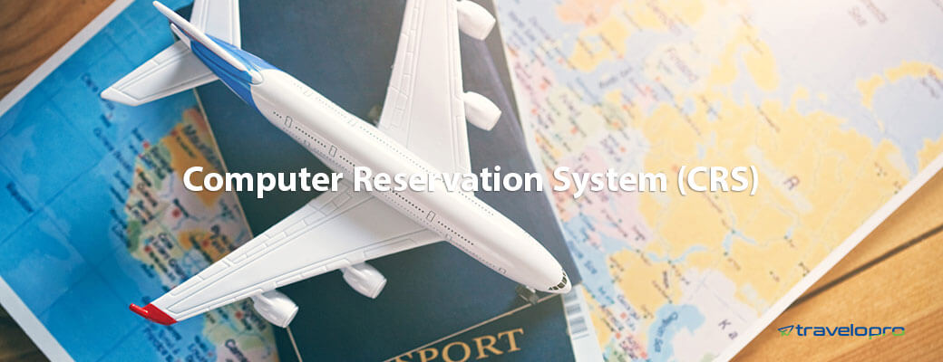
Computer Reservation System
Email id : contact@travelopro.com
Phone No : 98455 66441

Slide 2
What is Computer Reservation System in travel and hospitality domains?
The computer reservation system has evolved into one of the most widely used tools in the tourism industry. CRS/GDS regulations are required to promote fair competition in the travel industry and to ensure that consumers do not receive inaccurate or misleading information about travel services.
A computer reservation system (CRS) is web-based software that travel agencies and travel management companies use to retrieve and conduct transactions related to air travel, hotels, car rental, and other activities. CRSs were initially developed and operated by airlines before being gradually expanded for use by travel agencies.
A CRS is a computerized reservation system that can handle a range of tasks. These functions allow travel companies to distribute their services more effectively. This, in turn, improves their bottom lines and allows them to make more profits.

Slide 3
CRS's main goal was to create a one-stop service shop and eliminate physical and geographical barriers between mediators and consumers. These distribution systems, which have global coverage, provide information to airlines, hotels, car rental companies, travel agencies, corporations, and others.
The term CRS is no longer widely used because it is now part of a larger system known as the Passenger Service System (PSS), which includes CRS, an airline inventory system, and a departure control system (DCS).
The CRS software allows travel agents to boost sales and provide real-time information on product or service availability, price, reservation, and booking.
Travel CRS tools help travel companies to manage and control distributions, bookings, and rates through a comprehensive platform of capabilities.
CRS Solution is used by global travel management companies to access online travel content such as airlines, hotels, transfers, sightseeing, cars, and other value-added services.

Slide 4
What do you get with Computer Reservation System Integration?
Computer Reservation System is one of the most widely used tools in the Travel & Tourism Sector. It has transformed a whole industry.
Computer reservation systems are the backbone of the travel agent's operation. These systems allow the agent to book hotels, tickets, transfers, tours, and other services online, thus lowering operating costs.
Travelopro's Central Reservation System (CRS) will help you sell and distribute all of your Inventory products online, including Vacation Packages, cars, cruises, sightseeing, transfers, buses, and other special offers. It provides a complete booking process, from initiating booking inquiries to generating tickets and vouchers.

Slide 5
CRS (computer reservation system) functionalities include scalability and flexibility for business growth, a user-friendly framework, and a single core for rates, allocation, and contents, integrating points to GDS, online travel agents, and mobile booking engines, and implementing multiple distribution channels.
Through web services API XML Connectivity, the computer reservation system can also interact with all of your suppliers. Your customers can search for flights, hotels, cars, and packages in real-time, select & make the payment, and receive confirmation vouchers all in one place.

Slide 6
Computer Reservation System provides travel management companies and travel agents with a great deal of flexibility in serving their customers by exploring their business more efficiently to reach the global market from a single unified platform.
You can improve your customer engagement, distribution, and brand experience by using Travelopro CRS. Our Central Reservation System provides you with access to product details via an interface. You have access to availability, rates, cancellation policies, images, and descriptions.

Slide 7
What are some of the basic functions of the Computer Reservation System in the Travel Industry?
Displays travel services with rates and images
Inventory and booking management
An easy-to-use reservation system
Online payment gateway integration
Customer data management
Email notifications
Booking cancellation and refund management
Passenger or guest name record

Slide 8
Ticketing and fare quotation is determined by the complexity of the services provided
Provision of information about trade shows, visa regulations, and payment gateways
Prices and images of package tours are displayed on the system
Allows you to manage booking refunds and cancellations
It is an easy-to-use platform that enables email notification and payment gateway integration
Tariff quotation and ticketing, depending on the details of the services provided

Slide 9
What are the benefits of Computer Reservation Systems?
Management of invoicing, customer, accounting, and quota
Recording information related to the service of customers such as PNR
Saves administration tasks as it is a web-based application
CRS has interfaces with GDSs such as Amadeus and Travelport
High-speed network of information infrastructure
Fare quote, ticketing, and voucher generating process
The system can also store customer-related information, such as all services provided to a specific customer, payment type, service information, and so on.

Slide 10
CRS are web-based applications that save a significant amount of time on administrative tasks
Suitable for both B2B and B2C business models
Includes a comprehensive admin console
Offers custom reporting

Slide 11
What are the Major CRS Systems?
Hotel CRS
Hotel CRS, also known as Central Reservation System, is a real-time hotel reservation system that manages hotel data, room inventory, rates, hotel availability, and reservations.
Hotel CRS System checks hotel accommodations and allows you to easily book hotels with great search filter options. It also allows the user to manage price rates easily and add markup functionality from global suppliers. It manages hotel booking easily.
Travelopro offers the best Hotel Quotation Booking System, Hotel CRS System – Hotel Central Reservations System, an online hotel booking software solution designed for travel agencies, tour operators, and travel companies to simplify the work of online hotel booking.

Slide 12
We have experienced developers who have created the best Hotel CRS System - Hotel Central Reservation System that is easily integrated into travel agents' exciting travel portals and also easily integrated with multiple suppliers from the global market to provide travel agents with the best online hotel booking system experience. We also provide excellent API Integration services.
We create the best Hotel CRS System that supports both B2B and B2C businesses. We create the best Online MetaSearch Hotel CRS System that allows you to find hotels in less time.
The CRS software enables travel agents to promote sales and provide real-time info on product or service availability, price, reservation, and booking.
Travelopro’s Central Reservation System (CRS) will allow you to sell online and distribute all of your inventory products such as Holiday Packages, Cars, Cruises, Sightseeing, Transfers, Busses, and other promotional deals.

Slide 13
Travelopro’s CRS is a travel package management solution for travel agents and agencies, travel portals, consolidators, DMCs, and hotel resellers.
The hotel CRS system, also known as a central reservation system, enables hotel groups and chains of all sizes to maintain complete and unified control over their booking and online inventory distribution.
The CRS collects inventory from the PMS and then distributes rates and accessibility in real-time to direct and third-party channels, such as the hotel's website booking engine and call center (direct channels), as well as channel managers, OTAs, GDS, and metasearch (third-party channels).
The hotel central reservations system software is API-enabled and has fast response times. The scalable design of this architecture guarantees that all you need is to bring in place to meet the real-time, individual needs of the organization.

Slide 14
A CRS enables hotel managers to organize and manage their online and offline sales by allowing them to upload room rates and occupancy rates that can be easily displayed from their sales channels.
This product will benefit property owners who can sell their property online or through a website. Admin Control Panel will be given where hotel operators can load room types and rates, and control the content of their hotel profile, from descriptions of facilities and services to images.
Keep your entire hotel portfolio availability, rates, and inventory centralized and structured. Travelopro CRS provides the fundamental capabilities required to manage hotel distribution and merchandising.
Hoteliers can use the CRS application to automate updates to their availability, rates, and other details. In a nutshell, Hotel CRS allows travelers to search for and book more hotels as it acts as a hotel's central reservation system.

Slide 15
Key Features of Hotel CRS:
Real-time inventory access to multiple sales channel
Rates and availability can be managed in real-time
Receive instant booking and cancellation notifications via e-mail and SMS
Using an auto e-mail feature, you can easily send invoices and vouchers

Slide 16
Car CRS
Travelopro is a leading travel technology company that provides customized Car CRS systems for global agents, car operators, car rental agencies, and car rental operators. It is completely online car rental reservation software that allows you to easily manage online car rental operations and generate secure reports.
Our responsive Car CRS with mobile application (Android & iOS) is specially built for travel companies, travel aggregators, B2B B2C travel agencies, tour operators, and destination management companies to cater to clients worldwide.
Car CRS is one of the most dynamic solutions for car hire companies need to provide the fastest and optimum service to their customers.

Slide 17
Car CRS is a complete Car Rental Reservation Booking IT solution that offers the ability to manage car transfer inventory and also enables travel agents to book cars online and manage their car transfer inventory.
Car rental CRS allows users to book car rentals online at real-time rates and instant confirmation. The Car CRS provides users with complete control over their inventory distribution.
You can customize the details of all the cars in your fleet, the pick-up locations, the rates and availability for each car, as well as the promotions and details of all the car rental companies you work with. The Car CRS includes an Extranet, which enables operators to log in and manage their inventory.
Simplifying the car rental business with a fully functional booking engine and easy-to-use car rental CRS websites is best suited to individual car rental companies, tour & taxi operators.

Slide 18
We also specialize in the design and development of customized car rental systems. We provide and develop a Car Rental Reservation System that will assist you in retaining and managing all of your work through a single system.
Travelopro's Car Rental System is dedicated to assisting clients in achieving greater reach and opportunities, as well as making bookings easier to meet their needs.
Our car rental CRS allows customers to book car rentals online at real-time rates and instant confirmation. The CRS provides users with complete control over their inventory distribution.

Slide 19
With our Car CRS, you can accept online bookings and manage your entire fleet from a single control panel.
Car CRS Software consolidation with API makes the car booking system more transparent. This enables your customers to use the services of various car rental booking organizations and suppliers. The primary goal of our Car API Integration is to help customers choose the most efficient car booking services.
If you need a custom Car CRS Website, we can create a turnkey car rental website solution that meets your requirements. Our customized car rental website is the ideal solution for businesses of all sizes.

Slide 20
The functionalities of our Car CRS:
Availability of vehicle details
Customized web services
Print vouchers and reports
Generate quotes quickly
Site management facility
Booking cancellation
Advanced search and more

Slide 21
Airline CRS
The airline computer reservation system (CRS) is one of the most commonly used tools in travel & tourism. The Airline Computer Reservation System is a global distribution system used to book and sell tickets for multiple airlines.
The airline computer reservation system manages the booking system as well as flight details, inventories, and prices. Airline CRS includes both B2B and B2C interfaces for users to book flights.
Airlines CRS is a cost-effective and effective distribution channel that enables airlines to expand their market reach to leisure and corporate travelers. Airlines CRS allows travel agencies and management companies to aggregate their businesses with more enhanced and diverse selections of travel content for booking flights with real-time flight data and best offers.

Slide 22
It handles the entire booking process, from initial booking inquiries to ticket and voucher generation. With our Airlines CRS, you can easily synchronize and manage your listings on a single website. It also allows you to distribute exclusive deals and receive hundreds of direct bookings from across the web.
CRS includes both B2B and B2C interfaces for booking flights. A CRS is beneficial to an airline as it allows reservations to be checked and booked quickly.
A computerized reservation system (CRS) for airlines is used to maintain flight details, related inventories, and prices, as well as to control the reservation system. This system gives travel agents access to flight schedule information, fares, and seat availability.

Slide 23
Travelopro Airlines CRS connects and enables you to sell your inventory through all B2B/B2C sales channels, including online travel agencies (OTAs). The system dashboard has been designed to work on a laptop, tablet, or mobile device, providing you with a responsive back-end control panel.
Our cutting-edge Airline CRS is built on next-generation distribution technology and is one of the most innovative central reservation systems for airlines on the market. With our airline CRS, you can improve customer engagement, distribution, and brand identity.

Slide 24
CONTACT US:
For more details, please visit our website:
https://www.travelopro.com/computer-reservation-system.php
Email id : contact@travelopro.com
Phone No : 98455 66441

