Slide 1

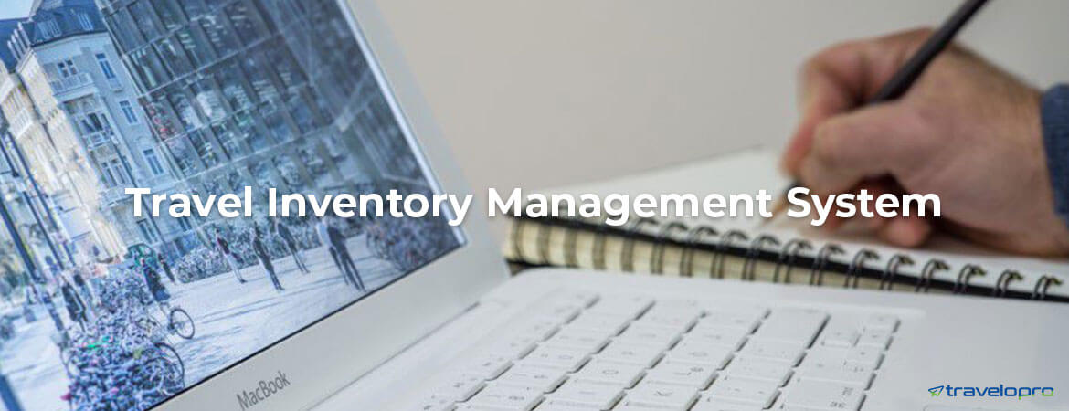
Inventory Management Software
Email id : contact@travelopro.com
Phone No : 98455 66441

Slide 2
What Is Inventory Management Software?
Inventory management is the process of managing and keeping track of inventory items. This can be physical items like products in a store or office or intangible items like data or information.
The travel inventory management system refers to the process by which you can track the number of products or services you have available for sale.
Travel Inventory Management Software also lets the company add their policies for corporate travel so that staffs can book flights and hotels themselves without needing any approval and thus save time. Travel management software also takes care of unexcepted circumstances such as flight rescheduling, overbooking of hotels, etc.

Slide 3
The solution stands different from others with its powerful online booking tool, unrivaled inventory and worldwide travel agents. It utilizes futuristic machine learning technology, remembering the individual choices and preferences of each traveler.
Furthermore, it should let you buy and sell live inventory across several channels - and take advantage of your purchasing power and distribute through your preferred channels.
Among the several advantages of inventory management software is that businesses can more accurately track goods, gain better product insights, develop a stronger customer understanding and avoid having too much or too little stock.

Slide 4
Why Use Inventory Management Software For Travel Agency and Tour Operator?
Travelopro is a fully web-based inventory management and computer reservation system (CRS) that supports your entire operational sequence as a tour operator or travel supplier.
Our Travel inventory management software for travel businesses enables quickly places their contracts and reasonable prices for hotels, transfers, tours, excursions, flights, and activities in an organized manner.
Our travel inventory management software comes with advantages for the travel business and keeps track of your available offers at all times. Have a quick time handling allotments and schedules due to the best visibility.

Slide 5
Our Travel inventory management software is used to book trips, handle upcoming trips, and track and report on previous trips. Other important features and uses involve the automation of corporate travel policies and the ability to consolidate travel invoices and vendors.
This type of software can help travel staff keep track of inventory levels, order new supplies when needed, and predict customer needs. Additionally, travel inventory management software can help travel managers save time and money by automating tasks that would otherwise be done manually.
It streamlines the process of online booking, inventory management, package customization, back-office administration, itinerary development, simplifying business leads and accounting, and more, helping travel agencies in increasing bookings and lowering costs.

Slide 6
Our modular platform that provides you flexibility to integrate the components you need with your existing systems. You can create a solution that best meets your requirements and simplifies your end-to-end business operations.
Our inventory systems are designed for any business that desires a full control over stock levels and inventory tracking. This software can be used either as a simple inventory control system or a full manufacturing solution.
Through Travelopro, the customer can select preferred destinations, along with preferred hotels and airlines in order to create a unique experience. It is a perfect tool for tour operators and destination management companies.

Slide 7
Travelopro has the world’s largest travel inventory alongside powerful management features, 24/7 customer support, state-of-the-art technology, and consumer-grade design, all of which are enabling companies worldwide to get the most out of their travel.
Additionally, travel reservation software provides rapid supplier connectivity for integrating worldwide hotel, flight, tour, package, and transfer inventory into a travel agent’s travel booking engine/travel portal via advanced functionality of GDS API Integration and Travel API Integration via Flight API, Hotel API, Travel API, and Transfer API to create a successful online travel reservation software system for a travel agent.

Slide 8
With our specialized inventory management software, you can:
Manage your own and contracted inventory all from a single system
Bring your offline suppliers online by easily adding their offers to inventory
Manage availability of your travel products
Cut your manual paperwork and boost productivity
Extend your sales channels globally
Minimize time-to-market for your product offering

Slide 9
Why Travel Industry Requires Inventory Management Software?
If you are looking for a Travel Inventory Management System then you are at right place. Travelopro develops amazingly profitable solutions for clients, who are constantly satisfying when they met a specific requirement that is identified with their business.
Travelopro is a complete inventory management software system that gives you the ability to control your financial situation, inventory as well as your relationships with your customers, suppliers and employees.
It is travel management software that handles travel expenses in addition to giving travel policies, reporting, and travel inventory. You may handle company travel more easily and effectively with its assistance.

Slide 10
Our Inventory Management software basically based system software to stay track on levels of inventory, stock orders, stock sales and its deliveries. The Manufacture trade will use it to come up with work orders and bills of materials.
Using inventory systems in travel agencies enriches and improves services rendered and keeps track of all your obtainable offers. It has a quick time managing allotments and plans due to its simplest visibility.
We provide the best Inventory Management System for the small and large business. We specialize in management software services for every kind of business with the latest features, marketing tools, and analytics. We work with the software to keep your business easy to manage.
To manage your accounts and other systems we provide online inventory management system handled by the experienced professionals. Travelopro is known for the inventory management software as well as inventory tracking software across the world.

Slide 11
Travelopro comes with a customized system to book, manage and track employee travel requirement from one platform, A digital and automated way of managing corporate travel requirements and more.
Using integrated systems to handle inventory means you can eliminate all your manual work in favor of a more simple approach where your technology automates most of what needs to happen.
Furthermore, you will have access to a dedicated team of travel experts who offers support, advice and a duty of care to travelers. You will also have greater control and compliance over travel policies, budgets and staff travel and well as having access to detailed reporting and insight.
We are reliable and committed inventory management system providers across the globe and we also provide the best services that have the most effective costs in a timely manner for your service management software package. We’re available 24*7 for the customers. Contact us for more details.

Slide 12
How To Choose The Right Inventory Management Software for Your Business?
Inventory management is a core aspect of supply chain management and helps every small, medium, and large industry in their daily inventory management operations. It provides essential information on your stock level, its position, the level of specific products and how much you can sell.
Travelopro, the only travel management software to provide end-to-end solutions to the hospitality industry, offers a competitive benefit to TMCs to access supply across the globe and assist travel management companies with rate audits for these hotel partners. So now, always provide the best offer to your corporate customers and never lose trust with our revenue management and distribution solutions.

Slide 13
Travelopro offers comprehensive Inventory Management System (IMS) to manage travel inventory allocation and stock transfer, control dynamic stock pricing and inventory availability management and connect travel agents with travel suppliers directly in real-time performance. Suitable for Travel Agencies, DMCs, Tour Operators and Wholesalers.
Our expertise enables our clientele to leverage viable business advantages that help in sustaining long term plans of going Online, Modernizing Software, Building Mobile Solutions, integrating into the larger Web Space and/or running non-core Operations.
We offer a variety of software solutions for our clients. We take pride in creating software solutions which resolve operational issues and deliver tangible value on a day-to-day basis. Our mission is to organize, store, protect and simplify the management and access of confidential documents and data.

Slide 14
Our Custom Inventory Management software development with high professional capabilities for efficient collaboration across Inventory Management operations. A well-designed and developed inventory management system will make sure optimum inventory management.
There are various software or online solutions for Travel and Tourism Industry such as Online B2C Booking System, B2B Booking System, Travel White Label Solution, Travel API Integration, Tours Package website or Inventory Management System etc. which makes your Online Travel Portal more simpler to use and manage.
We offer travel management software that provides competitive advantages and end-to-end solutions to the hospitality sector. Our complete travel management and customer engagement solution baked into one. You can now completely automate and effortlessly handle all your client travel activities from one screen.

Slide 15
It enables the travel professionals to upload custom products, which, on a later moment, can be marketed like individual offers or can be packed together with other services and sold like unique experiences.
Our cloud hosting is equipped with the modern technologies, ensuring seamless experience and security for travel agents. It also leverages inventory management process with accurate auto allocation and balancing features in real-time performance.
Our Inventory management system helps in tracking inventory levels, orders, sales, and Bookings. It also used in several industries to create a work order, bill of bookings, and other customer-related documents.
We have an experienced and efficient team to design and develop inventory management systems based on your business needs. We can develop an end-to-end solution to run your inventory effectively.

Slide 16
Importance Of Inventory Management Software
Managing your inventory may be challenging, but it's important to growing your business. Here are some of the importance of inventory management software:
A simpler process: If you're manually handling inventory, the clipboard could be creating stress, sucking up time and putting you at greater risk for errors. Automating inventory management can make it easier to track stock and handle customer orders, saving you money in the process.
Accurate tracking of what's in stock: Regularly running out of products can hurt your revenue, not to mention your reputation. But keeping too much merchandise in stock can max out your warehouse space while piling on inventory costs. An inventory management system can make it easier to find the sweet spot.

Slide 17
Greater visibility: By collecting all of your inventory data into a single system, inventory management software can offer you a dashboard with all of your metrics in single place, and in real time. This kind of visibility can provide you with a big-picture overview of your inventory trends.
Better-informed business decisions: Having clearer insights into your inventory trends can guide your decision-making toward more profitable results and help you negotiate more effectively with vendors.
More satisfied customers: When you've managed your stock efficiently, it takes less time to fulfill orders and handle returns. All of that translates into joyful customers.
Cost savings: The less time products spend sitting on shelves, the more money you'll save on inventory costs. That means more revenue gains for your business and savings you can ultimately pass along to clients.

Slide 18
What Are the Key Features of Inventory Management Software?
While enrolling for inventory management software, ensure that it offers the following features.
Tracks inventory status
Provides low-stock alerts and other important reminders
Easy to use interface
Affordable pricing
Sales tracking

Slide 19
What Are the Benefits of Inventory Management System?
Benefits Of Having Inventory Management System
Increase information transparency You will be able to track and control your travel inventory as it moves from your suppliers to your landing platform and to your distribution channels (partners, clients or other GDS)
Increase operational efficiency Manage your product inventory and live availability with multiple advanced pricing schemes and structures
Support inventory planning and optimise inventory levels Enable business to efficiently manage product inventory, stock levels as well as accurately refilling stock allocation
Provide business an insightful of their entire inventory visibility with decision making facilitation

Slide 20
Wrapping Up:
If you decide to start an Online Travel Business then you have at a right place as Travelopro Team has many years of great experience in Travel Technology. Inventory Management Software benefits your business in every aspect.

Slide 21
CONTACT US:
For more details, please visit our website:
https://www.travelopro.com/inventory-management-software.php
Email id : contact@travelopro.com
Phone No : 98455 66441

