Slide 1
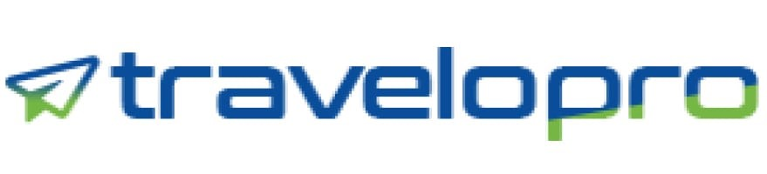
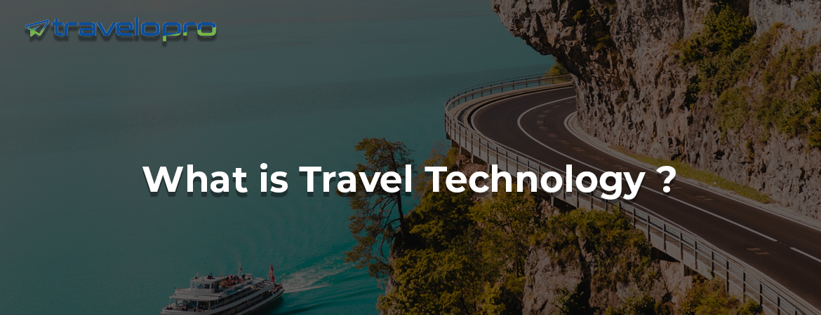
Travel Technology
Email id : contact@travelopro.com
Phone No : 98455 66441

Slide 2
What Is Travel Technology?
Travel technology is an umbrella term to describe the multitude of different customers of latest technology such as artificial intelligence, augmented reality and mobile technology within the fields of tourism, travel, and hospitality industry.
Technology increases the customer experience before, during, and after travel. Moreover, technology can optimize businesses through improved accuracy and convenience, while simultaneously assisting in reducing or eliminating human error.
For travel technology companies, hotels, airlines, car rentals, and other related sectors, this means that keeping up with the modern technology trends within the travel industry has become crucial.
Eventually, the goals or motivations behind implementing travel technology include automating travel and related processes, saving time, reducing costs, and creating a more seamless travel experience for consumers.

Slide 3
Which Technology Company Offers Best Travel Technology In Travel Industry?
Travelopro is a premier travel technology solutions provider with a focus on delivering end-to-end online travel technology solutions for travel agents, large travel corporations, TMCs, OTAs, and corporate houses.
We provide a cutting-edge suite of travel technology products that simplify searching, booking and managing leisure travel. We help our travel clients navigate through millions of travel options, flights, hotels, car rentals, and cruise, locally and globally to find the right travel choice for them.
We provide consulting, development for all the aspects of B2B & B2C travel portal development and travel API integration for airline booking, hotel booking, travel packages, bus booking, car rental, cruise booking and insurance.

Slide 4
We apply deep domain knowledge and technical expertise to create customer and employee facing software environments that cross-integrate with several data sources, including global distribution systems (GDS), cruise APIs, table booking systems, and computer reservation systems (CRS) utilized by vendors from airlines, railways, car rentals, and hotels.
Our product range also includes technology products that travel businesses can easily integrate and implement into their travel business that will deliver key advantages.
Through our leading technology booking engine, a system with which you can sell your tourism products and services via XML. We allow visitors to discover all the latest trends, develop technology processes and connect with experts in the industry, all in one place.
We operate and consolidate the world's largest inventory directly linking to 50+ travel suppliers to Online Travel Agencies, Corporate Bookings, Online Travel Search and Mobile app services.

Slide 5
Our brilliant travel technology solutions are spread across our products and you are free to choose the one that deems fit. If you want a combo of these solutions, we can do that too, to make sure that you can enjoy the advantages of more than one. At Travelopro, we offer three very important solutions for your travel business that covers your requirements.
Furthermore, it is well configured to fit the bill too!
With many years of expertise building customized high-end solutions, our understanding of the travel domain is underpinned by proven technical excellence. We are proud to have played a key role in changing the travel industry through developing systems for popular brands.
Our team consists of Travel Industry experts, business consultants with several years of experience in the technology and travel sectors, and highly skilled solution architects.

Slide 6
Who Can Use the Content?
Online Travel Agencies (OTAs)
Tour Operators (TOs)
Meta-search Companies
Travel Management Companies (TMCs)
Corporate Firms
Mobile Solution Providers
Destination Management Companies (DMCs)

Slide 7
How Is Travel Technology Used In Travel And Tourism Business?
Travelopro is the trusted technology backbone of over 100+ global travel management companies. Our entire range of software products are designed to cover any and all requirements of a travel agency, regardless of size, business model or market. At Travelopro, you will find reliable, efficient and cost-effective travel software solutions for your business.
For more business growth, we furnish you B2B & B2C travel portal development solution, which means business to business and business to customer. It can give you a better turn around ratio of clients.
Control sales, Bookings, Tours, Itineraries and track progress in real time – all with a few mouse clicks within the travel management software. Travelopro is a leading travel technology company working with travel agencies across the globe.

Slide 8
We provide travel agency software, Travel Portal Software Solution for large and small scale with comprehensive modules for flights, hotels, transfers, cars, sightseeing, insurance and holiday packages with various sales channels such as B2C & B2B & B2B2B etc.
The portal facilitates travel agents, tour operators, web portals consolidators sell, control and collaborate with their B2C clients and B2B partners and suppliers. It is a 100% web based system.
Nevertheless, of whether you are a large global travel agency, an airline, or a smaller leisure-focused business, we understand the challenges you are facing and are eager to solve them with you.
We understand that different travel businesses require different technology solutions and are aware that one size does not adjust all.

Slide 9
We are a team of specialists that can work through simple or complex travel policies, assist customers maximize efficiency, save costs and leverage technology in order to simplify and enhance customer experience.
Our B2C & B2B travel agency software & tour operator software is complete suit to automate the travel business process from content acquisition all the way to the distribution process. At Travelopro, you will find reliable, efficient and cost-effective travel software solutions customised to your needs.
From best online booking systems for the travel market, such as car rental, hotel accommodation, air ticket and all, our powerful team of tech enthusiasts makes it all the easier for you.
What makes us unlike from others is our expertise into travel portal development, we create customized and well-integrated websites for travel agencies.

Slide 10
How Travel Technology Software is Beneficial to Travel Industry?
Every travel business in today’s travel industry has to have appropriate knowledge about how travel technology software solutions work, From Airlines, travel agencies, and tour operators, to corporate firms everyone needs travel technology solutions to assist their business and sustain for a long time.
Travelopro, a leading travel software development company, strives hard to craft and modernize travel technology solutions in this fast pacing digital world. We concentrate on the needs of travel suppliers and partners and develop travel management systems that caters and covers all the needs of the stakeholders.
We, at Travelopro influence the travel technology market with cutting-edge business solutions and strive to be a one-stop shop for all your travel technology needs. We develop travel portals that can produce monetary returns for you at every single click.

Slide 11
Our main aim is to automate and boost client travel experience while making travel bookings, get the most reasonable rates of travel solutions, and also initiate last-minute booking.
Our value-added technology solutions are integrated into each travel management program and customized to be a perfect suited for your company. We strive to provide the top quality of service, while applying industry leading technology to drive efficiencies, program compliance, and overall cost reduction.
We have the latest, most effective technology including: real time information on bookings & status, policy compliance, service level monitoring, weather and safety advisories, and critical travel alerts. Each travel management program we design is completely accessible via our online platform.

Slide 12
Why Travel Agent find best Travel Technology Solution for their Travel Industry?
Travelopro is a global travel technology company with deep domain expertise, providing a comprehensive set of solutions & services. We have become the trusted partners of various marquee names in the travel business, helping our clients & allow a strategic IT transformation
At Travelopro, we integrate the best travel agency software into each custom-designed travel management program. This assists you and your employees stay ahead of the travel game in today’s ever-changing, tech savvy world.
We offer its software development services for tour & travel website development, flight and hotel booking website and mobile app development along with GDS integration such as Amadeus, Sabre, Galileo.

Slide 13
We provide all web-based services including designing, hosting and developing your website along with a round the clock web maintenance program. We come up with state-of-the-art solutions and designs and apply them with professionalism and dedication, all within realistic and affordable budgets as determined by our customers.
We understand that each market segment has its particular needs and priorities that need to be addressed. Our solutions are customized to cater to the key drivers of each industry segment.
We help travel businesses in creating new engagement models to keep up with the customers’ growing expectations in a digitally connected world while balancing costs. Our solutions aid travel companies in scaling limitlessly, reinventing services, and achieving an user experience vision, from touchpoints to journeys.
Therefore, as our customer, you can expect upgraded online travel portals with high usability travel technology

Slide 14
Why Choose Travelopro?
Travelopro is a customer focused organization with professionals having superior grasp of every aspect of multinational and national business and industry particular demands.
Secured User Data
Securing stored data requires preventing unauthorized people from accessing it along with preventing accidental or intentional destruction and infection.
Support
We're driven by our clients and committed to their success. At Travelopro, we're all about making you and your team quicker, smarter and better.

Slide 15
The Key Features of Technology Software Solution Include:
Empowers online International and Domestic Ticket Booking by fetching online inventory of air tickets, thus simplifying the process for customers along with personnel helping the customers in accessing them
Helps conduct a simple checkout process that is user-friendly, thus saving a lot of time of the customers and getting positive feedback with happy customers leaving the premises
Cloud computing-based software allows ease of maintenance and updates, unlike the earlier times where all the data was manually stored, searched and applied
Easy adjustment of pricing and packaging as per the requirement, seasonality and other factors is also empowered by the implementation of these travel technology company.

Slide 16
Hotel Reservation made easier for the customer with filters to select hotels with lesser tariffs and as per the preferences of the customers
Booking of vehicles (maybe a car or a bus) made easy with these Travel CRM software with proper needs stated beforehand
Provides fresh, instant and relevant information or content outline making the data real and thus useful.
Analysis of user behaviour can be done in order to maximize growth, profitability and user experience for revenue generation.
Itinerary Builder also helps to build the trip in a very detailed way.

Slide 17
Domestic and International holiday packages are developed and curated as per the client’s requirements, preferences and likings
All agents can be given separate login accounts to deposit funds with the assist of such software, which keeps a clarity thereby increasing the efficiency
Integration of social elements such as social media or other engagement applications promotes customer satisfaction and creates a positive as well as a long-lasting impact
Helps organize data in a structured manner post gathering data from several sources, thereby saving time and effort resulting in efficient servicing of the customers
Improved overall service to the customers as this software simplify the world of the clients with a whole of automation and systemizing the usual’s

Slide 18
Benefits Of Our Travel Technology Solutions:
Increase business visibility: ability to reach a wider audience
Safety and Security: quick payment without any theft & simple booking confirmation
Real Time Sales: Real time sales through online payment
Predict performance and sales: Understanding the market conditions, sales matrix, competitor analysis, business planning and modern trends

Slide 19
Which Are the Best Travel Technology Solution In Travel Industry?
Travelopro is leading Travel Technology Company delivers state-of-the-art travel technology solution for travel industry business. This travel technology solution includes:
Travel Agency Software
Tour Operator Software
Blockchain hotel booking technology
B2B/B2C Booking Engine
Hotel Booking IT Solution
Flight Booking IT Solution
Tour Booking IT Solution

Slide 20
CONTACT US:
For more details, please visit our website:
https://www.travelopro.com/travel-technology.php
Email id : contact@travelopro.com
Phone No : 98455 66441

