Slide 1

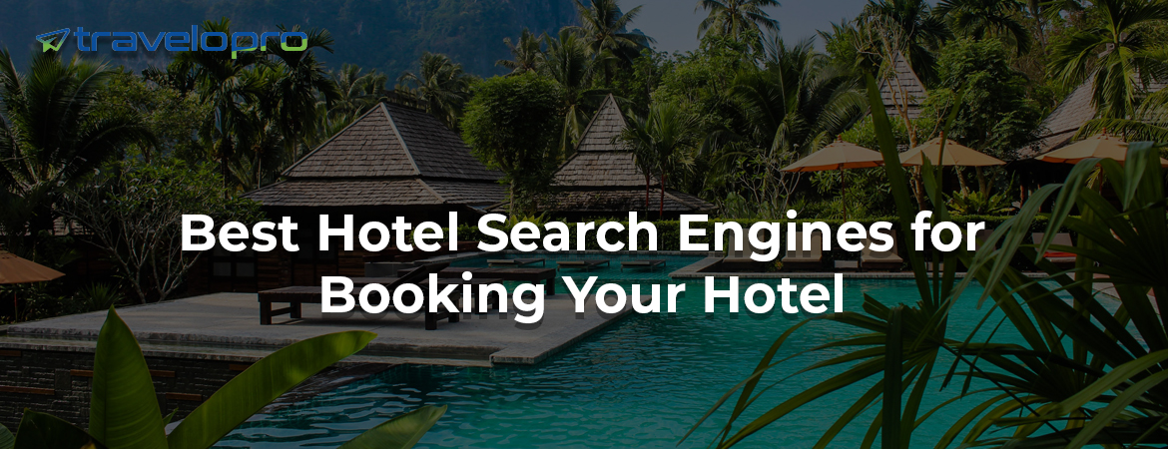

Hotel Search Engine

Slide 2
What are Hotel Search Engines?
A hotel search engine is a comparison tool used by travelers to compare rates across different hotels in a given destination. This unique search engine sends the user's request to other search engines and collects the results into a single, easy-to-use list, facilitating a quick booking procedure. Travelers may compare prices and availability in real-time.
As technology advances with more user-friendly interfaces, their focus has evolved from just showing listings to providing valuable services for travelers such as excursions, hotel and flight reservations, etc. Hotel search engines offer an excellent opportunity for hoteliers to access a wide range of clients.

Slide 3
Many companies now have their own hotel search engines to provide detailed information about their products as well as competing offers.
Hotels rely heavily on metasearch engines for direct reservations.
They play a vital role in minimizing hotels' dependency on OTAs by referring customers to the hotel's property website to complete their booking.

Slide 4
Best Hotel Search Engines for Booking Your Hotel
Expedia
Expedia is a well-known travel website that connects people with the best hotel room deals. They offer over 8 million hotels in 250 countries and are constantly adding new hotels.
Expedia works with over 4200 online travel companies worldwide to bring you guaranteed discounts. You may also use the search engine to discover low-cost flights, excursions, and car rentals for your travel.

Slide 5
Priceline
Priceline is a well-known online hotel reservation service. You may use the service to provide individual hotel rooms and save up to 60% off a hotel stay. Priceline has almost every sort of quality lodging available, whether you're looking for a luxury vacation or just a place to stay in the hotel.

Slide 6
Hotels.com
Hotels.com is a website that provides hotels and lodging in all of the world's top destinations. It includes over 350,000 hotels in over 1,200 destinations worldwide. Hotels.com provides secure hotel bookings and competent customer service 24/7 through our website, mobile applications, and call center.
Hotels.com is a powerful search engine that will assist you in finding the offer high-quality hotels at affordable prices. It also has many other features, such as personalized touch tones and quick check-in and check-out services, making it one of the most convenient ways to plan your next vacation right away!

Slide 7
Agoda
The purpose of Agoda is to link visitors with the world's best hotels by offering a reliable and convenient booking experience from users to locations. It gives passengers the best possible experience.
Agoda, founded in 2005, has grown to become one of the largest and most reputable hotels booking sites. The website is available in 15 languages, has a sleek new traveler-centric design, and provides contact information for over 380K hotels in 190 countries across the globe. They've also recently offered last-minute deals, providing travelers more options when planning their next vacation or business trip.

Slide 8
Kayak
Kayak is an excellent hotel provider due to its large selection and simple layout. Kayak not only assists clients in comparing and booking hotel accommodations but also provides links to other websites that travelers may want or need while on vacation.
In addition to its website, Kayak offers Google Maps and Bing travel searches, making it even simple for travelers to locate what they're searching for no matter where they are in the world.

Slide 9
TripAdvisor
One of the oldest and biggest metasearch engines is TripAdvisor, a website that aggregates travel evaluations from people who have visited a specific destination. This engine allows you to book direct hotel reservations and compare prices.
TripAdvisor was founded in 2000 and is headquartered in Massachusetts, United States.

Slide 10
Skyscanner
Skyscanner is a website that helps hotel owners and travelers locate the most affordable hotel rooms. It provides hotel room availability, price comparison, calendar search, and map search features.
It assists travelers in finding a better bargain in all forms of travel, including local and international rental vehicles and cruises. It provides features such as price comparison, calendar search, and map search to assist travelers in planning their next trip. The London-based service boasts a quarter million members globally, three million listings, and about 1.5 billion monthly searches.

Slide 11
Trivago
Trivago is one of our top hotel search engines since they provide discounts and special offers on over 45 million hotels worldwide. It is an excellent site for finding hotels in the UK and other countries across the globe. The website is easy to navigate and gives a plethora of offers, deals, and discounts to help you save money on your next holiday.
This website was designed with the consumer in mind, allowing you to quickly find a hotel based on your budget, location, or preferred facilities, among other considerations. Trivago provides an excellent free service that displays all of the prices from many travel sites at the same time.

Slide 12
Orbitz
If you're looking for a reliable and affordable hotel search engine, use Orbitz.com. This website allows you to browse vacation packages, view images of properties, compare prices with other businesses, and book reservations without ever leaving your desk.

Slide 13
Hotels Combined
Hotels Combined, one of the world's most renowned hotel search engines, has been serving travelers since 2007. The hotel booking website also includes a travel tool that allows customers to compare hotels and services in any place they are considering for a vacation, business trip, or conference. Visitors to this website get access to over 4 million rooms in 1,200 locations worldwide, as well as over 500,000 holiday properties worldwide.

Slide 14
Advantages of using Hotel Search Engines
The hotel search engine may be a very beneficial tool for growing the hotel's business and reaching a high number of travelers all at once.
Travelers are drawn to these booking engines because the pricing is transparent, they can view all of their alternatives at once, and they can do everything in one place: search, compare, and reserve.
Using this tool in connection with hotel booking system software is unquestionably a great strategy. You will get visibility and the opportunity for worldwide distribution, allowing you to optimize revenue by generating more leads and bookings.

Slide 15
A hotel search engine is a website that provides a range of listings, reviews, and prices for hotels. They are handy for collecting listings from several websites and displaying them in a searchable format
One of the key benefits of using a booking site is that it makes it much easier to offer packages, hotel upgrades, and special discounts. You increase your chances of increasing overall booking income by giving guests the option to enhance their stay by selecting value-added services.
A hotel booking engine is a website application that captures and processes direct online visitor reservations. It's your key to commission-free direct reservations, in addition to a way to enhance your property's sales and revenue strategy.

Slide 16
It's a highly convenient way for travelers to make a reservation. The booking engine will display your pricing and availability in real-time, allowing guests to choose their dates and finalize the reservation. Other options, such as automated reservation confirmation emails, may be included.
There are several advantages to including an online booking engine on your hotel website. It is available 24/7 and increases revenue by boosting visibility.

Slide 17
Looking For Next-Generation Hotel Booking Engine with All Features?
Travelopro is a full-service hotel distribution software solution that gives hoteliers complete control over their hotel inventory and reservations across all online sales channels. Our simple Hotel Channel Manager allows you to take complete control and manage inventory and pricing across all linked hotel sales channels.
With our user-friendly Hotel Channel Manager, you can sell your rooms across all channels more quickly and easily. You can manage your hotel inventory and change prices in real time using a single dashboard. Our powerful booking engine solution will assist you in increasing direct bookings and increasing sales revenue from your website.

Slide 18
Our hotel reservation system in the hotel industry allows tourists to book their stays online utilizing the software. It allows for a more seamless booking process and easily captures information for your database.
Furthermore, by automatically synchronizing across your platform and channels, booking software provides you with a competitive advantage and increases efficiency. The advantages of a hotel reservation management system can assist you in running your hotel smoothly and with high client satisfaction.
Travelopro is a one-stop solution application that combines an intelligent cloud-based PMS with a sophisticated Channel Manager to simplify and successfully manage your online hotel sales channels. Our booking engine can optimize your hotel website and allow users to verify pricing, availability, and room type.

Slide 19
Our hotel booking system automates the reservation process by synchronizing with your hotel's website, allowing visitors to make bookings quickly and easily without visiting another website. This booking system can be combined with your hotel's property management system, payment gateways, channel manager, and reputation management system, providing you with centralized operational control.
Travelopro is a leading Travel Software Development Company that provides the best Hotel Booking Software for hotels to automate day-to-day hotel management operations and increase revenues. We provide a B2B and B2C hotel booking platform with an integrated API solution. You may create travel agents throughout the world by using our hotel booking service and generating lucrative commissions.

Slide 20
Our professionals provide the best hotel booking software with the top 80+ XML In and XML OUT Suppliers globally, in addition to the best hotel data to improve the client experience and develop a robust hotel contacting system that fits your business identity.
Using our hotel reservation system, you may combine hotel inventory from several sources (direct contracts / GDS / bedbanks / channel managers) to give your clients the best possible rate. Your retail clients, B2B agents, and corporate clients may book the aggregated inventory online in just a few clicks, leveraging real-time pricing and availability.

Slide 21
Benefits of Hotel Search Engine
Improved online brand visibility and better ROI
Lists all the hotel rates in one place
Price Transparency
Provides reviews in one place which helps customers to make better decisions
Always displays the best rates
Increased direct channel bookings

Slide 22
Key Takeaways
A hotel search engine is a search tool that sends user requests to many search engines and compiles the results into a single list.
This online sales channel is rapidly expanding and has surpassed traditional advertising.
Hotel Search engine sites are gaining ground on OTAs while continuously developing. Google Hotel Ads, TripAdvisor, HotelsCombined, Trivago, Skyscanner, and Kayak are some of the major players.
They are gaining popularity among travelers and hotel guests due to their strategic position.
Metasearch engines are a low-cost way to market your business. Because they employ a pay-per-click model, you will not have to pay excessive commission charges.

Slide 23
Conclusion
Using these top hotel search engines, you can guarantee that you discover the best hotel room deals, which may be crucial while planning a vacation or simply looking for places to stay nearby.
These hotel search engines allow you to select your location and the type of rooms you want to stay in. It will evaluate and compare many different websites to get the best price that suits your needs. These websites will provide all of the best offers from across the internet.

Slide 24
CONTACT US:
For more details, please visit our website:
https://www.travelopro.com/hotel-search-engines.php
Email id : contact@travelopro.com
Phone No : 98455 66441

