Slide 1

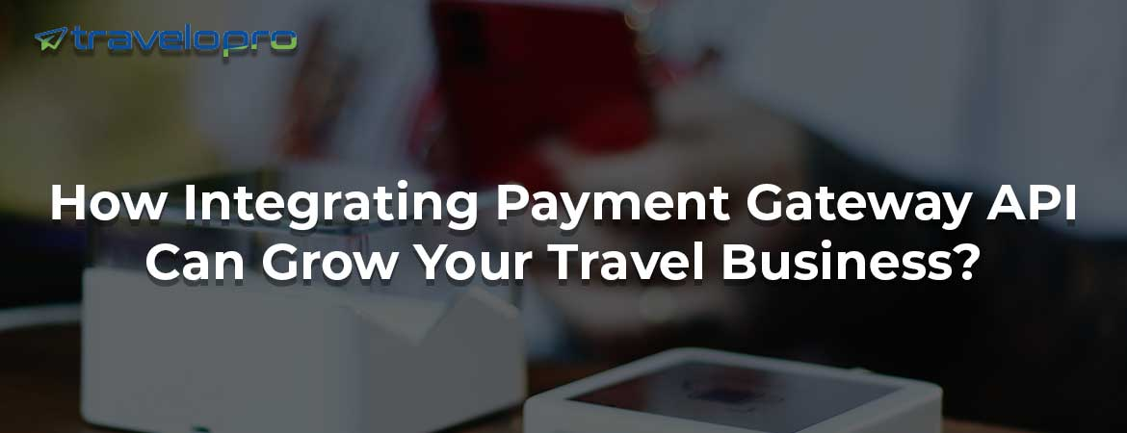
Payment Gateway Integration
Email id : contact@travelopro.com
Phone No : 98455 66441

Slide 2
What Is Payment Gateway Integration?
A payment gateway is a service that allows online payments. It directly approves or declines payments and authorizes the transfer of funds from the customer to the company. Payment Gateway Integration required a bank linking with the website in order to empower customers to pay directly from the account.
Payment gateway integration refers to the process of connecting a website, application, or online platform with a payment gateway service provider to facilitate secure and reliable online transactions. A payment gateway is a software application that authorizes and processes payment transactions between customers and merchants.

Slide 3
How Does Payment Gateway Integration Work?
This payment gateway allows your clients to securely pay their reservations with credit or debit cards on your either B2B or B2C booking systems without exposing their financial information, with secure data transmission and processing and directly to your own back account.
Payment gateways enable merchants worldwide to accept online payments 24/7, ensuring a smooth checkout process for every customer who wants to pay for their services immediately.
Travelopro has already integrated +35 payment gateways from all over the world, from the world-renowned ones such as Stripe and JP Morgan to the niche ones serving local markets.

Slide 4
Why Do You Require a Payment Gateway for Your Travel Business?
Nearly all travel and tour companies work exclusively online and therefore require a means for their users to pay for the adventures they offer. The travel industry relies extremely heavily on the ability to accept online payments.
To give travelers a seamless and convenient experience, integrating an online payment gateway into your travel website is crucial. This process ensures that clients can securely book and pay for their flights, accommodations, tours, and other services in one place.
A payment gateway allows the tour and travel company to always be open to serve whoever they need to, and the customer can book immediately rather than going away and thinking about it, possibly never returning.

Slide 5
Payment Gateway Solution for Businesses built for businesses of all sizes—SMBs to large enterprises—use our payment gateway to accept payments and manage your businesses online.
Explore over 100+ payment options with the best payment gateway services across domestic and international payments.
The online payment gateway integration helps you get more profits as it establishes a sense of security among the minds of your travel customers. Usually, clients prefer paying through an authorized mode of credit or direct payment, and this is possible if you install our safe and secure payment gateway integration API. Our feature allows your customers to pay for their travel packages through a user-friendly device such as a laptop or mobile.

Slide 6
Apart from that, here are a few reasons why you require an online payment gateway:
Instant Payments: An online payment gateway means that you can instantly approve or deny a payment. You no longer have to stress about your customers delaying the payment for various travel packages, as it allows you to set up proper payment policies upfront.
Offers Better Cash Flow: An online payment system provides better cash flow for your business. With this system, your clients can complete both the booking and payment processes at the same time. This feature saves you from having to wait for payment days after the trip is booked.
Enhanced Security: Online payment systems create a secure environment for conducting business. They decrease the risks of credit card scams and fraud, protecting both your business and your customers.

Slide 7
What Are the Benefits of Using Our Payment Gateway Integration System?
A few of the benefits of using our payment integration system.
Customized Gateway: A personalized, custom gateway helps a company save on payment gateway fees; this payment and sign-up fees can add up to a huge chunk of company profits in the long run, and it enables one to sell the payment gateway products to other merchants.
Secured Transactions: With an integrated online payment system and dedicated gateway, customers can rest assured that their transactions are safe and secure, as confidential data like account information is stored in an encrypted form. This builds trust and saves valuable time.

Slide 8
Simple Report Generation: A business would grow over a period of time. The growth would be caused by more processes, paperwork, and more employees, and maintaining data manually would no longer be feasible. Our innovative software would help you create reports in a flash, which would save a lot of time and reduce the probability of errors.
Enables Multiple Currency Payments: As people travel more and more, the world is becoming a global village, and they make a lot of transactions online. Hence, it is important that global customers get a personalized experience. If the website facilitates payment in their preferred currency, payment method, and local language, then they are more likely to make a purchase. The benefits of this software are accentuated when they are integrated with other channels such as websites, mobile devices, etc. It is also beneficial to a company from a business point of view as it reduces the number of refunds, chargebacks, and cart abandonments.

Slide 9
Protection From Online Frauds: The Internet and online payment have definitely made our lives easier, but one is exposed to a number of risks too. There are hackers and online thieves who steal your identity to get access to your wealth. Our secure and advanced software ensures that your online payment experience is stress-free and safe. We protect you from phishing, cell-phone phishing while using credit cards, internet banking, etc.

Slide 10
What Are the Advance Key Features of Payment Gateway Integration?
Advance Key Features of Payment Gateway Integration
Multi-Payment Method
Multi-Language Method
Multi-Channel Method
Fraud Management Method
Multi-Currency Processing
Responsive Mobile Interface
Value Added Payment Options
Built-In Analytics
Direct Payment Link

Slide 11
How To Integrate a Payment Gateway in a Travel Website?
To integrate a payment gateway in a website, follow these general steps:
Choose a payment gateway: Research and select a payment gateway provider that suits your business needs. Some popular options include PayPal, Stripe, Authorize.net, or Braintree.
Set up an account: Sign up for an account with the chosen payment gateway provider. This will involve providing necessary business and bank account information.
Obtain API credentials: After setting up an account, you will receive API credentials (such as API keys or merchant IDs) from the payment gateway provider. These credentials are required to integrate the payment gateway into your website.

Slide 12
4. Choose the integration method: Decide on the integration method based on the payment gateway provider's documentation and your technical expertise. The common integration methods are:
a. Hosted payment gateway: This method redirects the customer to the payment gateway provider's website to complete the payment. It requires less technical expertise but may provide a less seamless user experience.
b. API integration: This method allows you to customize the payment process within your website. It requires more technical expertise but provides a more seamless user experience.

Slide 13
5. Implement the integration: Implement the selected integration method by following the payment gateway provider documentation. This typically involves adding HTML forms, JavaScript, and server-side code to manage the payment request and response.
6. Test the integration: Ensure that the integration is working correctly by testing the payment process with test or sandbox credentials provided by the payment gateway provider. This enables you to simulate transactions without charging real money.
7. Secure your website: Implement proper security measures, such as using HTTPS (SSL/TLS) encryption for secure communication with the payment gateway and following best practices to protect customer data.
8. Go live: Once you have tested the integration thoroughly, switch to the live credentials provided by the payment gateway provider to start accepting real payments on your website.

Slide 14
How Much Will Be the The Cost of Payment Gateway Integration?
Are you wondering about the costs of payment gateways and API integration worldwide? You have made your way to the correct place. Travelopro is the most economical API integration partner worldwide, helping you connect with the best payment gateway supplier.
The payment gateway integration cost depends on the solution and platform that you select. It takes time and effort to select a payment gateway solution that satisfies your requirements, just as it does to integrate a payment system.

Slide 15
Why Travelopro Is the Best Payment Gateway Integration Provider for Your Travel Business?
In the fast-paced world of travel and tourism, providing seamless payment solutions is key to success. Whether you run a travel agency, a booking platform, or any travel-related business, integrating a reliable payment gateway like Travelopro can make a world of difference.
Travelopro is one of the reputed payment gateway integration providers who deliver payment gateway API integration to travel industries and authorizes travel businesses. We develop best-in-class travel portals with payment gateway integration for the processing of online payments and transactions.

Slide 16
By seamlessly integrating a payment gateway into your online business, you can provide customers with a secure and convenient way to make payments, thereby enhancing their experience and improving your revenue.
We provide a plethora of online payment gateway integration solutions that will allow you to process payments for selected services. We've integrated various payment gateways around the world as per your needs. We can integrate your website virtually with any payment gateway company right away.
We are able to integrate with a wide variety of merchant gateway solutions for processing electronic credit payments for travel companies that want to process secure online payments in real-time anywhere in the world.
We've got 100+ payment gateway API integrations for different platforms, such as flight booking, hotel booking, car rental engines, vacation rental engines, cruise booking, and other travel platforms.

Slide 17
We provide your customers with a secure and seamless way to pay, so you can concentrate on building unforgettable travel experiences for your customers. We allow your customers to safely pay for their reservations using credit or debit cards on your B2B or B2C booking systems, directly to your own bank account, without disclosing their personal or financial information.
We provide a payment and booking solution that is specifically designed to fit into a tour operator and travel organizer workflow. It includes specific features for travel companies, such as part-payment, upsells, and customizable booking forms. And it also comes with an advanced booking management dashboard, where tour operators can handle financials and communications with clients.
We are an experienced online payment gateway development company that makes online transactions and online payments quicker and safer throughout the world. We deliver smooth travel payments at every step of the travel experience—from booking to flights, hotels, cars, and beyond—while simplifying and optimizing payments for travel players.

Slide 18
Our range of services incorporates innovative booking engines, online travel portals, and travel software that serve the diverse needs of travel agencies, tour operators, and individual travelers. We specialize in API integration services, ensuring that you have the vital tools and resources to stay competitive in this fast-paced industry.
Our travel professionals help customize your payment gateway to drive acquisition, boost payment efficiency, and increase revenue. We offer unique foreign exchange and treasury solutions designed to minimize costs and maximize your profit.
We are here to cater to all your needs on time and help you expand your business with enhanced features, offering more deals and discounts when you start generating more revenue for it.
Contact us for detailed information without obligation, and you can have our payment platform implemented on your online travel agency's website in a very short time.

Slide 19
CONTACT US:
For more details, please visit our website:
https://www.travelopro.com/payment-gateway-integration.php
Email id : contact@travelopro.com
Phone No : 98455 66441

