Slide 1

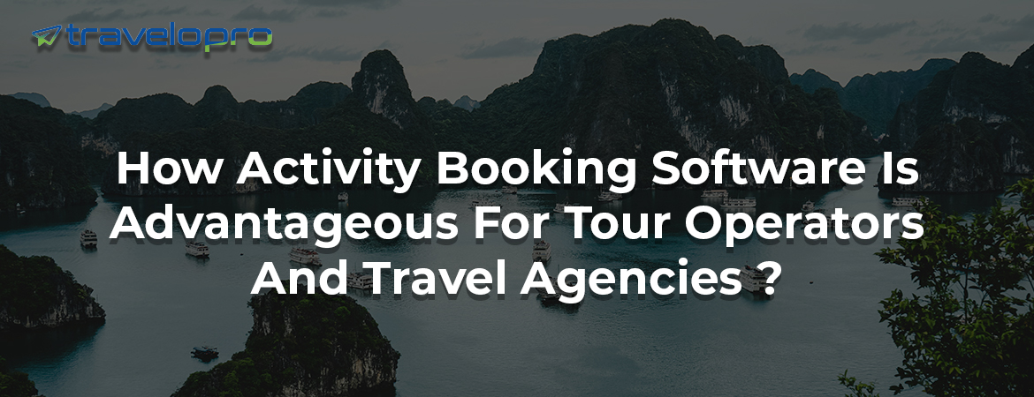
Activity Module
Email id : contact@travelopro.com
Phone No : 98455 66441

Slide 2
Award-Winning Booking Software to Power Up Your Activities
In the world of activity and experience bookings, having the right online activity booking system is essential. The best booking software will offer a blend of user-friendliness, flexibility, and advanced features customized to the unique needs of activity centers and outdoor activity providers.
Activity booking systems are software that enables users to book activities and services online. Every company, involving hotels or travel companies, can use the system. It can control an extensive range of booking types, from reservations for a single room to tickets for an annual event.

Slide 3
These activity booking modules are flexible, adaptable, and easy to interact with, so the users can accordingly schedule the activities in one module. It also provides suppliers with more bookings for activities and has effective interaction rather than the uneasiness of activity booking planning.
It helps tour and activity providers distribute activity tickets on multiple booking channels so that your activities can be discovered by worldwide travelers, and that's why it's also called travel ticket booking software.
Overall, an activity booking system enhances efficiency, improves the customer experience, and increases sales for tour operators by automating and optimizing the booking process.

Slide 4
How Activity Booking Software Is Advantageous for Tour Operators and Travel Agencies?
Implementing a suitable activity operator reservation system is an essential choice for tour operators in the travel industry. An effective activity booking software can change your entire tourism business.
Activity Booking Software is traveling software that is specially designed for tour operators and travel agencies to effortlessly manage their tour activity, book, and automate inventory. It is an easy-to-use, multifaceted booking system specifically built for travel companies looking to offer their customers a wide array of local tours, trips, and experiences in one location.
Activity Booking System is a travel software that aims to aid travel agents and tour operators in keeping track of tour activity such as itinerary, booking reports, automated inventory, and scheduling.

Slide 5
With this software, travel companies are able to easily organize tours to manage customers data and information, such as tour information, back-office activities, booking, accounting, and reports.
In addition to being a robust back-office system, Activity Reservation System incorporates a fully automated data-driven website for managing online reservations from travel agents and direct clients, with real-time payment processing and automatic emailing of confirmations. Reports involve seating plans, pick-up lists, and rooming lists, plus a broad range of other operational and financial reporting facilities.
Activity booking engines typically feature a search function that allows users to search for activities based on location, date, type of activity, and other criteria. Customers can then view a list of available options and select the activity they wish to book. The booking engine will generally provide a detailed description of the activity, including the price, duration, and any other relevant details.

Slide 6
However, tour operators and travel agents have to manage the entire booking process, inventory, and tour activity through a single platform; that’s where online activity booking software catches attention. The system is specifically designed for travel agencies to offer their customers a range of trips, local tours, and experiences in one location.
Activity modules are leisure activities that passengers engage in to experience the destination. It generally involves visiting multiple places of interest or participating in diverse events. Activity modules can be sold directly to passengers or through intermediaries (travel agencies, tour operators, DMCs, etc.).

Slide 7
The biggest activity marketplaces are Viator, GetYourGuide, TripAdvisor, and Peek. Common activity module offerings are
sightseeing tours;
adventure/sport tours;
cultural, natural, or historical landmarks;
local events (concerts, shows, theaters, festivals, etc.);
famous restaurants and wineries;
entertainment parks and zoos; and so on.

Slide 8
Looking For Activity Booking System Solution?
If you are looking for a travel activity booking system solution, you have come to the right place. Travelopro, the leader in travel technology, provides the best activity booking software solutions designed to increase your sales, reduce costs, and improve customer satisfaction.
Our solutions are built on an easy-to-use, web-based platform with a complete set of features that enable you to manage all the aspects of your activity booking business. It helps tour operators and travel agencies effectively manage their tourism businesses.
Travelopro is a strongly simple, all-in-one activity booking platform. We help you save time and money by creating a stunning user experience and automating unnecessary admin for your business.

Slide 9
Travelopro's activity booking software makes managing your tours quick and easy, so you can focus on your business. Deliver exceptional experiences that boost growth with Travelopro’s online activity booking software.
The activity system can be used by itself or in conjunction with a hotel booking engine and flight booking system, making it a significant cross-sell opportunity as you can offer local activities to people who use your portal to book a hotel or flight for a specific destination.
We specialize in custom software development services for activity booking systems. We design and develop customized booking solutions that integrate seamlessly with your existing website and management software, enhancing your operational efficiency and user experience. Our services include system design, software development, implementation, training, and ongoing support.

Slide 10
Each business aspires to have a personalized travel reservation system with first-class functionality. At Travelopro, we accomplish the dreams of our clients. We deliver customers what they look for, and it became possible only due to our tour and activity booking system.
It also shows the activity details of location, destination, date, price, duration, inclusions, etc., where travel agents can easily find out the activity itineraries of their travelers. It supports both a b2c travel booking engine and a b2b travel booking engine and also supports multi-language and multi-currency features.
Travelopro’s activity booking software provides everything you need to automate key tasks, create efficiencies, and drive more bookings and revenue. Using Travelopro’s package booking engine software, OTAs can provide multiple options to their customers, who can choose from a wide range of available packages as per their requirements.

Slide 11
Our online booking software helps you manage your attractions, tours, and activities straightforwardly and efficiently. Using our activity booking engine is the easiest way to log and track sales and control all facets of your business. Our software is also designed to be cloud-based to make it easy to use and mobile-friendly.
Using our activity booking engine software, online travel agents can provide multiple options to their guests, who can choose from a wide range of available packages as per their needs. You can also improve customer relationships with an email- or SMS-based automated follow-up system.
We are a dedicated travel industry platform built by a team of visionaries, architects, engineers, marketers, and strategic consultants with a deep knowledge of the industry. Our aim is to leverage the best of technology to streamline and optimize your travel business so you can spend more time winning, growing, and delighting your customers.
Probably, with travel software, tour operators are able to provide their customers with the most convenient and secure tour and activity booking experience.

Slide 12
Why You Should Integrate a Custom Tour and Activity Booking System on Your Website?
Competitive Advantage: Offering a unique and effective booking experience sets your business apart from competitors who rely on generic solutions. This differentiation can engage more customers and build a powerful brand reputation.
Integration with Other Systems: Custom booking systems can be integrated with other necessary business tools such as CRM, payment gateways, and marketing platforms, creating a seamless ecosystem that enhances overall operational efficiency.

Slide 13
Personalized Customer Journey: Customizing the booking process to align with your brand and customer expectations builds a more personalized experience, leading to higher satisfaction and repeat business.
Enhanced Security: Custom solutions can incorporate sophisticated security measures to protect customer data and payment information, ensuring compliance with industry standards and building customer trust.
24/7 Booking Capability: A custom system enables customers to book tours and activities at their convenience, any time of day. This 24/7 availability can remarkably increase booking rates, especially for international customers in different time zones.

Slide 14
Comprehensive Features:
Our activity booking and reservation system offers an extensive range of features designed to meet your specific requirements. These include:
Online Booking: Enable customers to beneficially book activities through your website or mobile app, providing a smooth booking experience and increasing your reach.
Real-Time Availability: Keep track of activity availability in real-time, ensuring accurate bookings and preventing overbooking or conflicts.
Resource Allocation: Efficiently allocate resources, such as equipment, guides, and instructors, to ensure simple operations and optimal customer experiences.

Slide 15
Calendar and Scheduling: Manage activity schedules and assign time slots, allowing for easy coordination and avoiding scheduling conflicts.
Customer Management: Maintain a centralized customer database, track preferences and booking history, and give personalized service to increase customer satisfaction and loyalty.
Online Payments: Accept secure online payments, offer various payment options, and automate invoicing, ensuring a hassle-free payment process for both you and your users.
Seamless Integration: Our activity booking and reservation system seamlessly integrates with other important tools and services, such as payment gateways, CRM systems, and marketing platforms. This integration ensures smooth data flow and a connected ecosystem for your business operations.

Slide 16
Key Benefits of Activity Module
Travelopro's activities module makes it simple to boost utilization and user experience at your business.
A COMPLETE ADMINISTRATIVE VIEW OF AVAILABILITY
Configure as many activity types as you'd like to promote online.
View availability and make new bookings within the integrated activity admin grid.
Easily manage existing reservations as needed.

Slide 17
INCREASE UTILIZATION WITH ONLINE BOOKINGS
Elevate activity availability to your customer base 24/7 online.
The responsive design of the of the booking engine looks great on any device.
If the customer’s desired time is booked, the next available times are displayed.
REDUCE ADMINISTRATIVE SUPPORT
Users may view availability and book resources independently.
As bookings are made, significant team members are automatically notified.

Slide 18
What Are Things to Look for When Choosing Your Activity Booking Platform?
Finding the right booking software is like finding the perfect business partner. You want to find a partner that will support you at every phase of the business.
Quick Setup And Easy To Use: The software should also be easy to use. This applies to you and your team, as well as your guests. The booking process should be intuitive.
Access To Data: Your software should provide you with an extensive range of financial reports, such as cash flow and realized earnings. It should be able to identify your most profitable listings and booking channels, assist in capacity planning, and track customer satisfaction scores.
Smooth And Secure Checkout: Go through the booking process on your website. The checkout page should load quickly and be simple to fill out. It should look professional and make the customer feel like their data is secure.

Slide 19
Mobile-Friendly: You want to ensure your website and checkout are optimized for mobile bookings so you can catch those last-minute reservations on the go.
Integrations: Find software that already integrates with the gift tools you already use so that you can handle all operations on a single system.
Customer Support: If something goes wrong with your booking software, you want to be able to contact someone as soon as possible. Preferably, you’d have access to 24/7 customer support and a dedicated account manager that helps with setup and troubleshooting any bugs.
Automated Email and Text Notifications: Every little thing from booking confirmation emails to weather updates can be automated through your booking solution. The software can automatically customize each message with relevant data about the guest’s reservation and send it to them at the right time in their customer journey.

Slide 20
Wrapping Up:
We are here to build a travel website the way you want. We cater to all your requirements by keeping pace with new technologies, which ultimately leads to more sales and profit for the business.
Partnering with Travelopro perfectly positions you to take control of your own digital transformation. Reach out to us to find out how Travelopro can assist your business.

Slide 21
CONTACT US:
For more details, please visit our website:
https://www.travelopro.com/activity-module.php
Email id : contact@travelopro.com
Phone No : 98455 66441

