Slide 1

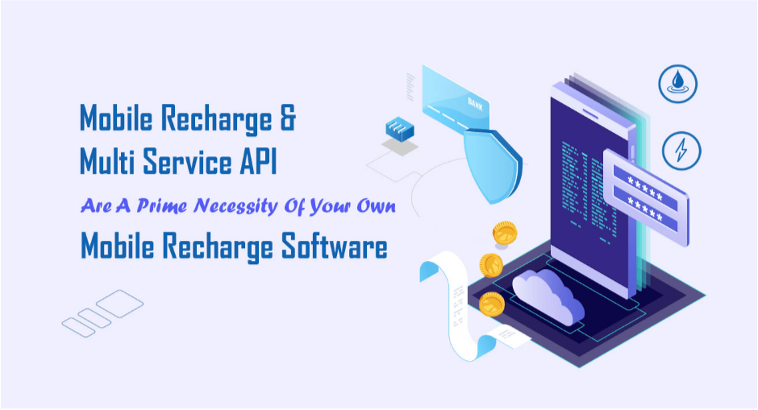
Mobile Recharge And Multi Services API
Email id : contact@trawex.com

Slide 2
Mobile Recharge API or application programming interface seems to be a technical term, but if you are running a business firm there is a specific need for technology and the compact solution will be brought by an effective API provider.
Being an individual business owner, you may have the slightest knowledge of such technical processes and on the other hand, without implementing the latest technology you will be left behind by your business competitors.
Trawex has brought the solution and your business will find more speed and success having such API support.
Trawex provides an easy and quick API Solution for Mobile Recharge. We support all DTH, mobile, and data card recharges in a single API.
So, Data Card recharge, DTH recharge, and all mobile recharge will manage with a single Mobile recharge API.
Mobile recharge and data packs are the sole and breathe of each person in today's world. Trawex is a one-stop recharge API solution for all recharge services.
It also works for every service operator of both prepaid and postpaid.

Slide 3
1. What Is Mobile Recharge API?
Mobile Recharge API is a supreme way to lead your mobile recharge business towards growth and prosperity. It will impart you the right to give a simple online recharge solution to your customers for major mobile operators like Reliance CDMA, Vodafone, MTS, TATA Indicom, TATA DOCOMO, Airtel, etc.
To get the benefits of Mobile Recharge API, you have to have your mobile recharge software. Our master recharge API gives you an agile and effortless recharge option.
We are one of the leading recharge software and API solution provider, offering recharge API service with maximum margin, and support all major telecom and bill pay operators across the world.
We have optimized it according to clients' requirements which helps to attract a customer which directly helps to increase traffic and business. And it is designed which is user- friendly and fully supported for business development.
Our Mobile Recharge API empowers you to offer postpaid/prepaid mobile recharge, DTH, Data Card & electricity bill payment via all service operators to your customers.
Our JSON response Recharge API permits you to check available balance, a daily or monthly commission earned, recharge transaction history & the success status of recharge.

Slide 4
2. How Recharge API helps in Mobile Recharge Business?
Recharge API plays an essential role for a mobile recharge business, Mobile Recharge API allows you to recharge mobile phones from any mobile operators in a single click.
To start a Mobile Recharge business API is a beneficial platform to make successful your business with instant profit on low investment.
Mobile recharge API is an excellent way to add to your income and generate additional revenue.
This is extremely applicable for website owners, hotels, shopkeepers, SMEs, and any other organization. With this ultimate value addition of prepaid mobile recharge service, you will be able to engage more and more customers to your website.
A simple API can assist you to give an online, secure recharge to your customers for 15 major mobile operations, and 6 major DTH operations.
Along with these, Data Card Recharging is also available. Not only this, you can help post-paid mobile users pay their bills with ease and speed online, the facility of paying electricity bills are also available with this option.
In addition to all, the online money transfer facility helps you transfer money to any bank account in India.

Slide 5
3. Why Trawex for Mobile Recharge API Integration?
Complete solution for recharge business - Portal design, development, API integration, and business promotion
User-Friendly Panel for reports and filtrations
Advanced mobile recharge API commission on all major operators
Affordable mobile recharge API cost
One-time investment and lifetime income
We offer a Single API for all major operators
Recharge API integration
You may sell your API at any time at any cost
You can build unlimited recharge distributors, retailers, and resellers at your API panel
No limitation with API
Instant margin benefits
Our recharge service covers nearly all major service providers of Mobile/DTH/Data Card
We offer strong backend support through our flawless services
No need for huge investment to start an online recharges service

Slide 6
4. What Is Multi Services API?
Trawex provides the best solution for Recharge Industry with the best Multi-Services API to handle all the business needs.
Multi Services API may be a prime necessity of your own mobile business. We provide the best Multi Services API solution to start your business with fast and effortless recharge options.
We provide all kinds of Mobile Multi Portal Development Services as per the client's need and budget-oriented.
We are one of the best recharge Software and API Solution Providers in India. We provide Multi Recharge API Service with maximum margin and provide good support.
You will get a Multi- Service Solution in one place. Start your business with Trawex and earn a profit on every recharge. We provide you with the easiest and affordable solution.
What is unique at Trawex:
Trawex develops custom recharge software for all customer
Multiple API integration facilities in recharge.
It is offering API for recharge, money transfer with life time validity.
Its service charge is affordable from market along with best service.

Slide 7
5. Telecom
Telecom API is a set of programming instructions and protocols used to access a web-based application. It is used for web applications and telecom related cloud applications including messaging, payments, location sharing, identity management, webRTC, and others.
Telecom API offers extra functionality to the existing systems by enhancing their performance and delivering time and cost-efficient solutions. This results in improved customer experience and the development of vast software programs,
Mobile Prepaid Recharge: Mobile Prepaid Recharge Service can be the great value addition that would attract more and more customers to your website. We provide automatic recharge solutions for any kind of prepaid mobile recharge. Mobile recharge API facilitates instant recharge of prepaid mobiles services.
DTH Recharge: DTH Recharge API is available for all the major DTH operators such as Dish TV, D2H, Big TV, Tata Sky, Videocon, Sun Direct, Airtel Digital TV, etc. Our API solution will furnish you the access to easily recharge the DTH services online for your customers. Our complete DTH API user can add the amount in the wallet anytime from anywhere instantly.
Data Card Recharge: We offer an online Data card recharge API service with which the customers can recharge any data card provider of Indian origin instantly. It provides ultimate value addition to your existing business.
Postpaid Recharge: Mobile phones are an essential part of our lives and with the association so is postpaid mobile recharge. Online mobile recharge gives you the liberty to recharge your mobile phone number anytime and from anywhere using Trawex API.

Slide 8
6. Utilities
Utility API is a utility data service for the new energy economy.
Hundreds of energy suppliers use it every day to request and download utility customer bills and interval data.
The Utility API offers a data collection system that can be integrated into renewable energy-oriented applications. It can be used to collect utility bills and usage data. This is a REST API and returns data in JSON format.
Electricity: Trawex offers its components through an exceptional gathering of API strategies, which fundamentally comprise of Electricity API.
One of our versatile APIs might be the electricity APIs as they can interface with a broad exhibit of organizations the complete way across the country.
Insurance: Your digital partners have special requirements - flexibility in your insurance technology stack is key.
Trawex gives you a leg up with our fully customizable insurance APIs which can be integrated into a matter of hours.

Slide 9
7. DMT (Domestic Money Transfer)
Domestic Money Transfer API is a great way to generate extra revenue for website owners, SMEs, and any other organization. Smart payment routing for minimum cost and maximum profit. APIs are used by a lot of banks all around the world. They are a very essential part of the banking system.
They can be used to access data both for internal and external use. They are also used to internally collect and collate data. APIs are also used by international organizations like the World Bank and others that have huge datasets with users in different locations all around the world who need to access it.
Trawex is a trusted Domestic Money Transfer API Service (DMT API) provider across India. We have a robust and secure instant money transfer API. Use our API services to transfer online money whenever from anywhere.
Currently, online approach is mandatory as it is an important factor to grow your business. We offer the modern technologies for money transfer API along with NEFT and IMPS channel.
Domestic Money Transfer API Benefits:
Easy integration with high security with SSL features
API Script is the leading and the most reliable and secure API platform in India
Instant money transfer to the beneficiary accounts National wide
JSON Based Money Transfer API. Easy To Integrate By Developer
Money transfer API works for all bank who accepts IMPS/NEFT/AUTO, IMPS is the most
popular mode to transfer money any time even on Bank Holiday Also
Our Money Transfer API support - Sandbox Environment, Restful APIs. Supports Multiple Languages, Code Snippets Available

Slide 10
8. Tata Sky Set Top Box Booking
Tata Sky Online Recharge API is an easy service for your business. You can elevate it on your website, android application, desktop application, and many more.
By using Tata Sky Online Recharge API service, your application can top up airtime/Talk time on any Indian Tata Sky mobile number.
It can recharge any Indian Tata Sky number with whatever valid denomination you like.
Trawex provides you a simple and easy method for your Tata Sky Recharges.
Now get a fasted recharge experience with Trawex.
Recharge your Tata Sky Connections and get connected with the Entertainment. With Trawex Online Services, getting your Tata Sky recharge is simple and quick.
Tata Sky Online recharge with Trawex Online Services is the easiest and fastest way for Tata Sky customers to recharge on the go.
We have the finest technology of the Tata Sky recharge service which covering the Full Entertainment Plan. We provide you Best and Secure Business.

Slide 11
9. BBPS (Bharat Bill Payment System)
Bharat Bill Payment System also known as BBPS, in short, is a form of unified payment system authorized by the government of India allowing its user to pay all the utility bills under a single platform. It's a practical bill payment service to individuals through agents or business correspondents.
Trawex is the best BBPS API provider in India. It enables you to start your own company to recharge and pay bills. It gives you the opportunity to earn huge amount of commission on each bill payment and build great customer relationships and leverages your business network. It offers you world class services at a lower price.
Offering utility bill services like water bills, electricity bills, telecom bills, etc. using our BBPS API provides an immense commission to the agents. Our BBPS APIs are cost-effective with the maximum commission rates to provide good returns on investment in a short span of time.
Broad Band Bill: Broadband bill payment can be easily done online in an instant. Online broadband bill payment makes sure instant bill payment and uninterrupted internet services. One can easily make an online broadband bill payment.
Electricity Bill: Trawex offers its products through a special group of API techniques, which mainly consist of Electricity Bill API. One of our flexible APIs might be the electricity bill APIs as they can interface with a broad exhibit of organizations the entire way across the country.
Gas Bill: Trawex is the convenient method of paying gas bill payments, digital wallet has further eased the payment way by providing all-time money available in just a single tap of fingers.

Slide 12
10. Gift Cards and Gift Vouchers
Gift Card API is an application programming interface that assists in fetch the gift card, coupons, and rebate. It extensively used for developing gifting websites.
These websites are making excessive demands these days. It is the reason for the competitive market.
It is hard for brands to attract new customers and maintain existing ones. Get more customers; brands are giving gift cards and discounts. For customers to achieve brand are great expenses on affiliate programs.
With our Gift Card API, we make it simple (and fast!) to deliver eGift cards, virtual eGift cards, and digital gift cards from a variety of national brands.
The API empowers B2B program buyers and clients in the loyalty, employee rewards, incentive, benefit, and membership industries to quickly integrate with our gift card catalog and send eGift cards in real time to gift card program member.
Our Gift Card API is an ideal solution for:
Consumer promotions requiring instant rewards
Rewards programs wanting premium eGift card options
Loyalty programs needing real-time eGift card fulfilment

Slide 13
Contact Us
For more details, Please visit our website:
https://www.trawex.com/mobile-recharge-and-multi-services-api
Email id : contact@trawex.com

