Slide 1

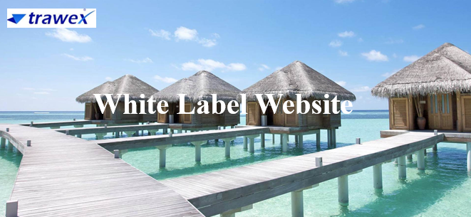
White Label Website
Email id : contact@trawex.com

Slide 2
White Label Websites - Flexible and Scalable System to Help You Adapt to Market Trends
Trawex white label platform is an ideal white label website solution for travel agents who want to get best B2B/B2C white label travel website/booking engine and build brand presence without huge investments.
Leverage our White label booking systems to earn higher commissions than competitors. Utilize our expert marketing & account management team to increase traffic and enjoy unparalleled customer service. Generate higher online ticket sales using our white label solutions and gain access to a worldwide audience. Our White Label Website solutions is a customized travel services solution for your site. We will provide the technology and support required to run the travel services through your own site.

Slide 3
A Highly Flexible White Label Booking Engine
White Label Website Solution Adds an Ultimate Value to Your Website
Trawex White label booking engine can transform your website into an all-in-one travel portal. Integrated seamlessly into your existing or new website, our platform also allows for the creation of customized Vacation packages supporting every part of your customer's travel needs.
The technology enables travel companies to spread different products across multiple specialist websites.

Slide 4
The Trawex White Label booking engine enables travel websites to tap into one of the largest collections of travel products in the industry, including 90,000 hotels , more than 1,000 attractions, activities, tours, festivals and events, 1,500 unique holiday packages, 1,000 hotel deals, 450 airlines, and 25 rental car companies under contract.
The white label technology allows distribution of all products, yours and 3rd parties.
This provides yet another opportunity to maximise your distribution and market share.

Slide 5
Implementing our White Label travel portal in website of travel agents allows them to earn more travel bookings, enhance customer experience and build brand loyalty in travel market.
Trawex is leading Travel Technology Company provides best white label online travel portal solution which is best for online portal of travel agent, online travel agencies, tour operator and travel management companies and automate travel business processes in a cost-effective manner to expand brand visibility and increase business profitability.
White Label Online Travel Portal is easy-to-use and feature-rich travel portal that attract more customers thereby increasing website traffic.

Slide 6
Using our White Label online travel portal Integration, travel agents offer customers one-stop solution or single platform to book their hotel, flight, travel and holiday packages.
White Label Online Travel Portal allows easy integration of white label solution in online travel portal of travel companies and enables them to sell travel services like flights, hotels, tours, transfers and packages through their website.
White Label online travel portal software is beneficial for travel companies as it increases direct bookings from customers and allows them to create customized tour packages to support every travel requirement of customers.
White Label Travel Portal directly integrate rates & availabilities for hotels, flights, etc., from multiple travel suppliers into online travel portal or travel website of travel agents and travel companies in an easier way.

Slide 7
Features:
A Wealth of Travel Reservation Products
You can choose our many travel categories to feature on your site with our booking engine tab widget. When viewed, each tab shows related products, all searchable by interest or type.
Because of your involvement in travel sites, you have an edge over newcomers. You should have no concerns about order processing or credit card processing.
Once set up, your account manager will send you updates on the latest trends, technology, strategies in the online travel industry, top selling events, on-sale dates, and much more to help you best promote the inventory through your website.
We have an abundance of tools, APIs, Widgets, and templates that you can use to customize your site.

Slide 8
Trawex White Label is an ideal solution for those travel agents who are not willing to invest lots of time and energy in building a B2B/B2C white label travel website/booking engine, however, they want to have an online presence. Trawex is a one-stop White Label Travel Portal solution provider for all the technology needs of travel agents, consolidators, and tour operators.
Our White label travel portal effortlessly allows the creation of customized tour packages supportive every part of your customer’s travel requirement. Our White label travel service can be the ultimate value addition that would attract more and more customers to your website.
Our White label travel solution for travel agents can improve travel business with their B2B white label travel portal or through B2C white label solution.

Slide 9
Trawex White Label option a ready-to-go co-branded or white-labeled template solution gives site visitors an easy way to plan their travel bookings using your website while seeing your own branded name and your customized website design as per your needs.
You can choose your own theme, upload your own logo, and much more. Our solution is best for both startups in travel business and established companies, Entrepreneurs or those who are looking forward to earning their pie in the industry.
We have worked with plenty of businesses over the years to develop custom designed white label websites. We aim to deliver our customers with complete travel solutions that simplify their business processes within the shortest time frame.

Slide 10
Contact Us
For more details, Pls visit our website:
https://www.trawex.com/white-label-website.php
Email id : contact@trawex.com

