Slide 1

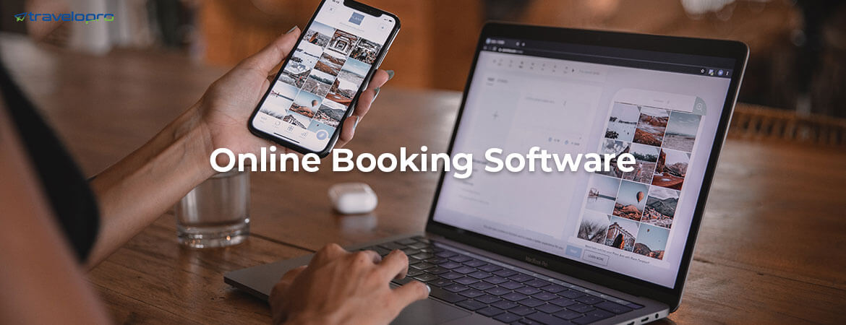
Online Booking Software
Email id : contact@travelopro.com

Slide 2
What is online booking software?
A software programmer known as an online booking system enables prospective clients to make reservations and payments for a service or activity through your website, social media platforms, and various devices.
Customers can use your online booking service at any time, from anywhere.
A booking system tailored to your requirements can streamline and enhance your customer service while enabling workload visualization and assessment through process and operation optimization.
Booking online has greatly simplified things for both agents and clients.
What is online booking software if not a more reasonable, precise, secure (due to payment) and frequently more convenient way to handle reservations and bookings?
With automation and other technologies, online booking software aims to maintain a smooth, effective, and productive booking process by streamlining and simplifying the process.

Slide 3
How does the Online Booking Software work?
Every feature, layout option, and step in the online booking software has been thoughtfully designed to provide the best user experience for your customers and help you capture more sales.
The intuitive booking process — from selecting a service to picking a provider and a time and paying online — helps to reduce cart neglect.
While the highly customizable interface can be completely personalized to match your branding and provide a seamless transition from your website to your booking platform.
They choose the time and date from available calendar slots and enter their contact information.
Without ever leaving your website, your client can select the kind of service the meeting is for and instantly pay any consultation fees.
Your calendar is automatically updated with scheduled booking. The email or notification you receive will depend on how it's configured.
You get access to information on staff activities, notifications, the number of scheduled meetings, and the recipients of invoices. Additionally, you can schedule a client's booking.

Slide 4
What Are the Benefits of Online Booking Software?
Simplification: Streamline bookings and reservation procedures for customers.
Automation: Real-time information, updates, and communication.
Review Feature: People can add ratings and reviews to the booking that they have made
Payment Security: Secured, assured, and convenient payment mechanism.
Bookings 24/7: Anytime, anywhere bookings with an online platform.
Advance Search/Filters: People can use the advanced filters to search for bookings that they want to make
Productivity: Reduce hours and optimize time for managing booking activities.

Slide 5
Efficiency: Lessen customer requirements, especially for repeat bookings.
Accessibility: Easily access needed data from a central location wherever you are.
Mobility: Manage, enable, and oversee bookings with your mobile device.
Integration: Work with third-party apps and services directly from your booking platform.
Favorites Feature: People can add bookings to a list so that they can find them easily next time they visit the site

Slide 6
What Are the Features of Online Booking Software?
User-friendly – Any type of user must find the platform straightforward to use. It needs to have simple navigation that guides the user to the next action after, say, completing a form, choosing a service, choosing a time slot, and making a payment.
Payment processing – Deposits and payments should be accepted and processed by the booking software in the most practical, quick, safe, and effective way possible.
Integration – It needs to be able to interact with your office apps, link to your payment system, and sync with your website and social network pages.
Calendar – This function monitors and notifies you of schedule changes, commitments, and bookings. To ensure that clients only view pertinent booking information, the calendar should be shareable and customizable.
Data management – It must include reporting capabilities, a centralized repository for consumer and business data, and the ability to gather and analyze data such as daily, weekly, and monthly booking volumes.

Slide 7
Inventory management system – Every booking service you provide must be able to be sorted, itemized, and organized, and it must be able to automatically update the inventory with new items.
Automated updates – Together with sending real-time notifications and reminders, it must offer real-time and automatic updating of booking details, pricing, bills, and the like.
Mobile device compatibility – For clients, agents, and staff to access booking information anytime, anywhere, the software should be compatible with mobile devices.
Customer support – Users of software should always have various ways to contact the vendor or support staff with any questions or concerns regarding system malfunctions.
Make Data Driven Decisions – Monitor Business performance and get insights for growth.
24/7 Appointment Scheduling – Booking can be done by clients from anywhere at any time. In your booking widget, include information on business days, working hours, staff availability, real-time services, time buffers, and block time.

Slide 8
Why Choose Travelopro Online Booking Software?
Travelopro has developed online booking software to make things a whole lot easier for both the travel industry and your customers.
Travelopro provides an all-in-one booking platform that can handle all kinds of business and also provide scalable solutions to fit your particular booking requirements and budget.
Travelopro is an online booking system with a focus on the Travel, Car, Hotel, and flight industry. Super easy to use and also super cheap.
It has the most important features but without unnecessary fuss. An online platform in the cloud, on which you can offer your rental objects in order to book.
With Travelopro, guests or clients can quickly and easily make a booking on your own website.
Thanks to its multi-purpose operation, Travelopro can be used for different types of rental objects.
So, if you run a campsite with a car rental, you can combine both in this booking system.

Slide 9
Contact Us
For more details, Please visit our website:
https://www.travelopro.com/online-booking-software.php
Email id : contact@travelopro.com

