Slide 1

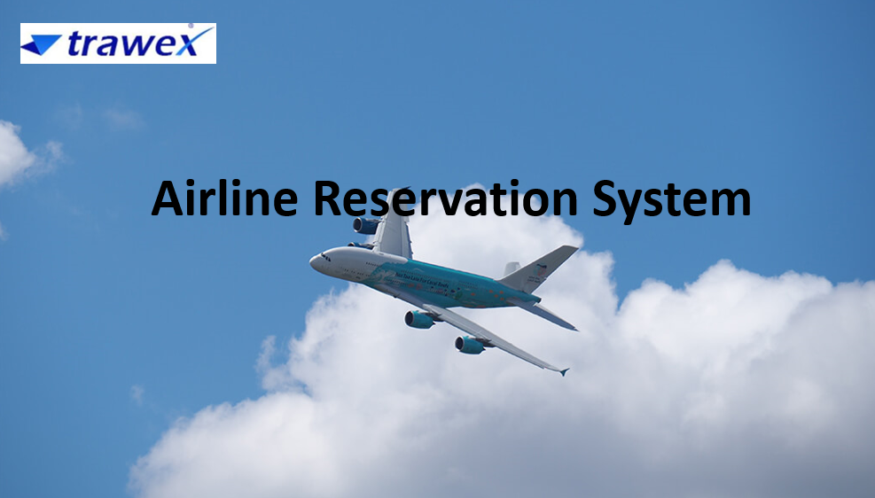
Airline Reservation System
Email id : contact@trawex.com
Phone No : 77600 34800

Slide 2
What Is Airline Reservation System?
Whether you are a startup airline selecting an initial system or an existing airline choosing to replace outdated technology, Trawex Airline Reservation System provides the features that will allow you to lead your market. Instantly react to competitive market conditions with intuitive access to all key parameters including fares and inventory.
Control all your sales outlets whether web, agent or GDS based. Quickly establish alternative revenue sources such as seat selection and ancillary products.
Trawex is the Flight Reservation System for the future. In fact, there is no Airline Reservation System better prepared for innovation than Trawex. It combines the ease of use and flexibility that modern airline businesses require the traditional capabilities that allow inter-airline collaboration.

Slide 3
Designed specifically for the low cost/hybrid airline sector, Trawex allows airlines to maintain a primary low-cost ticketless business model with direct sales/distribution, while simultaneously enabling IATA standard e-ticketing, supporting code sharing, interlining and conventional GDS connected travel agency sales distribution.
With a truly customer-centric approach with a mega customer record repository at its core, the system integrates data and information from social media, enabling powerful self-service options while linking PSS and loyalty.
Streamline your operations from route scheduling through to passenger boarding with an integrated system. Easily configure all the functionality you need to manage your revenue while also allowing you to quickly adapt your sales model to changing market conditions.
Today, a reservation system needs to do more than ensuring receipt of a flight ticket. The system should be adaptable enough to provide passengers a wholesome flying experience.

Slide 4
This is why a lot many forward-looking airlines are taking a hard look at their inflexible and revenue draining legacy reservation systems.
As an increasing number of airlines ponder a change in one of the most critical business systems, they are faced with a set of very complex decisions which has important commercial overtones. Choosing the right partner with the right capability is the key.
Trawex provides a travel distribution and traveler service system software used for airline commerce, bookings, and distribution. Airline Reservation System Software is required to manage flight ticket booking, scheduling flights, delivery of necessary information to the end-user.
To be competitive within the market in terms of turnover, goodwill and profit generation it's necessary for the airline companies to own an efficient and best reservation system.

Slide 5
The Airlines Management System has benefited each airline industry and therefore the client moreover.
For the airline industry, it's edges like the accuracy of the knowledge, breakdown of grievances of the client, getting the faith of customers, building goodwill within the market and increase within the surplus, etc.
For the client, it's benefits such as simple and timely access of data, the safety of their cash, a saving of your time, worth comparison, flight ticket software, ease in reserving and getting offers from many airline companies.
We have a tendency to a dominant travel technology company providing travel technology products to companies engaged within the travel sector.

Slide 6
Our products assist travel businesses in delivering simple services to their guests. we have a tendency to deliver travel technology products for hotels, Flight booking Engines, relocation, excursion, and customized packages, etc.
We have deployed our work toward enhancing the efficiency of the B2B travel booking system, B2C and B2B2B company universally.
We have a tendency to use cloud-based and absolutely integrated solutions that give support to all or any airline models. We have a tendency to designed entirely new technologies to produce a versatile system and business model for extremely economical operations.

Slide 7
Why An Online Airline Reservation System Is Required?
Through API/XML integration of GDS like Amadeus, travel website we have a tendency to facilitate in upgrading end-user expertise by providing them updated info as per their want. We offer business processes to fill your airplanes, logic for your front lines, and technology to require your airline to ensuing level.
Our Airline Reservation System provides modern, flexible reservations and inventory management solutions for Airlines together with a call centre, travel agency, internet engine, GDS and online booking.
By executing our system, airlines will make sure that bookings will be created not only by their airline staff but also by travel agents using a GDS system or further airlines that have a naturalized Interline Traffic Agreement utilizing our interline interface.

Slide 8
The systems also offer airline management support by subscribing financial, executive, back-office issues, organizing, and airline load data, decision help to control of overbooking, supply seat allocations and submit management that can be used to balance the number of special fare seats based on a number of bookings.
Airline ticket representatives can access the reservation systems to make flight arrangements, view current bookings, and check traveler lists, as well as several different responsibilities. Airline agents, as well as travel agents, can issue both paper tickets and e-tickets for a booking made on the system that conforms to the IATA customary.
E-tickets are provided online via the internet reservation engine for any reservation created by the general public. And our traveler booking and distribution system offers integrated solutions and powerful superior technologies that assist airlines of all business models to grow.

Slide 9
Our ARS software maintains customer information in case of emergency, e.g. flight cancellation due to inclement weather.
The airline companies will use this profile to track user choice and travel patterns to serve them better, plan routes, for better marketing and effective scheduling of flights.
It will help to raise the revenue of the airline company by various means: make aware of frequent travelers about various offers and discounts, reduce the number of vacant seats on a flight and boost flight limit usage, and keep up the capacity to adjust an adaptable evaluating strategy.
The fare of the tickets should be determined based on how early, before the date of departure and the customer buys the ticket. Our Airline Reservation Software (ARS) will help you to make transactions like air ticket booking, which also includes blocking, reserving, cancelling and rescheduling the tickets.

Slide 10
It will minimize repetitive work done by the system administrator and reservation clerks which has consistency among different access modes, e.g. by mobile, online, at the inquiries, and across various locations.
The users should be taken through the same steps by the system as they go through in conventional desk-reservation systems. we have a tendency to touch a broad vary of client and business management pillars.
We have a tendency to conjointly offer an excellent platform for addressing recognized business issues and raising the chance bar for all sizes of business models. We enable airports and airlines to sell ancillaries, tickets, and airport services to their customers by using multiple distribution channels.

Slide 11
We offer business processes to fill your airplanes, logic for your front lines, and technology to require your airline to succeeding level. With intelligent design and smart options, we have a tendency to facilitate airlines to keep profitable.
Trawex is a Travel Portal Development Company offer excellent travel software development solution, Web Design and Development Services.
We offer Travel Portal Design and Develop Such as B2B Travel Portal, B2C Travel Portal, XML API Integration and many more with best features such as multi-language, multicurrency, high speed, low rate and many more.

Slide 12
CONTACT US:
For more details, please visit our website:
https://www.trawex.com/airline-reservation-system.php
Email id : contact@trawex.com
Phone No : 77600 34800

