Slide 1

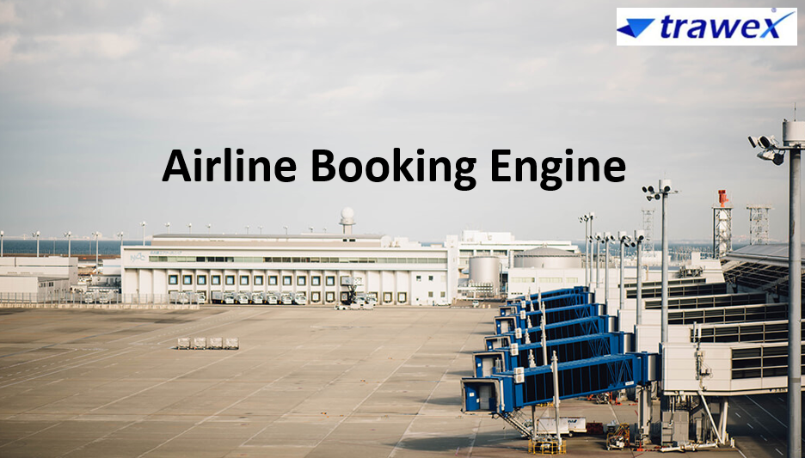
Airline Booking Engine
Email id : contact@trawex.com
Phone No : 91485 87111

Slide 2
Full Featured Airline Booking Engine to Fit Any Device
Greetings to a web of confusion on online air tickets. Here is some help. The first lets you buy the tickets through the Airline Booking Engine.
The second kind searches a list of the first kind for the cheapest price and then directs your purchase through the consequent site. Trawex Technologies understands that your privacy is important and therefore we will only use the personal information collected through your use of this web site for the purposes set out in this Privacy Statement.
The expense of flights is proceeding to increase around the world, rising fuel costs and decrease in competition means that flights are only going to get more expensive.

Slide 3
To help international students out, we have partnered with Student Universe to offer cheap, low cost international and domestic airfare options to our customers all over the world.
The flight booking system comes with features such as management of ticketing, refunds, cancellations, schedule of flights helping the travel intermediary to minimize cost incurred with distribution.
To start the process, please use the search tool on this page and it will look through their database of flight options to find the best solution, and hopefully the cheapest solution for you.
Through our transporters or carriers, customers can utilize Sea Freight Forwarding, Air Freight Forwarding, Custom Clearance, Rail Transportation, Crane hiring or Truck Transportation and are provided with an online tracking system.

Slide 4
Along with frequent modifications in IT analysis development tourism around the world has improved greatly and productively.
We bring you travel application development as a main travel technology to help you make your travel more useful, much safer and a life time experience by our world class technology solutions in travel applications.
Trawex Technologies is offering the services for the clients with awesome results in Travel web Application development. We give Travel web Application to satisfy the demands.
We have over wide experience to satisfy all requirements in Travel web Application development. Trawex Technologies offers high quality services to a wide range of areas related to travel and transport.

Slide 5
Our web development service can definitely improve the business operating and maintaining good customer satisfaction.
The functioning of these portals helps users to choose the suiting mode as per the requirement.
They manage all aspects of planning trips to the site or portals.
The transportation Website Design includes transportation services, tickets, packages, places.

Slide 6
Benefits
An end-to-end solution.
Low cost
Access anywhere, anytime
Increase income

Slide 7
Trawex provides ‘Airline Booking Engine’ used for airline merchandising, bookings, and distribution.
The airline booking engine is a platform in airline reservation software systems that are needed to manage air ticket booking, e-ticketing, scheduling flights, and delivery of necessary information to the end-user.
To be aggressive in the market as far as turnover, goodwill and benefit age it is fundamental for the airline organizations to have compelling and best booking platforms.
The Airlines Management System has profited both the airline business and the client too.

Slide 8
For the aircraft business, it has preferences, for example, the exactness of the information, settling complaints of the customer, getting the confidence of customers, building goodwill in the market and an increase in the surplus, etc.
For the customer, it has favourable circumstances, for example, basic and convenient access of information, the security of their money, a sparing of time, value assessment, flight ticket programming, ease in holding and getting offers from a couple of airline associations.
We are a dominant travel technology organization offering travel technology items to organizations occupied with the travel division. Our items help travel organizations in delivering simple services to their guests.
Through API/XML integration of GDS such as Amadeus, travel website we help in upgrading end-user experience by providing them updated information as per their need.

Slide 9
We give business procedures to fill your planes, rationale for your bleeding edges, and technology to take your carrier to the following level.
We also deliver travel technology products for Flights, Flight booking Engines, relocation, excursion, and customized packages, etc.
We have deployed our work toward enhancing the efficiency of the B2B travel booking system, B2C and B2B2B corporate universally. We use cloud-based and completely incorporated arrangements that offer help to all carrier plans of action.

Slide 10
End To End Air Ticket Management System Solutions for Travel Agencies
Trawex is built entirely on new technologies to provide a flexible system and business model for highly efficient operations.
Our advanced system provides an excellent platform for streamlining operations, controlling costs, and achieving optimal performances.
Trawex is a popular Travel Technology Company, delivering best in class travel internet booking engines (IBE)’s to clients across the globe.
Trawex Best Airline Booking Engine/ Airline Tickets Engine will help your business increase revenues while it automates processes and reduces the time and effort required to complete an airline booking.

Slide 11
Our Airline booking system incorporate airline schedules, fare tariffs, passenger reservations and ticket records. Trawex is a leading Amadeus Airline Reservation System development company, we can integrate Amadeus reservations to provide unique travel software for travel companies.
Our Reservation System to access the inventory for everything travel related to flights, car rentals and bus bookings. Our platform pre -integrated with Sabre Airline Reservation System and Customized Airline Booking System that offers a broad range of software and to help airlines market.
Our Online Booking Engine is a Business (B2B), Business to Consumer (B2C) and Business to Business to Consumer (B2B2C) application.

Slide 12
We develop, integrate and utilize air ticketing systems by integrating GDS and Non-GDS APIs. We practice in many GDS Integrations services including World span, Galileo, Amadeus, and Sabre.
The GDS union services we offer for flights. Whether you are a large, small, or medium-sized block-and-combine travel agency, a specific tour operator or a general web consolidator, Amadeus GDS software is it’s complex and unique.
It prepares the largest number of transactions daily and has grown a leading GDS software and a major travel content aggregator globally.
As a travel portal company, Trawex produces Custom Travel Software with various modules for B2B, B2C, and corporate.

Slide 13
When we develop your travel portal, it will offer seamless online booking and online travel management tools with Amadeus Software system integration.
The portals will connect all the information in real-time. It will provide ‘live availability’ information for flights scheduled worldwide and books of all, including, low-cost carriers in the domestic and international market.
We are a Flight Booking Software development company, offering airline booking system with Amadeus GDS Integration.
We provide Amadeus Airline Booking System combination service for IATA travel agencies, tour operators and travel companies.

Slide 14
Services we try include- Amadeus web service integration, Amadeus XML API integration services. Technically, Amadeus airline bookings are regarded as user side system for airlines.
We develop Flight Booking Software with the use of globally accepted applications. This engine lets travelers search for global destinations, register and make PNR by making an online payment.
Airline Booking Software (ABS) is online application software used to retain, retrieve information and perform transactions related to air travel.
Originally designed and performed by airlines, ABS was later developed for the use of travel agencies. Global distribution systems (GDS) are the process of book and sell tickets for multiple airlines by the major ABS operations.

Slide 15
The Airlines have regretted most of their direct holdings to dedicated and committed GDS companies, who made their systems accessible to customers through Internet gateways.
Modern GDS is providing services like booking hotel rooms and rental cabs as well as airline tickets. They also provide entry to railway reservations in some areas even if these are not always in touch with the main system.
Our Airline Booking Software is a well-aligned reservation system integrated with global GDS systems including Amadeus, Galileo, and Sabre, which stabilizes the data from all the airlines.
The customized booking engine associated with our special GDS systems gives far superior inventory and rates to the clients and travel organizations.

Slide 16
Global travel organizations are going for online airline reservation applications simply because of 24x7 accessibility and live appointments.
Increasing bookings directly equal to scalable revenues. This can happen when you have an efficient Airline booking software added with a value-added cab and room booking system. Different objective reservations help to set up the fact that your travel site offers huge amounts of highlights.
Being easy to use by the customers depends largely on the fact that you fix an interactive and user-friendly air ticket booking API with additional add-ons of the reliable cab and hotel booking engine.
Whether you are a travel agent and you are doing an airline or hotel booking system, you can upsell various travel features within a matter of time in few clicks.

Slide 17
CONTACT US:
For more details, please visit our website:
https://www.trawex.com/airline-booking-engine.php
Email id : contact@trawex.com
Phone No : 91485 87111

