Slide 1

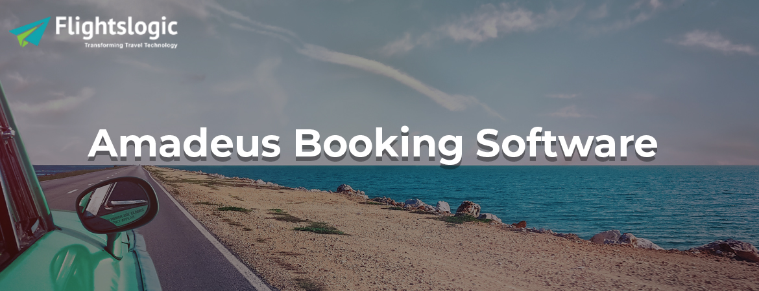
Amadeus Booking System
Email id : contact@flightslogic.com
Phone No : 97312 78600

Slide 2
Supercharge Your Travel Business With Amadeus Booking System
Flightslogic is a leading software solution provider of airline operations to travel industries globally A flight reservation system is an online instrument utilized by travel agencies (both IATA and Non-IATA operators) for a problem-free flight booking experience for their clients just as their accomplice travel specialists.
Within a short time period, FlightsLogic has become a world head in giving the travel business better arrangements than deal with the appropriation and selling of travel services.
We consistently improve our products and services with the advantage of contribution from our different client bunch who effectively takes an interest in discussions.
Along these lines, we guarantee that the solutions we offer satisfy the necessary desires. Our products and services are utilized by our unmistakable client bunches in differing manners.
Nearly 75.000 travel agencies and more than 11,000 airline sales agencies use the FlightsLogic Services to run their business.
Many of the business' driving travel service providers utilize our modular technology to improve their dispersion and inside operational requirements.

Slide 3
Why Amadeus Booking System Is Important For Travel Industry?
Our Airline Reservation System integrates with the Amadeus GDS System allow its end users (B2B or B2C) to have real-time inventory and best prices. The system additionally supports multiple currencies standards and multiple payment gateways.
Amadeus GDS is one of the most preferred GDS systems, offering the best deals on flights to travel management companies.
Amadeus GDS helps travel agents and organizations to serve the traveler to grow their business all-inclusive by helping their clients to get the best arrangement.
Amadeus is a principle trade processor for the overall travel and the tourism industry, giving exchange handling force and innovation solutions for both travel providers (counting full-service carriers and low-cost carriers, hotels, rail operators, cruise and ferry operators. car rental organizations and tour operators) and travel agencies (both on the web and off the web).
The organization acts both as an overall system interfacing travel suppliers and travel agencies through a profoundly viable processing platform for the conveyance of travel products and services (through our distribution business), and as a supplier of a far- reaching arrangement of IT arrangements which computerize certain strategic business forms, for example, reservations, inventory management, and activities for travel suppliers (through our IT arrangements business).
A Computer Reservations System (CRS) is a modernized system used to store and recover data and lead exchanges identified with air travel.

Slide 4
Features of Amadeus Booking System
Flight XML API Integration (International & Domestic)
Hotel XML API Integration (International & Domestic)
Bus API Integration
Car API Integration
Manage Holiday packages
Agent Registration
Sale Report
My Booking
Hotel Booking CRM
Add Fund/e-Wallets for Travel Agent
Quick View Booking
Chat API Integration
Discount Coupons for agent/Client
Booking Management module
Special Offer / Deals
Trip Advisor plugin integration
Payment Gateway Integration
Agent Login
Customer Login
Markup Management module
Discount Management module
User Management module

Slide 5
Amadeus GDS integration for the flight booking system
Amadeus booking system gives a Computer Reservation (CRS) System, which causes Travel Agents to grow their booking by circulating aircraft and non-airline content to distribution channels.
It gives ongoing information, getting to continuous refreshed information about flight status and rates, reserves online reservation easy! Integrating Amadeus GDS (global distribution system) to your booking engine or travel portal can provide huge real-time data to book flights online!
A portion of our Flight Booking System benefits Include GDS availability, 24/7 appointments. Increase advertise reach, wider distribution network.
We are among the best flight GDS Integration suppliers. We have a team of expert developers who have experienced professionals when it comes to airline booking system development and integration for Travel Management Companies, Online Travel Agencies, Tour Operators, Mobile Solution Providers, and Corporates.
To discover how we can enable your business to use Amadeus GDS Integration, talk about your necessities with our business group today.
A flight booking system is an online tool utilized by travel agencies (both IATA and Non-IATA specialists) for a problem-free flight booking experience for their clients just as their accomplice travel agents.
The system incorporates well known GDS systems around the world like Amadeus. Sabre, and Galileo permit its end clients (B2B or B2C) to have continuous inventory and best costs. The system also supports various currency forms and numerous payment gates.

Slide 6
The airline reservation also supports uploading of self-contracted inventories provided by partner flight suppliers of the agency using the software.
The system likewise comes with simple usefulness of XML Out utilizing which travel partners can share their inventories. The end-user interface of the system works very similarly to an e-commerce website where the customer can choose the desired airline and proceed with the booking process.
Global Distribution System is server-hosted web services that offer deals on booking of travel products like flights, hotels, transfers and holiday packages around the globe.
A GDS system is a search-based system that permits clients to search for travel products from the providers around the globe and the system will return results with constant evaluating and accessibility comparisons. Users can book and process the travel deals that best suits their requirements.
GDS system has evolved from processing flight bookings only to processing bookings of hotels, cars, and buses, etc. GDS systems structure the base of online travel software.
Online travel organizations and clients overall use travel programming coordinated with GDS systems to book travel services they need.
Amadeus, Sabre, Galileo, and Worldspan are the four significant GDS systems being utilized by over 300K IATA operators and few non- IATA travel agents from all over the world.
FlightsLogic provides Booking System by integrating with Amadeus Global Distribution System allowing end users to book flights from different LCCs and airline companies.

Slide 7
FlightsLogic Amadeus Booking system
Flightslogic gives consulting, development for all the parts of B2B and B2C Amadeus GDS/Amadeus XML/Amadeus API Integration.
The Amadeus Booking System / Amadeus Software includes Amadeus Airline Reservation System, Amadeus Flight Reservation.
System. Amadeus Airline Booking System, and Amadeus Airline Booking Software, Amadeus GDS helps to manage your travel business, reducing costs and increasing revenues.
Incorporating Amadeus GDS to your booking engine can give tremendous continuous information to book flights on the web. Along with this it also provides accurate details about flight status and rates, makes online reservations easy.
Amadeus GDS system is the most worldwide utilized booking system for all airlines which gives the expert and successful travel portal solution for travel agents, tour operators, and travel organizations around the world.
It helps the agents and clients to deliver comprehensive travel itineraries quickly and efficiently. With Amadeus API incorporation your travel site will permit you to look through ideas from over 900 aircraft and 500000 hotels in 50 nations across 4 continents.
Flightslogic offers one of the most complete Amadeus travel software that solidifies different travel services at a single portal.
Flightslogic pre-integrated with Amadeus airline reservation system which allows overall information about flight schedules, availability of seats and ticket fares from multiple airlines.

Slide 8
FlightsLogic Amadeus Booking system is the most worldwide utilized booking system for all airlines which gives the expert and successful travel portal solution for travel agents, tour operators, and travel organizations around the world It helps the agents and clients to convey complete travel agendas rapidly and productively.
With Amadeus API integration your travel site will permit you to look through ideas from over 900 airlines in 50 nations across 4 continents.
Flightslogic offers one of the most extensive Amadeus travel software that merges different travel services at a single portal.
Flightslogic pre-integrated with Amadeus airline reservation system which allows overall information about flight schedules, availability of seats and ticket fares from multiple airlines. We incorporate Amadeus GDS to get to the inventory for the flights. ticketing, and other terminal services.
Our Amadeus booking system has been presenting technological and dynamic business solutions dependent on the technology of things to come in the developing complex market, exceptionally serious and a delicate business condition.
We offer services that are comparatively radical and along these lines, unrivaled in the technology field. Our Amadeus GDS is picked the time and again over its competition because of an exhaustive offering of tweaked devices no matter how you look at it in the travel business.
Our best, proficient and easy to use software tools help to oversee sales exercises and office networks while corporate travel management solutions grant business travelers to book game plans from their work area.

Slide 9
Advantages of Amadeus Booking System
Increase Income:
Travel industry-leading solutions help clients to augment their income from existing channels and investigate new ones, in this manner keeping their organizations effective, both now and later on.
Diminished expenses:
Amadeus solutions are planned to expand productivity through comfort. Persistent development and improvements to the solutions incorporate the fuse of best-in-class graphical interfaces, making it simpler to book travel while Business Management solutions incorporate value-added highlights that expansion effectiveness sparing time and cost.
Administration Differentiation:
Amadeus structure solutions might be redone and customized with the goal that travel providers and vendors can convey the best client service and advantage from expanded appropriation and client dedication.
Simple framework movement/network:
The blend of Amadeus strong driving edge technology and inside learning of the travel business permits a consistent combination of arrangements.

Slide 10
Amadeus Flight Booking System
The airline booking system is an online booking engine associated with worldwide GDS systems including Amadeus, Galileo, and Sabre which merges the information from all the aircraft. The booking engine integrated with the GDS system gives better inventory and rates to end clients and travel agencies.
Worldwide travel organizations are going for online airline reservation software in view of 24/7 accessibility and constant appointments.
In fact, aircraft booking systems comprises of the trading of information through the worldwide appropriation frameworks sub as Amadeus, Galileo/Travelport or Sabre, which unites the overall airline accessibility and valuing data and offers through web services APIs/XMLS.
Utilizing these web services on the airline reservation system interface, the data for the aircraft availability and pricing can be distributed on a companion GUI interface. The end-client can choose the flight and continue for the booking.
Over the most recent couple of years, travel agencies have demonstrated more prominent dependence on the aircraft reservation system, travel technology and portability solutions to grow.
With round O clock accessibility, incredible client engagement multiple display choices and dynamic packing are key focuses for these aircraft reservation systems to succeed.

Slide 11
Features of Amadeus Flight Booking System
The flight booking engine for the site gives quick and online reservation facilities to the users.
Manage your agent's list and bookings List, markup management, discount management
Online payment opportunity is available for the booking producers
Appealing pennants are accessible for advertisements
Notification through email with respect to ticket appointments, cancellation, and flight delayed, etc.
User can manage and cancel their bookings through the online booking portal
Provide discounted and offered fair to your customer.

Slide 12
Contact Us
For more details, Please visit our website:
https://www.flightslogic.com/amadeus-booking-system.php
Email id : contact@flightslogic.com
Phone No : 97312 78600

