Slide 1

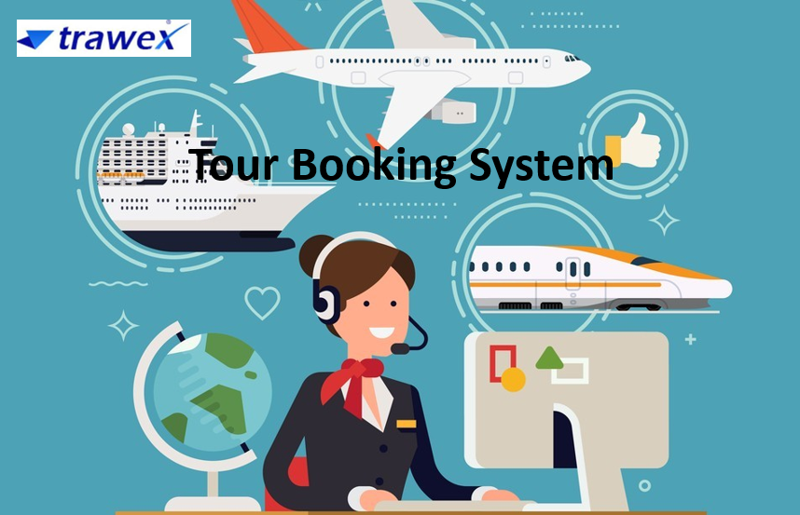
Tour Booking System
Email id : contact@trawex.com
Phone No : 91485 87111

Slide 2
What is Tour Booking System?
Tour booking system is an essential technology solution mainly designed for tour operators to streamline their process of managing and facilitating tour reservations. It helps the Travel Company to organize tours to manage customer information, back-office activities, tour information, accounting, and reports.
Furthermore, tour booking software is a feature-rich, user-friendly booking system designed for travel agencies who wish to provide their clients with a large selection of local tours, excursions, and experiences in one place.
The primary purpose of tour booking software for any tour operator business is to make it easier for businesses to manage bookings, customer information, payment details, and other operational tasks.

Slide 3
An online reservation system lets tour operators’ package and sell their tours online. They will combine flights, hotels, activities, and transfers from any part of the world and sell them as fixed or custom packages. It is useful for inbound and outbound tour operators as well as activity/excursion providers.
With this software, travel companies can easily organize tours to manage client’s data and information such as tour information, back-office activities, booking, accounting, and reports. A tour booking system or online tour booking website streamlines the booking process for customers from all over the world by providing a tour booking quotation system that eventually increases booking and revenue for the business.
Tour operators can easily integrate tour operator reservation systems into their travel websites, allowing 24/7 access and quick response, preventing the loss of potential bookers.

Slide 4
How do you choose the right Tour Booking System?
Implementing a suitable tour operator reservation system is an essential choice for tour operators in the travel industry. An effective tour booking software can change your entire tourism business game.
If you are searching for the best tour operator booking software, you are at the right place. Trawex builds Tour Booking Software that helps travel specialists including tour operators, destination management companies, and travel agencies to interact efficiently with their clients’ requisites.
We build a tour booking system that meets all the needs of tour operators and travel agencies to keep up with new trending technologies and lead to increased revenue for their tourism business.

Slide 5
Why go for our Tour Operator Reservation System?
Trawex’s tour operator booking software provides a versatile and powerful solution for tour operators looking to thrive in the ever-evolving travel industry. Trawex enables operators to simplify their processes, improve customer experiences, and easily adjust to changing marketplace dynamics thanks to its extensive feature set, modular architecture, and dedication to customer-centricity.
The unique feature of our tour operator software is its ability to increase consumer reach and return on investment, enabling you to achieve exceptional success in all aspects.
Our enterprise specializes in creating tour management software for DMCs and tour operators. From inquiry to itinerary creation, it is an all-inclusive solution for managing the tour cycle.

Slide 6
The software manages a wide range of business operations for Destination Management, Tour Management, Excursion Management, Fleet Management, MICE Solutions, and Financial Accounting.
Trawex's Online Travel Management Software is affordable and can be modified based on your needs. We provide a comprehensive, expert travel software system that is integrated with online booking technology. We also focus on delivering end-to-end solutions for travel reservations, hotel reservations, back-office, and distribution systems.
For managing the daily schedule of tours, the tour module integrates seamlessly with the itinerary module. Our tour management system features an intuitive UI, complete with all the features required to turn a booking into an actual trip with real-time traveler tracking.

Slide 7
Using this software, travel agencies can manage client data and information, including tour details, back-office operations, booking, accounting, and reports, to arrange tours with ease.
Our Tour Booking System helps increase the web presence of their tourism business and drives travelers directly to their tours and excursions. We provide the world's best tour booking system for vacation, activity, tour, and package reservations.
Our tour booking software is designed to meet the needs of travel agencies and tour operators, enabling them to stay up to date with emerging technology and boost their revenue streams.
The tour software can be fully customized with the integration of travel APIs for travel deals and payment gateway. By integrating GDS, Hotel XMLs, and Car API one can allow the guest to customize his travel plans and various bookings of flights, hotels, and transfers.

Slide 8
Our Tour Booking Software consists of:
These portals assist customers/agents in searching for and booking tours based on real-time pricing and availability via the B2C/B2B booking engine, both on the web and mobile.
Itinerary Builder: These systems create fixed packages as well as custom packages, allowing the customer to choose from a wide range of flights, hotels, activities, and modes of transportation.
Quotation Builder: It enables tour operators to share quotations for complex tours and then send them to customers via email, decreasing turnaround time and cost. It would also eventually assist in servicing more queries.

Slide 9
Back-Office: The back-office system automates management functions, allowing operators to manage suppliers, agents, customers, and accounting from a single web-based location.
Inventory Management and Channel Management: It also enables tour operators to distribute tour packages to B2B agents and resellers through a unified API. The sales channels can be managed from one dashboard.
Automate your Sales: Allow your clients to book your package excursions online, anytime, anywhere. Our websites are appealing and designed for Smartphones and tablets, enabling you to book both on the web and mobile devices. Moreover, these are CMS-based, making it incredibly easy for you to configure the platform and manage all of its content on your own.

Slide 10
Real-Time Booking: Allow your clients/agents to search and book your tours/excursions using our B2C/B2B booking engine, which offers real-time availability and pricing. Our online booking engine is incorporated with Payment Gateways, enabling your consumers a choice of payment options.
Manage your Inventory: Easily create and manage all your negotiated inventory of hotels, packages, activities, and transfers along with availability and net rates.
3rd Party Supplier Connectivity: Tour Booking System incorporated with each major supplier (GDSs/LCCs/Consolidators/Aggregators) enabled by the travel industry.

Slide 11
Key features of the Tour Booking System
Here are some key features commonly found in Tour Booking Systems:
Online Booking: Tour Booking Systems allow customers to book tours and activities directly through a website or online platform. This feature provides real-time availability and enables instant confirmation of bookings.
Real-Time Availability Updates: The system keeps track of tour availability, instantly updating it as bookings are made or cancelled. This ensures that customers are aware of current availability and helps prevent overbooking.
Secure Payment Processing: Tour Booking Systems often integrate with secure payment gateways, allowing customers to make payments securely using credit cards or other online payment methods. This feature helps protect sensitive customer information.

Slide 12
Booking Management: The system provides a single dashboard where tour operators can manage their bookings. This includes viewing, modifying, or cancelling bookings, assigning guides, and tracking sales and revenue.
Online Booking and Reservation Management: With the help of tour booking software, a user can easily view the available tour packages, check the availability of tickets, make bookings, and cancel bookings via the website or the mobile application.
Payment Processing and Integration: Some people might not trust the tour booking software at first. But, these software are safe to use as they integrate their users to a secure payment gateway. Users can pay using credit cards, debit cards, or any other currency they choose.

Slide 13
Automated Communication: Tour Booking Systems automate communication with customers, sending confirmation emails, booking reminders, and other notifications. This reduces manual effort and assures that customers receive essential information before their tour.
Reporting and Analytics: Tour Booking Systems frequently offer reporting and analytics features. This allows businesses to track key performance indicators (KPIs), monitor sales trends, and gain insights for strategic decision-making.
Mobile-Friendly: Many Tour Booking Systems offer mobile-friendly interfaces or dedicated mobile apps. This enables tour operators to manage bookings and access vital details while on the go.

Slide 14
Customer Database Management: The system allows tour operators to maintain a customer database, storing data such as contact details, booking history, and preferences. This helps personalize the customer experience and enables targeted marketing efforts.
Integrations: Tour Booking Systems frequently integrates with other software and services such as accounting systems, email marketing platforms, and customer relationship management (CRM) tools. These integrations enhance operational efficiency and offer a seamless workflow for the business.

Slide 15
How does Tour Booking Software help tour operators?
Tour operator software is a game-changer in the travel industry, offering a wide array of benefits to both operators and travelers. It streamlines operations, enhances customer service, and allows operators to stay competitive in a rapidly changing market.
Tour operator software incorporates more than just an online booking engine where customers can search and book tours based on their preferences. In addition, it gives tour operators the ability to effectively control bookings, create new itineraries, and manage existing ones, ensuring a complete solution for both tourists and tour operators.

Slide 16
Key benefits of the Tour Booking System:
Implementing a Tour Booking System for a travel business can bring several key benefits. Here are some of the key advantages of using a Tour Booking System:
Streamlined Operations: A Tour Booking System automates many manual processes, such as managing bookings, availability updates, and customer communication. This reduces operations, reduces administrative tasks, and saves time for tour operators, enabling them to focus on providing excellent customer experiences.
Increased Efficiency: With a Tour Booking System, tour operators can manage their bookings and operations from one location. This eliminates the need for multiple spreadsheets, paper records, or manual processes. By automating tasks, businesses become more efficient, minimizing errors, and reducing double bookings.

Slide 17
Real-Time Availability and Instant Bookings: A Tour Booking System provides real-time availability updates, allowing customers to instantly view tour availability and make bookings online. Customers can book tours and activities at their convenience, boosting the booking experience.
Improved Customer Experience: A Tour Booking System enables tour operators to provide a seamless and personalized experience to their customers. Automated confirmation emails, booking reminders, and other notifications enhance communication and ensure customers have all the necessary details before their tour. Additionally, a centralized customer database allows for personalized service and targeted marketing.
Increased Online Visibility and Reach: Many Tour Booking Systems offer integration with online travel agencies (OTAs) and other distribution channels.

Slide 18
Automated Booking Process: Tour booking software automates the booking procedure and makes it available 24*7 so that users can quickly create or manage their bookings. It streamlines the entire procedure and even reduces the need for paperwork and manual record-keeping.
Real-time Updates and Availability: Customers can use tour booking software to obtain real-time availability, providing them with the most current schedules and available slots. It helps by reducing the risk of overbooking and even provides the customers with the most accurate details.

Slide 19
Grow Your Tour Business with Trawex
Grow your business to reach more customers with a powerful travel technology company - Trawex. As the travel and tourism industry continues to transform, Trawex stands as a steady partner for tour operators, helping them navigate the path to success in this dynamic landscape.
Trawex is a reliable technology partner focusing on Tour Management Systems. Our wide range of travel technology solutions provides travel agencies with a competitive advantage, that's why they rely on us. Our excellent, affordable solutions can help you grow your business to new heights.

Slide 20
We provide the Best Travel Technology for travel agencies, tour operators, hotel operators, and travel corporations to assist them streamline day-to-day operations, increase operational efficiency, and maximize bookings while increasing the customer experience.
Trawex transforms the travel industry with its innovative flight reservation software. Say goodbye to the hassle of searching for flights across the globe. With Trawex, travelers can easily browse and book their desired flights online with the convenience of secure online payments. This cutting-edge software offers a comprehensive flight schedule, passenger reservation management, and thorough ticket records – all at your fingertips.
Additionally, Trawex's vacation booking software enhances online visibility. It ultimately draws maximum traffic to the travel website. When it comes to serving clients, we have no limits.

Slide 21
Each business aspires to have a personalized travel reservation system with top-notch functionality. At Trawex, we accomplish this dream of our clients. We deliver clients what they look for, and it became possible only due to our tour and activity booking system.
At Trawex, we collaborate with experts in their respective fields. That is why we recognize what features support the growth of travel companies. No matter how big or small, we address every need of our clients.
Our team at Trawex works continuously to provide the most effective and efficient solution to our clients. Grab our tour booking system to unleash the full potential of your business.
If you are a Tour Operator or Destination Management Company (DMC), looking for the best software or travel portal to increase your sales & achieve better results.

Slide 22
CONTACT US:
For more details, please visit our website:
https://www.trawex.com/tour-booking-system.php
Email id : contact@trawex.com
Phone No : 91485 87111

