Slide 1

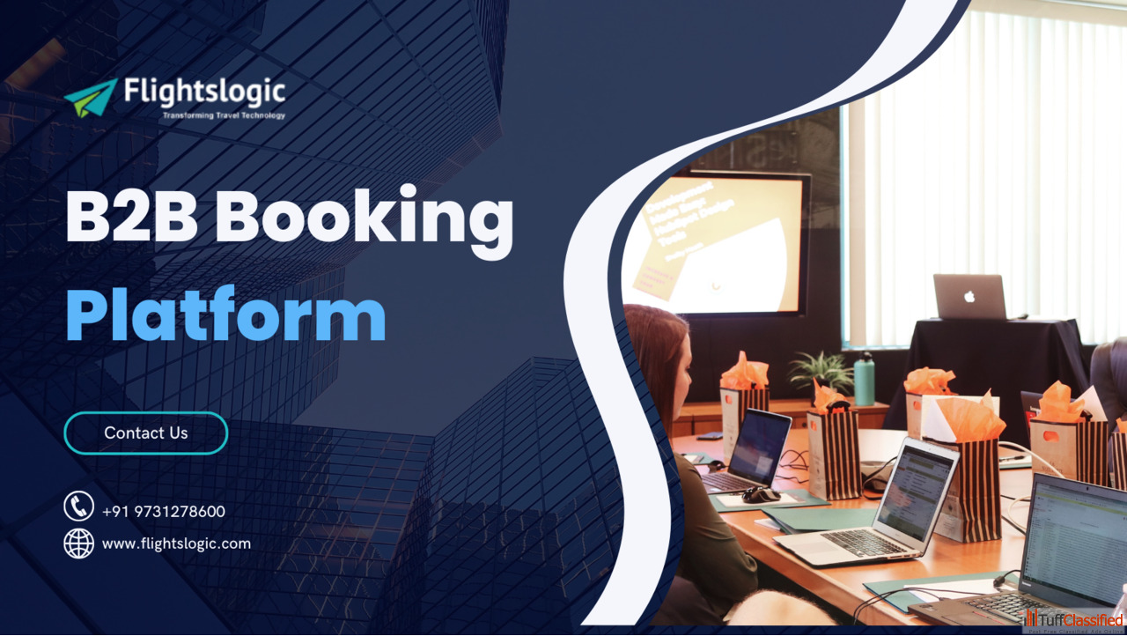
B2B Booking Platform
Email id : contact@flightslogic.com
Phone No : 97312 78600

Slide 2
What is a B2B Booking Platform?
B2B Booking Platform is an online booking platform that is designed to cater to the needs of modern travel companies. It is a flexible and modular management software that supports all the steps of a travel business process.
The platform allows travel companies to manage their bookings, operations, and customer interactions efficiently.
With a B2B Booking Platform, travel companies can easily manage their inventory, pricing, and availability across various distribution channels and partners. They can also automate their booking processes, reduce manual work, and streamline operations.
It's the perfect online booking platform for all modern travel companies, with adaptable and modular management software that covers all aspects of the travel business.
It provides a white label solution for travel agents and tour operators to access real-time online bookings and availability via the most user-friendly booking engine platform.
The B2B Booking Platform connects your customers with travel partners in various countries, allowing you to offer more diverse travel options.

Slide 3
How does the B2B Booking Platform work?
B2B booking platforms work with multiple service providers to combine various modes of transportation into a single interface This integration streamlines pricing availability, and benchmarking allowing businesses to make better decisions while saving money.
The B2B Booking Platform provides your travel agents access to a web-based booking engine, allowing them to search for and book your travel services in the name of their clients.
Your agents will have real-time access to making online bookings via a control panel where they can manage all reservation processes, as well as their sub-agents and operators.
Through the B2B Booking System, you will be able to control the access of hundreds of agents and sub-agents to an extended inventory and negotiated rates by controlling your mark-ups and commissions, allowing you to rapidly grow in the online environment from a single comfortable workplace. This portal allows travel agents to search for and book flights, hotels, tours, and other travel- related services on behalf of their clients.
B2B booking platforms are primarily online platforms that meet the specific travel needs of businesses and organizations These portals act as centralized hubs, allowing businesses to efficiently meet their corporate travel needs.
B2B travel portals provide comprehensive travel services. From booking flights, hotels, and car rentals to managing travel plans and expenses, these portals offer a one-stop shop for all corporate travel requirements. The entire travel planning process is done quickly. saving time and effort.

Slide 4
Key Functionalities
XML API integrations with several leading suppliers and GDSs.
Inventory management (directly contracted suppliers and online XML suppliers)
Price control (negotiated rates with each supplier based on direct agreements, markups, and affiliate commissions)
Fully automated finance module
Advanced reporting and finance tools
Multiple languages and currencies in the booking engine
Comprehensive booking management (real-time access to online bookings, availability of stock, cancellation policies, and business rules)
Unique mid and back-office tools (mini CRM module, corporate module, in-house bookings module suppliers management)
Add miscellaneous and offline bookings.
Multiple Payment Gateway Integration
Unlimited travel agents and sub-agents, with control over permission levels
Agents can set markups and commissions to their own rates.
Payment Gateway Integration
Multiple Supplier APIs
The ability to add indirect contracts
Redistribution API

Slide 5
How Can A B2B Booking Platform Benefit Your Travel Business?
B2B stands for 'business-to-business It refers to transactions, interactions, and relationships between businesses in the travel industry. B2B interactions play a role in the travel industry because they involve various types of businesses collaborating and supporting one another to provide comprehensive travel experiences to travelers.
It is an online booking engine that connects travel agencies, tour operators, and other travel intermediaries to a vast number of travel suppliers, such as airlines, hotels, car rental businesses, and others. These portals allow travel companies to book travel products and services for their clients, often at discounted rates, and manage their reservations effectively. It has become an essential tool for ensuring traveler comfort, cost-effectiveness, and efficiency in operations.
B2B booking platforms are built around key modules that address a specific aspect of the B2B travel business. These modules include features like supplier integration, booking management, expense management, and sophisticated reporting and analytics. Understanding how these key components function is critical for maximizing the platform's capabilities for a smooth and successful B2B travel operation.
The primary goal of a B2B booking platform is to simplify and automate the various processes that occur in the travel industry supply chain. It includes inventory management, checking availability and pricing, making bookings, processing payments, and generating necessary documentation.

Slide 6
B2B Travel Agencies and Distribution Platforms provide access to a vast range of travel services, including flights hotels tours. transfers, and more It enables travel agents to offer a diverse range of options to their customers.
In the fast-paced world of the travel industry, staying ahead requires streamlining operations and optimizing productivity.
B2B Travel Booking Software plays a pivotal role in achieving enhanced efficiency for online travel businesses by revolutionizing the way they manage their processes.
B2B Travel Booking Software acts as a central hub, connecting travel businesses with a diverse range of global travel service providers.
The software provides a single point of access to an extensive range of travel products and travel portal development services by integrating multiple suppliers such as airlines, hotels, car rental agencies, tour operators, and others.
B2B travel booking software is suitable for all sizes of businesses, including OTAs, travel agencies, and destination management organizations. You can use the B2B booking platform to sell your own contracted rates and third-party XML supplier inventories that offer the best prices.
With the help of a B2B Travel booking engine and a sub-agent network, you can expand your business globally. directly increasing sales.

Slide 7
B2B Booking Platform for Travel Management Companies
A B2B booking platform for TMCs is a comprehensive digital tool for organizing and managing business travel. The goal of this software is to make it easier to find, book, and manage travel services. It accomplishes this by collecting organizing, and disseminating detailed travel product data from various sources.
These sources usually include leading GDSs (Amadeus. Sabre, and Travelport), direct airline connections, hotels, vacation rentals, car rental companies, etc.
FlightsLogic is a leading B2B travel portal development company, offering businesses a comprehensive solution to streamline booking operations, expand offerings, and improve customer satisfaction.
Our B2B module is a crucial tool for automating sales across all B2B channels, including partner agencies, distribution networks, and corporate clients. The multi-level distribution capability of our B2B module allows your partners to develop their own agent network, expanding your sales outreach.
With our solution, which incorporates travel technology advancements, you can create a single, convenient workspace for your B2B partners, allowing them to easily search for the best prices among all available travel suppliers, book them online, and keep track of all reservations. Our platform helps you stay organized and increase your online bookings for tours and activities.

Slide 8
Our solution is a robust online travel reservation system with multiple sales channels, including a web booking engine, mobile applications, tablet kiosk applications, and the ability to redistribute inventory via an API that supports JSON and XML.
From the search stage to booking, booking management, and support, each of these channels incorporates advanced automation and business logic.
We help our customers grow their businesses by providing a robust, user-friendly, responsive, and custom-made B2B reservation system that meets your unique requirements.
Our B2B platform is user-friendly and built with cutting-edge technology, allowing DMC tour operators to collaborate with hundreds of partner tour operators all over the globe.
FlightsLogic's B2B travel portal development services are designed to help businesses capitalize on market opportunities by providing innovative, scalable solutions that can adapt to the ever-changing global travel industry.
Our experienced travel professionals create advanced features for B2B Booking Engines such as Hotel.
Tour, Package, and Visa allowing you to upload your own contracted products, integrate third party suppliers, adjust pricing and markup at runtime, generate agent-specific reports, map banners, incorporate business rules, and easily track business sales.

Slide 9
Why Should You Go With FlightsLogic for a B2B Travel Portal Development?
FlightsLogic, a leading provider of online B2B travel booking systems, and B2B travel booking websites, offers innovative travel solutions. The all-in-one B2B Travel platform that maximizes your revenues and allows your agents to book your services seamlessly.
We offer a fast and secure flight booking API and other travel booking engine solutions to help you provide high-quality services to your customers. Our team creates XML-based travel portals for travel agencies, corporations, and companies. Our responsive and user-friendly online travel portal improves your customers' booking experience.
You can integrate third-party suppliers' XML/API for flight booking systems, hotel reservations, packages, sightseeing, car rental booking services, and multiple GDS into your online booking engine.
We offer travel portal development, allowing businesses to deliver a fully functional online travel booking website that exceeds your customers' expectations. Whether it is a custom-made solution or a B2B travel portal, we can help you by providing the services, which match all your requirements.
We work with a wide range of clients, including travel agencies, travel agents, and other business organizations that offer travel services to customers. It is a specialized technology solution designed to make travel-related transactions and collaborations easier for businesses in the industry

Slide 10
Real-time inventory and price
A B2B booking platform gives travel companies access to up-to-date inventory and price information, allowing them to provide their clients with the most accurate and competitive options
Multi-user accounts and permission levels
B2B booking platforms typically support multiple user accounts with varying permission levels, allowing businesses to control booking access and effectively manage their teams.
Corporate Booking Tools
B2B travel software frequently includes corporate booking tools that allow businesses to simplify the booking process for their clients. such as creating group bookings and managing travel policies.
Integration with existing business systems
B2B booking software can be integrated with existing business systems like CRM and accounting software to improve workflow and efficiency.
Seamlessly Integrate with GDS systems.
Connect your B2B travel portal to a vast network of GDS systems for more travel options and competitive pricing

Slide 11
Are You Looking For A B2B Booking Platform?
FlightsLogic B2B booking platform not only improves the travel experience of travel agents and consolidators but also enables them to distribute inventories to sub-agents more efficiently. In the b2b travel portal, you will have complete control over creating sub-agent logins, monitoring bookings and cancellations, adding markups, checking daily bookings and cancellations, and much more.
We specialize in B2B travel portal design, development, and module integration with top GDS/XML and JSON APIs. Authorized agents can log in to your B2B portal, search for and book products, add mark-up. and pay for bookings online. They can view, email, or download booking vouchers for their customers from any device at any time through the Admin booking panel.
We offer GDS/third-party API Integration for all our b2b hotel booking software, flight booking portal, and Car booking services. Our B2B travel portal can be utilized by tour operators, corporate travel companies, and B2B travel consolidators and empowers companies to deliver a fully loaded online travel booking to customers. You can integrate the B2B booking platform with major GDS and API integration providers such as Amadeus. Travelport, and Sabre.
FlightsLogic ensures that the B2B travel portal is fully customizable with custom functionalities, an accounting and reporting system and multiple inventories integrated The appealing design and simple navigation assist our clients in attracting and converting visitors into customers.

Slide 12
Contact Us
For more details, Please visit our website:
https://www.flightslogic.com/b2b-booking-platform.php
Email id : contact@flightslogic.com
Phone No : 97312 78600

