Slide 1

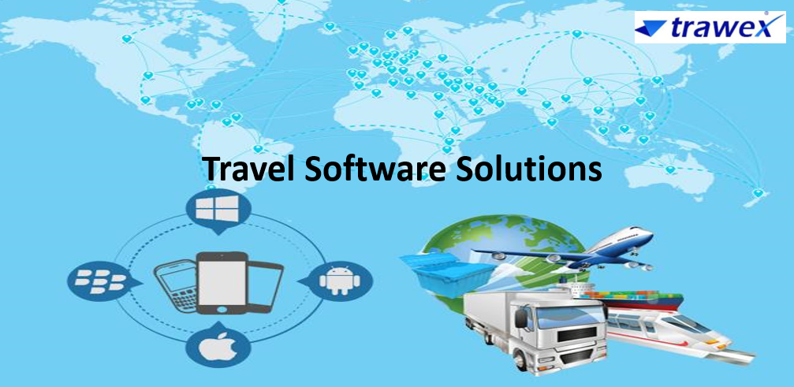

Travel Software Solutions

Slide 2
Travel Software Solutions in Sync with Your Needs
Trawex Technologies are the inventors of the most needed Travel software solutions for the Travel and Tour companies.
We provide user-friendly software oriented Tour Management Application that enables a tour operator to efficiently manage the complete tour cycle from inquiry to tour process.
Financial accounting and balance sheet with Multi Company, currency and language incorporated with various points of sales. Our collected information base on Travel inventory distribution, unique ability to strategies, architect and implement end - to- end solutions, and global delivery standards are ensuring the successful execution of our solutions.

Slide 3
With the Cloud for Travel and Expense, you can handle your business travel, from planning to expense repayment. Prepared for the way you travel, our option lets you travel more elegant, spend better, get refunded faster - all while staying in agreement with corporate guidelines and providing on your business goals.
In addition to the systems for tour operators, we have also been building IT solutions and software for travel agencies since the initializing of our business activities. We want to help you hit the ground running so you can get the most out of our state-of-the-art travel technology and travel management solutions as fast as feasible.
Corporate travel booking means a tool designed for small and mid- level companies to plan their business travel in a cost-effective way.

Slide 4
This majorly integrates all kind of inventory required for regular travelers at corporate fares. Corporate booking tools can provide revenue management, time management, convenience management for the organizations.
Trawex provides Corporate travel software solutions that help you create a more travel budget will determine what kind of corporate travel program you can develop while other solutions, like using corporate travel software, can get your travel.
Our leading travel industry software solutions for tourism and travel admin tools to form advanced customized travel portal software and provide a wide range of customized solutions to all travel agencies and travel companies all around the world.

Slide 5
Trawex travel booking interface designed to enable the travel partner to make reservation directly when they have availability to information like product, price, and information about special price, promotion, services, availability, and similar information.
Trawex is a leading Travel business software solutions provider offers software solutions for corporate travel management companies and software solutions for travel agents.
Based on our global and local knowledge, we provide maximum travel consulting and assistance to help you implement our business travel solutions in the most effective way possible.
Trawex is a suite of software solutions that allow travel & hospitality companies to come to be a fully-fledged Online Travel Business.

Slide 6
It's a business level, a completely customizable solution that offers high-end software infrastructure for companies to control IT for their business development.
We also manage long-standing project partnerships with key players in the industry. We therefore have a deep knowledge and required skills to implement or optimize the IT landscape of tourism companies of all sizes, whether they are locally active or globally.
You can depend on us to work closely with you and your online travel agents through the implementation process to ensure your business goals are fulfilled. We'll make sure you gain a deep knowledge of our online travel technology solutions in order to maximize their value.
Our application development team is constantly working to improve the product and modify it to ensure our clients have a business solution that is the peak of the line and future proof.

Slide 7
Benefits:
Enhance customer satisfaction
Increase income
Low costs

Slide 8
As a leading online travel portal development company, we take care of complete Travel Portal Development, Travel Booking Engine Development, Travel Booking Software, Best B2B and B2C Travel Portal Development, Hotel Reservation System.
As a travel portal development company, we keep a hawk’s eye on the arising sector in the travel arena and do our best to come with innovative travel booking engine software every time.
We try to build a travel booking engine software that encompasses all the features scattered along with the globe. Trawex offers comprehensive online flight booking software for a travel agency.
We offer airline reservation system and GDS booking system empowering with the trending travel technology features.

Slide 9
We're proud to introduce you to our software suite specifically designed for travel companies that want to grow, increase their sales, expand their travel inventory and optimise their complex operational flows with the help of the most innovative tourism technology today available on the market.
Travel portal development company & travel technology company includes flight booking engine, hotel booking engine, hotel central reservation system, online booking engine, online travel software, tourism portal development & holiday packaging system.
We have done GDS, XML & API integration, Travel Port API integration, Sabre GDS integration, Amadeus GDS integration, Hotel XML integration. makes you a superior travel website through high-end coding and the best of UX design.

Slide 10
We deliver quality work to our clients on time within a budget that brings your travel business at a higher position as compared to your competitors.
We work on your ideas and understand your whole industry-specific working process and develop cutting edge and custom website that delivers targeted results.
Our years of working experience with well-known travel clients and popular tourism planners enhanced our ability to build result in delivering web designs and unique travel portals.
We aim at leading real value to your travel agency’s business via updated programming techniques for mobile app development supporting almost all platforms that stand perfect at achieving your travel business goals.

Slide 11
Our global presence enlarged to comprise a wide range of travel companies utilizing our cutting-edge technology and deep 3rd party supplier relationships to compete on an international scale.
Trawex is a web-based easy to use, pocket-friendly & feature reach Travel Agency Software. It helps Tour Operators in promoting their travel products, increase sales, organize day to day operations and reduce admin cost.
Trawex’ s meticulously designed features maximize your potential and lets you easily manage your travel business. One-of-a-kind Travel Software that accelerates your sales, improves team performance, automates your process and keeps you on track with key reports.

Slide 12
Trawex is an international travel technology and travel software company and we serve travel companies from many countries Trawex platform is powered by so many suppliers across flight, hotels, car, sightseeing, vacations and other ground services.
If you are related to the travel industry as a travel company, tourism development organization, travel agency, consolidator or a travel adviser; you may be using a travel technology solution that grants you the edge to attract/retain customers and beat the competition.
Travel portal software is ideally suited for those travel agencies involving flexible, easy-to-use solutions to automate and control their business online. Your experience in your industry, backed by this robust technology, will give you the necessary data to your business through the web.

Slide 13
An online booking system is a software you can use for reservation management. They permit tour and activity operators to accept bookings online and better manage their phone and in-person bookings. But they also do so much more than that.
This guide’s intention is to help you understand booking systems a little better, how they can help your business. As you realize travel agency software is basically a travel software and expense management software for travel agents. Hence, it must have all those qualities that serve the purpose of travel and expense management.
Trawex is providing you advanced holiday packaging software for tour operators that help you manage inventory and group travel, create a package, manage customers and travel agents, fully automate your sales process, improve your services ordering, handle accounts and gain full insights into your travel business.

Slide 14
Trawex allows Tour Operators to design Fixed packages as well as Custom packages wherein the customer can have the flexibility to choose different flights, hotels, activity and vehicle options from a standard package.
Trawex is the World's leading online travel company that delivers tailor-made international holidays. Our aims to change the customer experience so they can explore destinations at their own pace with a holiday website design system.
Our unique matching algorithm and price comparison engine guarantee that travelers build their itinerary completely suited to their tastes and at the best online prices.

Slide 15
Trawex’ s intelligent platform helps save time and effort, without having to wait for a travel agent's quote, yet letting you have the fun of planning your own trip! Our holiday travel software System allows you to design tour packages, apply business rules and sell them via multiple online distribution channels.
The travel software allows the consumer to access data in real-time. The API acts as an intermediary between the actual source of the data and what the user eventually views on their smartphone or computer.
Our team of highly dedicated professionals and a portfolio of null clients in many countries around the world substantiate our ability to build a robust and feature-rich travel software that plays a crucial role in your growth.

Slide 16
We are continuously working on integrating the latest technologies and updates and devising new ways to ensure you are always ahead of the market when you use our product. Rest assured, you will always have a simple and firm travel agency software that you can rely on.
Our travel agent reservation software permits you multiple customizable features to run your mid or large size travel agency business. Agencies are empowered by our software to make frequent bookings using our simple interface.
With credit allotments, agents and sub-agents can book, select rooms and even pay instantly using a payment gateway or a credit facility. Ease of operation allows your agents more time to work with a number of customers without the confusion that can be involved in offline operations.

Slide 17
Customize your own travel agent reservation software to capture customers who book beyond working hours and give customers access to your inventory 24x7.
Using our travel reservation software, customers will have access to the best available hotel rates in addition to your own hotel, tours and transfers inventory, making your sales independent of the working hours of your agency.
To make the most of your business, you can avail of software that will construct your thought, germinate your motto and blossom opportunities at the very first go.
The major advantage your agency can enjoy is the booking software which manages every client tour of yours- be it London, Paris, New Delhi or anywhere in the world! With just a single click

Slide 18
CONTACT US:
For more details, please visit our website:
https://www.trawex.com/travel-software-solutions.php
Email id : contact@trawex.com
Phone No : 91485 87111

