Slide 1

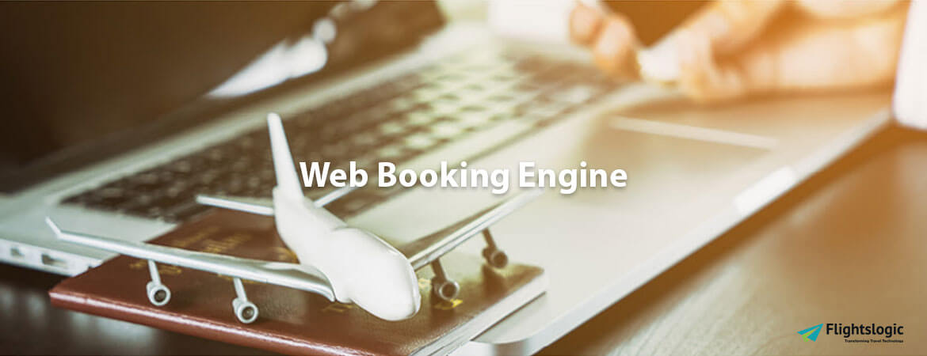
Internet Booking Engine
Email id : contact@flightslogic.com
Phone No : 97312 78600

Slide 2
The Ideal Internet Booking Engine for Your Travel Business!
FlightsLogic Internet Booking links your booking system with the Internet to form an online booking system. Create your products reserved online. Our Internet Booking makes your products obtainable online in your existing website layout.
Our Internet Booking supports you in each B2B and B2C. We have designed our Internet Booking in such a way that we can integrate it with your existing system landforms.
Here, the important goals are to win new clients and simplify your work processes. Our Internet Booking permits B2B and B2C through travel agents, tour operators, and travel industry across the world. The Internet Booking, therefore, drives traffic to your website, because your business partner Internet pages have backlinks to your website.
Travelers see it as being more convenient because they can create their booking at their leisure rather than having to attend until you’re at your table.
FlightsLogic Internet Booking is a web-based booking system that enables passengers to form bookings and manage their flight reservations and have the benefit of different services obtainable.
Our Internet Booking is extremely customizable, internet booking for airlines. Its responsive interface is appropriate for each mobile, Android and net.

Slide 3
Our Internet Booking contains a convenient graphical user interface that enables the planning of targeted booking processes and offers, providing insights from completely different market segments.
With our Internet Booking, passengers can book, modify flights and receive mobile boarding passes themselves, without having to decision airline agents or visit airline offices and counters. A website’s internet booking is that the software being used to secure online bookings.
FlightsLogic internet booking engine permits clients to specify their travel needs like the Flight and class of travel. There are several advantages to using internet booking engines.
But all of them can have an honest impact on your business and plenty of them, when used in conjunction, can offer you a way bigger return than if you were to use only the options in isolation.
As flight booking online continues to provide more and more air travel content, options, and varieties, the market goes to still grow and thrive.
This is necessary when you’re making an attempt to provide your customers the best provide you can, generally, you can offer them a superior offer when you provide your own internet booking engine.
FlightsLogic Internet Booking System can combine multiple services (like flights etc.) and will be integrated from a third-party seller (like Bookings.com etc.) into the website.

Slide 4
Why Travel Agency Need an Online Travel Booking Engine?
At FlightsLogic, we perceive however necessary the Internet Booking System is to you and your business. Comprehending that we use best in industry technology to provide you with a smart and powerful Internet Booking System that gets you enormous bookings for zero commission right from your travel website.
With bigger access, Internet Booking System is the method the travel industry will continue to grow, and provide higher client service by meeting the wants of their customers at a time that is convenient for them.
The end-customer version of our Internet Booking System helps clients through the booking method. The travel planner assists its customers in their travel planning.
This module is geared towards end-users. We have emphasized however the services are conferred. Another one of the key professionals in getting an internet booking engine is flight booking engines.
It's crucial for you as a business to be able to grow. Rather, by having your own internet booking engine you will permit your customers, the flexibility to book their own travel when and wherever it's best for them.
In addition to this, this also permits you to stay your customer's files on record just in case a suggestion comes up for their favorite vacation place. Being able to collect all this data and have it organized in a very single place is one of the most strengths of an internet booking engine.

Slide 5
Our Internet Booking Engine runs on top of the powerful and demand gateway platform and can be integrated with multiple properties.
Simply exchangeable for your current booking platforms, our Internet Booking Engine continually integrates with your systems to provide cheap costs to your existing landscape.
Connecting with your backend inventory & booking management systems, the Internet Booking Engine offers a wide kind of options that facilitate simple & prompt bookings for your customers leading to conversions. This is wherever FlightsLogic Internet Booking Engine comes in.
It links your booking system with the Internet to form an online booking system. Whatever services you want to form available for Internet Booking on your website, FlightsLogic will support you. If you want to distribute each package and distinctive services, then select our Internet Booking.
For distributing services targeted on specific themes, our special Internet Booking can facilitate. They provide a sub-group of the effective range, focusing instead on optimum sales for a specific market segment.
Such booking engines include Flight Internet Booking and other Internet Booking. There has been such a gradually increase in accommodations being reserved online that even the smallest of travels can’t ignore the necessity for an Internet booking.

Slide 6
Gain Higher Revenues with Integrated Booking Engine:
Increase Direct Revenue: Using a Booking Engine will result in direct bookings being added to your own website. This offers many advantages, the most notable of which is a decrease in acquisition costs per booking.
Effective Management & Distribution: Using an integrated booking engine (which integrates with PMS & Channel Manager) will minimize the time management needed to update various platforms, remove the need to manually insert bookings into your PMS system and enable you to control your inventory distribution.
Smarter insights: Access to booking data, helping you to better understand your customers, when and how they want to book along with the data to enhance your product offering in line with the needs of the customer.
Turn your website into the most competitive channel: Turn your website visitors into bookers with Booking Engine. It allows you to make more direct bookings to your hotel website so that you can own the guest and pay no commission.
Provide your guests with a convenient booking experience: Be immediately bookable via the Booking Engine solution on your hotel website and meet your guest's standards. Don't miss out on the chance to have a smooth booking experience both on the smartphone and desktop.
Manage Bookings: A seamless integration of the booking engine to PMS instantly updates the records and bookings of all your guests.

Slide 7
Multiple Room Types Bookings: Allow your guests to select multiple room types without any restrictions and make the booking process easy and comfortable.
Currency Conversion: Our booking engine supports multi-lingual and multi-currency to ensure that guests from every part of the globe are never missed.
Promotions: Develop personalize exclusive deals and promotional packages to convert visitors into customers and to promote online bookings.
In-depth Reports: Review your site’s performance and generate customized reports using our system’s advanced filtering options. View detailed reports from your booking calendar with Up-to-date check-in and check-out.
Digital Cancellation: Guests no longer need to call Hotel for cancellation approval. Instant cancelation digitally on the Booking Engine website, with confirmation of return.
Secure & Multi Payment Gateway: Get instant payments directly into your bank account with various payment gateway options. Secure payment gateways allow your guests to do safe transactions.
Book on Any Device: As the number of mobile bookings is increasing, we provide a responsive Booking Engine which allows customers to book from any device easily in a few minutes.
Multiple Secure Transactions: Let your customers pay securely online during booking or at the hotel.
Email Tracking: Online hotel reservation services allow businesses to track all bookings effortlessly starting from payment confirmation to booking failure.

Slide 8
Single Login Access: A single login platform allows you to access all the details of online bookings.
Bookings from Social Media: Integrate your Booking Engine with social media platforms to increase the conversion rate and marketing your website.
Quick Support: Our dedicated technical team is always happy to assist you with the queries related to Booking Engine, 24 hours a day.
Responsive Website: Responsive website design with a booking engine from any device. Simple, professional website design allows guests to book rooms of their choice with a seamless booking engine.
Transparency with hotel reservation system: Automate hotel website integration with a hotel reservation system and provide you with an admin panel to accept bookings and configure room images, rates, facilities, etc.
Drive online bookings: Integrate a completely web-based hotel reservation engine seamlessly with no required technological installation or expertise.
Reservation Management: Oversee individual guest and group bookings, conveniently control online bookings, customer details, and finances in one dashboard.
Room Management: Add or delete rooms in your inventory, set rates, and fees, verify availability of rooms and provide details and images effortlessly.
Hotel Profile Management: Develop multiple user profiles for your staff. Track all system accesses, actions, and updates with a fully logged report.

Slide 9
Benefits of Internet Hotel Booking Engine:
Easy to set up, user-friendly booking engine
Multiple languages and currency support
Aesthetic, intuitive and responsive
Easily customizable
Multiple destination search options
Connected with multiple GDS
Option for dynamic packaging
Cross-sell functionality for multiple products
Customized to suit the design aspects of your website
Promotion codes and voucher redemption
Secured online payment options with a credit card, debit card or net banking
Centralized admin panel for easy booking management
Generates tickets and vouchers automatically
Easily control inventory, pricing, and availability
Advertise hot deals for last-minute sales
Set exclusive rates for corporate customers, travel agents and preferred guests
Gain valuable insight into your market by analyzing online booking reports
Never miss a booking with a hotel booking engine that’s open for business 24/7

Slide 10
Contact Us
For more details, Please visit our website:
https://www.flightslogic.com/internet-booking-engine.php
Email id : contact@flightslogic.com
Phone No : 97312 78600

