Slide 1

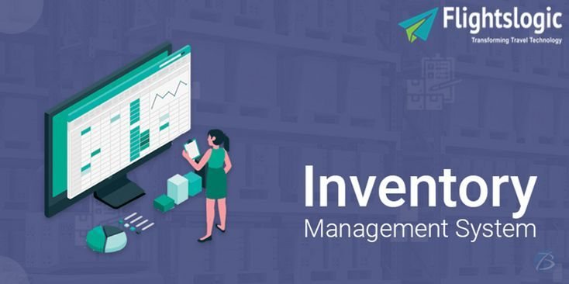
Inventory Management System
Email id : contact@flightslogic.com
Phone No : 97312 78600

Slide 2
Thousands Of Businesses Use Flightslogic To Find The Best Inventory Software.
FlightsLogic Inventory Software is a standard platform that provides you the flexibility to integrate the parts which are required with the existing systems.
You can produce a solution that meets the streamlines and needs throughout the business operations. Our Advanced Inventory Software leverages open systems technology to provide quick, versatile solutions for addressing challenges of the client's segmentation and Inventory process for all distribution channels.
Our Inventory Software works closely with travel platforms. Our Inventory control and inventory auditing are necessary functions of travel solution integration.
Our inventory software can be integrated with travel agents, tour operators, and travel industry across the world. Our Inventory Software is straightforward to put in and is organized well on your software system.
With simple instructions, the software gets installed. Our inventory software is more advanced and provides the correct status of real-time knowledge (i.e., flight). Some also offer their list and this makes the whole inventory method smooth going.
FlightsLogic Inventory Management Software provides travel services (like self-operated accommodations, transfers or excursions) and can find them up available right away.
Also, get a full grip over your current availability and costs so that you and your partners can quickly search and book products from the Travel Inventory Management Software.

Slide 3
Our Inventory management Software is a key factor that influences whether or not you create a sale or lose to a competitor, and inventory management software helps your business avoid such damage whereas overcoming connected challenges such as, increased inventory tracking, Lower incidents of inventory thievery, and improved supply chain visibility for your suppliers, improved financial performance, Accurate accounting, and financial reporting.
Our travel inventory management software comes with edges for the travel business and keeps track of your obtainable offers at all times.
Have a fast time managing allotments and schedule due to the simplest visibility. By using our Inventory Management Software, you can expand information management capabilities, download price and availability information from Inventory or upload it from external resources.
Set up distinguished markups depending on travel products and distributing agencies in line with the business model. The Inventory management software from FlightsLogic is an efficient and versatile logistics management software that can be tailored to the travel industry necessities.
These travel inventory management software permits travel businesses to offer this inventory simply to clients and partners of their selection.
Our basic perform of inventory software is to permit organizations to trace the real-time information, type and organize their stock levels.

Slide 4
Inventory Software facilitates the logistical management of stock and travel and can enhance processes associated with ordering, transportation, and reservation. The best thing relating to our inventory software is accessibility. Your staff can also use the software without any interference.
The company’s inventory can be often managed online from anywhere if you have a laptop with an online affiliation and store management software.
Designing tours is one of the most time -long works in a travel agency. It needs booking, planning, scheduling, valuation – all considering the most popular, budget, or distinctive inventory for each location. Thankfully, there's software for this. FlightsLogic Inventory Software that saves your time and money.
FlightsLogic Inventory Management system manages and distributes travel inventories through multiple sales channels. It provides functionalities to automatize the distribution and reasonable costs relying upon the market demand.
Travel aggregators and charter resellers can manage the pre-purchased travel inventory then expose them a sale to the online portal, agent dashboard.
The system assures revenue integrity through the real-time application of inventory controls while addressing the expansion of travel convenience requests.
The flexibility to evaluate booking requests in real-time and increase the full revenue of the complete travel network through our Inventory Management System and it's considered a breakthrough in revenue management.

Slide 5
Key Benefits of Inventory Management Software for Travel Agencies
Our Inventory Management System provides flexibility and sales outlet-based travel Inventory controls which can increase travel overall revenue.
In addition, Our Inventory Management System utilizes a new approach to availability processing that reduces value and maintains revenue integrity through the real-time application of travel inventory controls.
In the travel industry that values quick and relevant service, travel suppliers, tour operators, and travel companies need to change our travel inventory management software to appeal for the demand.
Our Inventory Management software simplifies everything regarding travel inventory and permits it to under your complete management through automation.
By using our Inventory Management Software, create and publish your elaborate product descriptions in many languages, enrich them with hi-quality photos add services and location-specific data.
Even it manages your complete list of all allotments for all the suppliers, as well as track all bookings across travel inventory varieties in real-time and from a unified dashboard.
Enable your companions in through their specific extranet account so that they need full access to manage their own listings and bookings in your travel inventory system.
Our Travel inventory management software for travel business permits quickly places their contracts and reasonable costs for flights in an organized manner.

Slide 6
Below is how travel agencies can utilize Travel Inventory Management:
1. Inventory Control
Inventory management assists a travel agency in keeping track of inventory and preventing overbooking. Adding the system with accurate data allows you to make direct connections via API, and a great travel agency will manage the business inventory.
2. Reservation Management
With excellent reservation management, you will be able to track payments and issue various types of receipts. It helps you keep track of travel documents, invoices, and payment confirmations.
Reservation Management retains and contributes a significant part of a travel agency. Obtaining booking can be difficult sometimes and a flexible system provides support in helping you track already made reservations.
3. Marketing Reports
Every travel agency has to keep track of the number of passengers and hotel bookings made daily. When it comes to negotiating better prices and higher commissions, marketing reports can help.
4. Numerous Sales Channels
You can get clients in a variety of ways and methods at times, but keeping track of them is the most important aspect. This should be the major thing in your mind when thinking of how your travel agency can use the inventory system, selling online and offline in an accessible manner is the most essential thing.

Slide 7
The function of Travel Inventory Management:
Increased productivity and efficiency: By automating the daily manual tasks that are required, Inventory Management Software helps to maximize the growth of your business by increasing productivity and efficiency. It also saves countless hours, and the software allows you to print shipping labels, manage stock, process and dispatch orders, and create and update listings all from a single dashboard.
Barcode scanning: Inventory management software integrates with barcode scanners for instant product identification and labeling, making it simple to identify and track your products.
Inventory optimization: Maintain just the right amount of inventory for each product, without under-stocking any item. It’s especially useful if you deal in products that experience a seasonal rise and fall in demand.
Stock notifications: Receive alerts and notifications when there’s over-or under-stocking beyond a defined threshold. This allows you to place orders or provide promotional discounts to clear out excess inventory.
Report generation: View sales history in the form of a list of your most popular products. This feature also helps to manage items in your inventory that have not reached the sales levels you expected, for example, by offering discounts on them.

Slide 8
Stock returns handling: Manage returns more effectively and reduce time-to-return through process automation.
Material grouping: Group inventory into predefined categories and ensure you’re always updated about quantities of components and specifications that make up your product stock, and manage their reordering schedules as needed.
Purchase order records: Create a unified view of purchase order records. You can easily identify which products are in high demand, both permanently and seasonally, and plan accordingly to meet your customers' needs.
An all-inclusive solution: It is a key feature of a reputed Inventory Management Software to include order management, listing management functionality, and shipping management and will assist in streamlining the selling process.

Slide 9
Major Features of Travel Inventory Management:
Fully Responsive and User-Friendly Interface
Customizable Itinerary
Sightseeing Management
Transport management
Accommodation management
Guide Management
Query / Lead Management
Itinerary Builder
Quotation Builder
Voucher or Invoice Creation
Finance management
Advance Report System
Coupon Management
Staff Management
Bulk SMS / Email Management
Customer Complain or Feedback Tracking

Slide 10
Contact Us
For more details, Please visit our website:
https://www.flightslogic.com/inventory-management-system.php
Email id : contact@flightslogic.com
Phone No : 97312 78600

