Slide 1

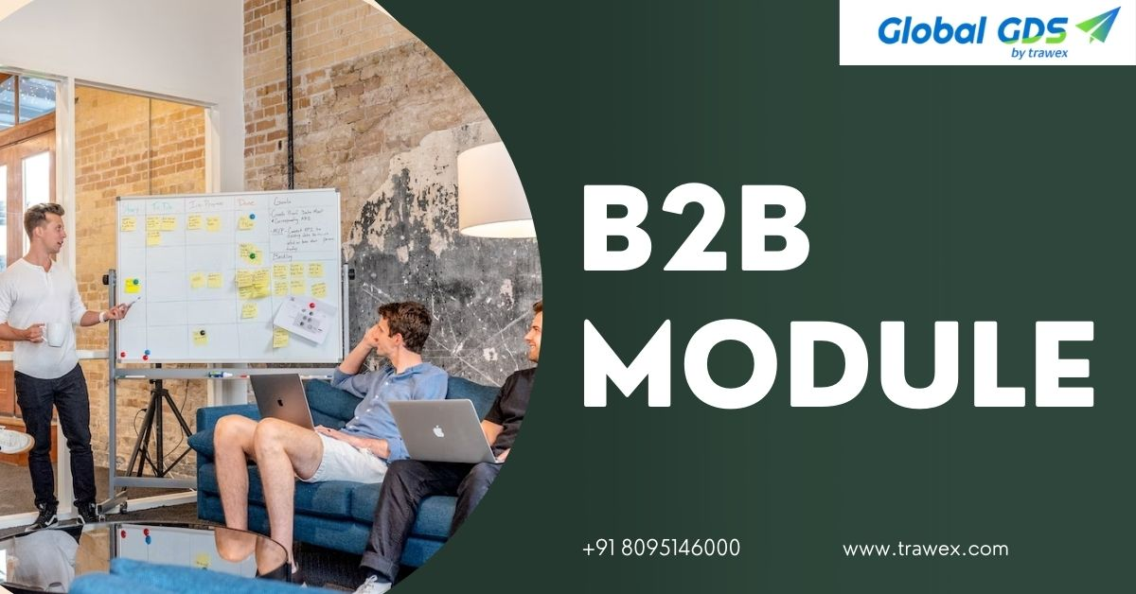
B2B Module
Email id : contact@trawex.com
Phone No : 077600 34800

Slide 2
What is B2B Module?
A B2B (Business-to-Business) module is an online platform designed to help travel agencies, tour operators, corporate travel managers, and other travel service providers set up and manage travel-related services and bookings.
This portal serves as a complete system that connects travel businesses with various suppliers, such as airlines, hotels, car rental companies, and tour operators, allowing them to effectively and effortlessly provide a wide range of travel services to their clientele.
These specialized websites simplify operations by allowing real-time access to various travel services. From flights and accommodations to car rentals and activities, everything is at your fingertips. Automation makes the booking and management process more efficient, saving time and resources.
In addition, B2B portals facilitate better connectivity by enabling businesses to easily connect with numerous suppliers, expanding service offerings, and nurturing robust business relationships.

Slide 3
The significance of a B2B travel platform for travel companies
In the modern marketplace, every travel company wants to maximize revenue. B2B travel portals are the most essential and widely used tools for travel companies and agents.
A B2B travel portal connects corporate clients with travel agents, tour companies, and other travel service providers. This includes a lot of businesses that help in amazing business growth and outstanding relationships. In the Traveling Business, B2B is a vital module.
B2B travel portal development provides travel companies with a consolidated platform that allows them to operate more quickly, spend less money, and ultimately increase their revenue. It is a complete solution that enables travel agencies to control their inventory, keep track of bookings, and boost partner communication.
B2B travel solutions provide an innovative approach to managing and optimizing corporate travel for businesses. B2B travel solutions help businesses save money and generate more revenue. By streamlining procedures and reducing manual tasks, companies can save time and resources.
Furthermore, these solutions also enable access to a larger network of partners and suppliers, allowing businesses to diversify their services and reach new markets. This not only increases their competitiveness but also provides customers for growth and development in the tourism business.

Slide 4
Need to hire the top B2B travel portal?
Global GDS is the best B2B travel portal development company that provides the best B2B Travel Portal with third-party API Integration or GDS API Integration of flight booking and hotel booking for the travel agent.
The GDS (Global Distribution System) is an interface that allows travel agents and their clients to access data, browse for and compare booking options, and book travel. Similarly, B2B booking engines for Third-Party API Integration is a versatile and powerful web-based online booking system designed for the travel industry, specifically for Travel Management Companies, Destination Management Companies, Travel Aggregators, B2B, B2C travel agencies, Tour Operators, and home-based travel agencies.
Our experienced travel professionals build advanced features for B2B booking engines such as Hotel, Tour, Package, and Visa, allowing you to upload your own contracted products, integrate third-party suppliers, adjust pricing and markup at runtime, generate agent-wise reports, map banners, incorporate business rules and easily track business sales.
With an array of B2B travel portal features, Authorized agents can log on to your B2B portal, search and book products, add a markup, and pay for booking online. From the admin booking panel, they can view, email, or download booking vouchers or cancel the booking of their customer from any device at any time.

Slide 5
How Global GDS’s complete B2B Travel Agent Module can benefit your business?
The benefits of Global GDS's B2B agent portal are manifold. It streamlines the booking process for tour operators and travel agents, saving them time and effort in managing the bookings.
As the booking data is centralized, the portal can provide real-time updates, increasing operational efficiency and accuracy while also reducing errors and discrepancies.
The unique characteristics provided by the portal empower travel agents to deliver exceptional service to their clients. From comprehensive search capabilities to customizable booking options, agents can simply generate tailor-made travel packages to fit their customers' interests and budgets, building trust and loyalty.
Furthermore, Global GDS's B2B agent portal allows agents to control their commissions to maximize their revenues while maintaining price transparency and integrity. Global GDS's B2B agent portal enables collaboration and mutual success between tour operators and their agent partners by allowing agents to adjust commissions based on specific agreements.
Global GDS provides a comprehensive B2B Agent Module that enables you to manage your agent profiles. With a single click, you can create agent accounts and manage their profiles.
It's also useful to manage agent commissions and markups, as well as allocate inquiries, quotes, and bookings to any agency. In addition, you can quickly generate invoices.
Streamline your agent communications, sending emails in the agent’s branding. In a nutshell, enjoy easy control of your agents.

Slide 6
What do you get with our B2B Module?
Our B2B travel software offers numerous benefits:
Centralized Sales Management
A unified booking interface for all B2B sales channels.
Flexible commission and markup configurations.
End-to-end automation of reservation management
Data-driven partner relationship management based on detailed performance analytics
Increased Collaboration with Partners
24/7 search and book accessibility.
Excellent online booking experience with B2B interfaces and API connection.
Full-featured self-booking tools for partners and corporate clients.
More business opportunities.
Increased sales and revenue by building multi-level distribution channels through tour operators and agencies with multiple business branches.
Know the services Global GDS deals with
Global GDS engine is designed with cutting-edge technology for online retailers and tour businesses, whether they are small or medium-sized businesses. Our B2B flight booking portal allows you to book both international and domestic airline tickets.

Slide 7
Here are a few points that explain the reason for choosing Global GDS:
Domain Expertise: Our team of highly qualified and skilled developers, designers, and travel industry specialists has extensive knowledge of the latest technologies and trends, ensuring that your B2B travel portal is not only cutting-edge but also in line with the evolving needs of the travel industry.
Innovation and Technology: We stay at the forefront of travel technology, allowing us to provide cutting-edge solutions that will provide your business with a competitive advantage and keep you ahead of the curve.
Personalized Approach: We specialize in developing long-lasting connections with our clients. Our professionals will collaborate closely with you to understand your specific needs and create personalized solutions that meet your business's goals.
Commitment to Customer Success: We are committed to providing our clients with the highest level of guidance and support throughout the development and implementation phases. We go beyond simply delivering a product; we partner with our clients to ensure their success.
Quality Assurance: Our rigorous testing and quality assurance procedures guarantee that your travel solutions are secure, reliable, and operate exceptionally well.
Scalability for Future Growth: We anticipate your business growth and design B2B travel portals that are scalable to accommodate increasing traffic, user volumes, and future expansion plans.

Slide 8
Who should be looking to develop B2B Travel Portal?
B2B travel portals provide several benefits to a diverse range of travel-related businesses. Here are some specific types of businesses that should consider developing a B2B travel platform:
Travel agencies
Travel agencies can leverage B2B travel portals to boost their booking processes, gain access to discounted prices from travel suppliers, and provide a larger selection of travel options to their corporate clients. This can result in more revenue, higher customer satisfaction, and greater competitive edge.
Tour Operators
B2B travel portals allow tour operators to effectively manage group bookings, access real-time inventory and pricing, and interact with other travel businesses to build bespoke tour packages. This can improve operational efficiency, broaden their reach, and boost overall profits.
Travel Consolidators
Travel consolidators can utilize B2B travel portals to negotiate bulk deals with travel suppliers, package travel products and services, and then distribute them to travel agencies and other travel intermediaries. This allows them to maximize their purchasing power, grow their distribution network, and generate additional revenue sources.

Slide 9
Key Features of B2B Travel Portal:
Advanced Search and Booking: This allows businesses to look for and book flights, hotels, car rentals, and other travel services more effectively.
Multi-Currency and Multi-Language Support: Supports global customers by offering multiple currencies and languages.
Supplier Integration: Easily integrates with various suppliers to provide an extensive selection of travel services.
User Management: Manages various user roles and permissions to provide secure and effective portal access.
Payment Gateway Integration: Provides secure and diversified payment options to help transactions go smoothly.
Reporting and Analytics: Provide detailed reports and analytics to help businesses get insights and make better decisions.
Customizable Interface: Enables customization to meet individual corporate demands and branding requirements.
Inventory Management: Manages inventory from numerous suppliers in one centered platform.
Automated Invoicing: Creates automated invoices for completed transactions to streamline the billing process.

Slide 10
Advantages of B2B Module:
Discounts and offers: The B2B booking engine that can bring the best travel deals for clients, can help build customer trust. With such a B2B portal, travel companies can enhance agent networks also, as agents are more attracted to portals where they can offer tailored packages with better profit possibilities.
Integration with Global Distribution Systems (GDS): B2B travel portals frequently come integrated with Global Distribution Systems. This interface connects travel agents with a global network of service providers, providing them access to an array of travel packages and possibilities. Businesses can utilize GDS systems to increase their offerings and respond to their consumers' requirements and preferences.
Real-time Information: With a B2B travel agent portal, businesses gain access to real-time travel data. This includes alerts and updates about flight departures, changes in flight schedules, and variations in hotel prices. Having up-to-date information allows travelers to make timely and cost-effective travel plans.
Partnership with Global Travel Service Providers: B2B travel portals facilitate partnerships with global service providers, allowing travel agents to offer unique experiences to their customers. Since the travel reservation system integrates with leading GDS systems like Amadeus, Travelport, and third-party APIs / XMLs and LCCs, travel agents can expect a vast range of accommodations, flights, transfers, and tour packages from global travel service providers.

Slide 11
Wrapping It Up: The Global GDS Impact
In the ever-changing travel landscape, an effective B2B Travel Portal is a valuable asset. Global GDS meets and exceeds expectations with its cutting-edge solutions.
The combination of diverse inventory, advanced features, and a user-friendly interface strengthens Global GDS's position as the leader in B2B travel portal development.
Global GDS offers professional B2B travel portal solutions for all of your travel needs.
Our consulting approach, dedicated team, and extensive product and technological experience are all reasons why we are global leaders, and our customized travel technology solution distinguishes us from the competition. Partner with us and benefit from our extensive experience in the travel technology industry.

Slide 12
Contact US
For more details, Please visit our website:
https://www.trawex.com/b2b-module.php
Email id : contact@trawex.com
Phone No : 077600 34800

