Slide 1

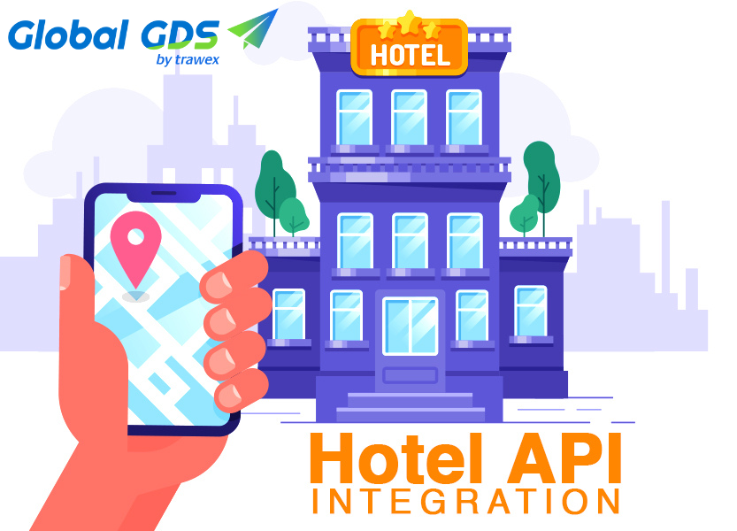
HOTEL API
Email id : contact@trawex.com
Phone No : 077600 34800

Slide 2
HOTEL API ADVANTAGES
Choose the modules that are right for you.
Access to excellent negotiated rates.
Wider choice of hotels.
Realtime availability and confirmation.
Booking is simple.
Mapping and De-duplication
Clean & accurate data
Easy to Integrate
Integration Support
Personalised service
Cost savings
Search, Book, Confirm – Through a Single API Integration

Slide 3
HOTEL API FEATURES
Flexible, scalable and easy to integrate and implement
Build and update customised travel booking applications
built on scalable Open System architecture
Decreased development costs and time to market
Custom-designed solutions which maximise efficiency
Completely scalable and Web 2.0 compliant
Reliable and robust,
Independent of language and application framework
real time streaming of prices for your users
Continually optimised product solutions
RESTful API format, with JSON or XML responses available
Browse and Live prices feeds

Slide 4
Why Global GDS Universal Hotel API
Extend the Functionality of Your Website with Hotel Booking Engine API
With a wide range of accommodation choices in every location, each providing various pricing, and availability, the task of navigating through multiple suppliers can be made simple with our Hotel API.
By integrating our Hotel API with your Travel portal, you as an Online Travel Agency can offer hard to beat Hotel deals to your potential clients.
With the Hotel API, you can browse a large number of Hotel offers, book Room, cancel Room, generate reports for booking and cancellation, etc. very easily. A good API is a precious resource for the company.
We realize this and so through our Hotel API, all the Hotel needs can be customized according to the customer's needs.
Global GDS API aggregates hotel content into a single system from leading hotel suppliers, consolidators, hotel chains and online travel agencies (OTAs).
We offer unrivalled hotel search and booking technology designed to meet all of your requirements.

Slide 5
Our Partner-Focused Approach Is Long-Term; Supporting You Through Integration, Optimization and Business Growth.
Global GDS Hotel API offers rich hotel content that is generally not available in other Travel Aggregators. Our online booking system allows our clients to access our vast hotel inventory from anywhere in the world swiftly. Best Hotel Booking Engine is specialized in reserving hotels online with very best hotels available.
By integrating this travel and tourism API with your own software solution, you as a travel service supplier can provide hard to beat travel related solutions to your potential clients. It helps in travel and tourism business to help get the Hotel reservation done easily.
Global GDS Hotel API provides comprehensive descriptions including room types, images, and facilities, of over 500,000 properties worldwide.
As one of the trusted API providers Globally specialized in Hotel API Integration. All our services are integrated, tested and maintained by experienced team of professionals.
Hotel APIs are web services that allow travel companies to collect and aggregate information such as descriptions, galleries, availability and pricing from multiple hotel providers into a single-engine. It allows end-users to search and book hotels around the world using only one Hotel Booking System.

Slide 6
Integrate Your Website with API for Seamless Business Operations
Travel portals and applications built with our API are also adaptable to different devices and sizes, using the latest responsive technologies to automatically change the display layout to match the screen of the device used.
The portal gets the real-time search data with the advantage of this software solution and gets to know the traveler's requirement about hotel booking. This can include room no, type of room, destination, and traveler's budget.
Hotel API is one of those search solutions that lets hotels provide travelers with the latest and most suitable search results so they can seal the portal deal and reserve their itinerary with it.
Our Hotel API will help your business increase revenues while automating processes and reducing the time and effort required completing a room booking.
Travel agency can automate their services such as hotel booking, reservation, payments and much more through hotel API integration.
In addition, travelers nowadays love smart work, so when you have fully automated website travelers can rely on you and book your stay making you the medium.

Slide 7
Why choose Global GDS for Hotel API Integration?
What you need to do is integrate the hotel API into your website or management system, and yes! You have access to thousands of hotels, resorts all over the world.
Our Hotel API provides comprehensive descriptions of more than 500,000 properties worldwide, including room types, pictures and services. As one of the trusted API providers, widely specialized in the integration of hotel APIs.
HOTEL XML API
Hotel XML API is a web service providing an online functionality of searching and booking hotels. It gives you the opportunity to provide your clients with more better options to select their ideal stay place in a particular city.
Thus it enhances your business beyond the limit. The complete transaction happens on your own website under your Brand. You can also collect payment from your customers by integrating payment gateway.

Slide 8
HOTEL RESERVATION SYSTEM
A Hotel Reservation System is a necessity for today’s accommodation providers, both large and small. An increasing number of travelers are relying solely on online reservations in order to book their accommodations, and without this capability, you will lose a significant amount of business.
It gives you an advantage over your competitors.
It improves your efficiency as a business
Features:
Real-time integrations
Quick Booking Confirmations
Fast, Robust and scalable
Fully Flexible
Customizable response
Automatic end to end invoicing
Easy to use solutions for booking via call center

Slide 9
Why Global GDS Universal Hotel API?
Our Hotel API offers you the following benefits:
Easy hotels reservation facility is available for entire world.
Our service covers nearly all major service providers of hotels.
We provide a powerful backend support through our unblemished services.
No need of huge investment to start hotels reservation.
Boom in hotels industry favors promising results.
Hotel Reservation API Provides a great Value addition to Existing Website or business.
Working capital depends on your daily transactions.
No minimum deposits and balance maintenance required

Slide 10
Contact Us
For more details, Please visit our website:
https://www.trawex.com/hotel-api.php
Email id : contact@trawex.com
Phone No : 077600 34800

