Slide 1

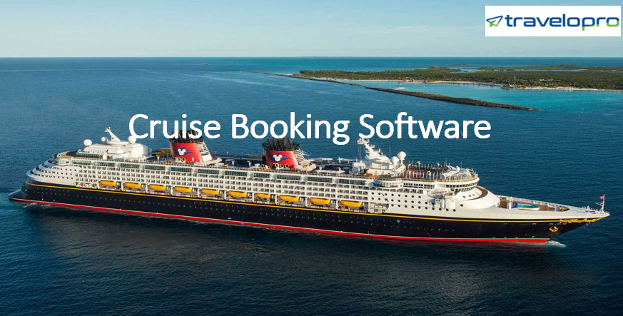
Cruise Booking Software
Email id : contact@travelopro.com
Phone No : 98455 66441

Slide 2
Streamline Your Cruise Booking Software
Traveling around the world by sea on a cruise is an interesting and thrilling experience. The number of cruise liners is growing at regular intervals due to the high rise in the popularity of sea adventures and regular cruises.
A cruise booking software is an online platform that allows cruise operators to connect with customers, offering a continuous booking experience for cruise vacations. It empowers agents to search, select, and book cruises, as well as access information about availability, rates, and promotions.
Cruise booking software lets travel agents and end customers search for and book cruise deals online. It can be connected with a comprehensive inventory of cruise suppliers (such as MSC, Princess, and Carnival) for travel agents and tour operators in the form of a cruise XML.

Slide 3
An online cruise booking engine offers remarkable advantages for cruise operators, enabling them to tap into a broad market segment and showcase the best deals to attract passengers.
The cruise online booking engine authorizes browsers to check online cruise availability, examine deck plans, cabin inventories, and finally make user-friendly online bookings.
In such a competitive marketplace, reaching the targeted customers would require a trustworthy source. An online cruise booking engine would play a handy role for the cruise operators to reach a large market segment and offer multiple available deals to attract the market.

Slide 4
Why Cruise Booking Software Is an Essential Tool for Cruise Industry?
Cruise Booking Engine Software is a crucial tool for cruise industry professionals, providing them with a comprehensive solution to manage their inventory and bookings effectively.
The software enables customers to browse, compare, and book cruises easily while providing profitable insights and data for cruise lines and travel agencies to make informed decisions.
The software is user-friendly, secure, and integrated with multiple third-party systems, providing a seamless booking experience for customers. Cruise Portal software is a must-have tool for any cruise industry professional looking to simplify their operations and maximize their revenue and profits. The software is designed to simplify and automate the complete booking process, from search and reservation to payment and confirmation.

Slide 5
The software comes with a payment gateway integration, enabling customers to make payments securely and effortlessly. Once the payment is made, customers receive instant confirmation of their booking, including their cabin details, itinerary, and other relevant data.
Cruise booking software enhances customer satisfaction by providing a trouble-free booking experience. Features such as mobile optimization, instant booking confirmation, and simple access to booking details contribute to a positive customer journey. The ability to manage bookings on the go, offer multiple payment options, and provide quick customer support are all factors that lead to more bookings and higher customer satisfaction levels.
Travel agents and end users can use cruise booking software to find and book cruise offers online. Browsers can use the cruise online booking engine to check online cruise availability, look at deck blueprints, look at cabin inventories, and eventually make a user-friendly online booking.

Slide 6
Cruise booking engines can be owned and operated by cruise lines themselves or by third-party travel agencies. These engines can be integrated into the websites of cruise lines or travel agencies, providing a smooth customer experience for customers.
Similar to several others, the cruise industry has experienced profound changes due to state-of-the-art technology. This includes an expanding reliance on artificial intelligence, machine learning, and automation software, as well as the widespread adoption of intelligent devices.
Together with our cruise software product, one can book a cruise reservation over the Internet or via a cruise supplier agency. Users can receive information and order tickets via the Internet at their leisure, 24 hours a day, seven days a week. Reservations can be made in real time and paid for using an authorized credit card on the spot.

Slide 7
Why Handpicked Travelopro for Cruise Booking Software?
Being next-gen in design and scalable in development, Travelopro is the leading travel technology company delivering cruise booking software to cruise providers, cruise management, cruise suppliers, and all leading cruises in the cruise industry. You can synchronize bookings, compare prices among other travel operators and agencies, and even list real-time online rates with a single click.
Travelopro is a major travel technology firm that provides cruise booking engines to travel management companies throughout the world. To associate with and port the live feed, we integrate online services from well-known cruise vendors.
Integrate our cruise booking software with a travel business booking system to grow your business. We offer the best place to book a cruise for travelers and cruise services all over the world. We are dealing with a cruise booking system. A cruise booking system is designed to increase revenues while automating processes.

Slide 8
We develop customizable cruise booking systems for various cruise-provider companies, cruise booking agencies, cruise hiring businesses, and cruise operators. Our cruise booking engines essentially help in managing reservations, tracking available cruises, automatic maintenance and servicing notifications, checking cruises in and out, etc. We have been providing cruise software solutions for the past few years.
We have been providing our clients with tailor-made solutions based on their specific requirements and needs. You can straightforwardly customize your booking engine to suit your brand and make it work.
Designed to increase revenues while automating processes, our cruise booking engine reduces the amount of time and effort required to complete a cruise booking. This online booking engine includes an extensive amount of cruise line, cruise ship, and cabin descriptions linked to media files and rich content such as cabin photos, ship images, and deck plans to help in the shopping process.

Slide 9
We provide you with all the tools to automate your cruise bookings via a user-friendly interface so that you can focus on providing excellent customer service onboard.
Our cruise booking software streamlines cruise tour and activity management by enabling easy creation of cruises and sea activities, personalization of ticket types, managing reservations, and launching promotions comfortably—a solution that increases sales and fosters customer loyalty for cruise operators.
With the cruise reservation system, all the details, from availability to different deck rates to arrangements under one single roof, can be reached by travelers. With our extensive experience spanning several years and a reliable, powerful team in the travel technology market, we develop technologies in accordance with market trends and are committed to delivering our work with the utmost care and proficiency.

Slide 10
Redefining your travel business, we develop and maintain an online ecosystem that is made in accordance with contemporary design and modern technology. To become a cruise management captain, try our broad range of website development services so as to establish a digital presence and become one of the most significant companies in travel and hospitality across the world.
Cruise Booking Engine is a booking engine designed especially for cruises that allows you to increase your internet sales and revenue and empower your sales plan for your business. Our passion is helping businesses enhance their conversion rate by increasing direct bookings.
We offer custom-tailored cruise booking systems for all kinds of travel businesses. Whether you need a booking system for a small, independently owned local business or a large international corporation, we can help you build a plan that will meet your demands and exceed your expectations.

Slide 11
Our cruise booking engine is designed for you to manage inventory, all about reservations, and has several features that you can use effortlessly. Our cruise line booking engine enables you to explore new markets by integrating with the latest multi-source procurement and third-party inventory integrations.
By leveraging these elements, you can create a platform that enables travelers to navigate the exciting world of cruises with confidence and ease. Here at Travelopro, we understand the complexities of the cruise booking landscape. We offer extensive booking engine development services to help you build a rewarding portal that sets sail for profitability.
With a team of highly skilled tech experts at the helm of API integration development, you can expect nothing less than top-notch results. Say goodbye to time-consuming booking procedures and embrace our responsible cruise API to boost your productivity, revenue, and much more!

Slide 12
Travelopro is committed to providing our customers and future customers with the highest level of support for all pre- and post-booking concerns.
Furthermore, our website is very intuitive, allowing travel agents to easily find all the information they need. The Travelopro’s cruise search engine helps drop prices and increase efficiency, meaning more benefits to our clients.
Consider Travelopro services, then enhance your portal websites with our professional services and acquire offers from our offer crate. We also provide distinct screen access to your portal, such as on a on a PC, mobile device, tablet, etc.
Let Travelopro be your partner in creating a cruise booking experience that reaches beyond expectations. Contact us today to discuss your idea and turn it into reality.

Slide 13
How Does a Cruise Booking Software Work?
Cruise allows you to capitalize on the potential of this rapidly expanding area of the travel industry. It delivers real productivity and booking quality benefits through eliminating time-consuming mobile reservations and providing a complete desk-based cruise reservation and information system.
Whether you require a cruise reservation system, cruise booking software, a cruise API, or anything else, we can help you transform your business and prepare it for the future. Our cruise reservation system is built to associate cruise lines with a unified platform using the cruise API.
The API provides a connection between travel agencies and suppliers when using the cruise reservation system, enabling these OTAs to check their live, real-time inventory and availability.

Slide 14
What Are the Features of Cruise Booking Software?
Search Filter Options: When booking a cruise vacation, there are numerous factors, from the destinations to the number of nights. To secure the maximum number of bookings possible, make it super easy for consumers to navigate the site. Put filters in place to narrow down their search. Customers will make the purchase considerably sooner if they can quickly identify a cruise holiday that suits their needs.
Real-time Availability: Make sure that you have cruise booking software that works in real time. This means that inventory levels will naturally decrease as more people reserve staterooms and buy additional amenities.
Itinerary Displays: Empower the cruise booking software to display a carousel of the trip’s itinerary. This is a foolproof way to have an engaging website that actively promotes vacations.

Slide 15
Online Payment Processing Options: Make use of cruise booking software that provides passengers with a selection of payment methods. Cruise vacations can be quite costly. Plus, a lot of customers opt for payment plans. It’s critical that there are flexible options where each one abides by PCI regulations.
Upselling and Cross-Selling Elements: One of the best aspects of a cruise is that everything you could possibly need is in one location. This idea also makes it very simple to upsell and cross-sell different amenities. And as you can imagine, these two concepts are crucial when you want to maximize profits.
Reporting and Data Analytics: Data reports and analytics dashboards will tell you everything you need to know about your business. From restaurant inventory counts to consumer data trends, there are also numerous ways to leverage this information. The way in which you use data will differ from one business entity to the next, so make sure that you have objectives or goals in mind.

Slide 16
What Are the Major Advantages of The Cruise Booking System?
The online cruise booking system offers several advantages to its customers, be they end-customers or travel agencies. Here are some of the main advantages of the online cruise booking system:
Customers can simply insert and update payment methods, set discount limits, etc.
You can add cruise-related images, travel images with descriptions, and other media content.
Report on analyzing your business tracks and improving your business strategy for the future.
24/7 service is available; customers can book cruises any time of the week and on weekends.
Effortlessly set fare codes and tax rates and assign them to the partnering channels.
Superior user-friendly interface for simple operation.

Slide 17
CONTACT US:
For more details, please visit our website:
https://www.travelopro.com/cruise-booking-software.php
Email id : contact@travelopro.com
Phone No : 98455 66441

