Slide 1

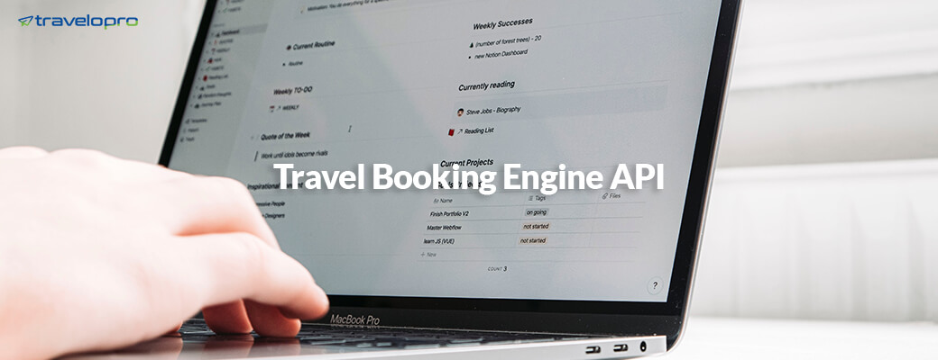
Travel Booking Engine API
Email id : contact@travelopro.com
Phone No : 98455 66441

Slide 2
What is Travel Booking Engine API?
Travel Booking Engine API is a web service that brings together the best travel deals and content from global travel suppliers such as Hotel API, Flight API, Tour API, Transfer API, and Package API for travel agents, tour operators, and travel companies to provide their customers with the best travel options from which to choose and book their travel package.
Travel platforms require travel APIs to get current information and display up-to-date data. Travel Booking and API integrations provide quick and easy access to thousands of third-party travel products. It is your opportunity to become the ideal online destination for travelers and partners by providing a varied range of travel products as individual services or packages.

Slide 3
Customers can use Travel API to search and book a hotel or flight all from one platform (travel website of a travel agent), minimizing the additional work of travel agents. Travel agents can integrate travel inventory from third-party GDSs, travel wholesalers, aggregators, consolidators, and others into their website's booking engine or travel portal.
Travel agents may use the Travel API to gain access to various travel options and improve the usability of their website. A travel API provides access to rich content, detailed descriptions, and travel deals, like hotel API, car API, flight API, transfer API, etc.
Booking engines allow OTAs / Online Travel Agencies to consolidate and resell inventory from multiple XML API suppliers or consolidators and add their own markups; where numerous options for adding markup are available, such as based on region/cost/cost/ star rating/ booking class/fare range, and so on.

Slide 4
Travel API Integration in the travel portal is critical for your online travel agency to enable real-time bookings and availability fetch during Travel Portal Development for your travel business. Before you start developing your Online Travel Agency, you should evaluate and understand the total cost of your Travel Portal Development with Travel Portal API Integration.
As a result, travel businesses use third-party Travel API integration to save time. They can quickly browse and book fares from many integrated suppliers using the Travel API. Your clients may use travel APIs to search for and purchase flights, hotels, and vehicles. Travel agents incorporate third-party flight and hotel APIs into their booking websites to have access to the lowest travel costs.
Travel Booking Engine APIs, such as flight APIs, car APIs, and hotel APIs, allow travel agencies, tour operators, and travel companies to access their extensive information and travel discounts.

Slide 5
Major Travel Booking Engine APIs:
Flight Bookings Engine API
Multi-city search, One Way Search, Return Search.
Secured booking page from auto-fill capability
live ticketing and cancellation
add meal and extra baggage at the time of booking
Ticket and invoice E-mail to the customer and admin for booking confirmation

Slide 6
Hotel Booking Engine API
Search by (city/hotel name)
Advance search by star rating/price range) Modify Search
Secured booking page from auto-fill capability and save search.
The live voucher and cancellation terms & conditions.

Slide 7
Car Booking Engine API
Largest car routes inventory
Fast, Robust, and Scalable
Easy To Set Pick Up and Drop Location
User-Friendly Booking System
Real-Time Available Cars
Pre-estimated fares are available with us.
A travel agent can manually book a car by adding a mark-up

Slide 8
Bus Booking API
Search by city, modify search & refine search
Grid view/list view and save search
seat selection and seat boarding point
Filter options for the search results are available
Sort Functionality by recommended/ price/ Bus Type

Slide 9
Travel Booking Engine APIs For Online Travel Agencies
Travelopro's XML API allows seamless integration with all GDSs (Global Distribution Systems). A GDS is a centralized reservation system that provides travel agencies with real-time rates and availability for flights and other travel-related products.
It is connected to the airline, hotel, and other supplier systems on the back end and manages inventory distribution for various providers globally.
If you want to create your own booking engine with flight, hotel, and bus ticket booking, you should use an XML response travel API.
Our travel API can allow you to add live pricing and booking functionality with multiple supplier integrations.

Slide 10
By integrating a travel booking API into your travel website, you can enable clients to search for availability, access your content and descriptions, and easily make bookings.
We have expertise in developing travel applications and integrating many types of API. APIs for bus booking, flight booking engines, hotel booking engines, etc.
Once the flight API, hotel API, Bus API, and Car API have been integrated with your travel booking engine, you can instantly start offering travel solutions online to the customers and generate higher revenue with a large amount of traffic.
The Travel Booking API allows you to incorporate third-party Wholesaler inventory into your website's booking engine.
So, if a customer searches for a flight on your site, they will not be redirected to another site, and you will collect the payment.

Slide 11
Travelopro's travel agency booking software, which automates the ticket booking process, travel itineraries, payments, business operations, and invoice management, can help your travel agency achieve new heights.
Our portals empower the travel and tourism industry to generate a profit. We at Travelopro provide a wide range of travel API integration services, including GDS Suppliers (Galileo, Amadeus, Travelport, Sabre) and third-party travel API providers (Travel Boutique Online, GRN Connect, Mystifly, HotelBeds, HotelsPro, GTA, DOTW, roomsXML, Acerooms, Redbus, Clear Car Rental, Jac Travels, Travco, Tourico, DOTW, Kuoni, etc.).
We integrate APIs that are most suited to your company's needs. Travel API connections provide you access to hundreds of third-party travel inventories and deals. We design and develop an integrated web reservation system with XML and API interfaces to ensure solutions for tour operators, travel agents, and start-ups.

Slide 12
Our travel API integration with your technological solutions enables massive sales and profits. Our API development team is an expert in the travel industry and we have integrated multiple APIs from different providers. APIs allow online travel agencies and booking agents with worldwide travel content such as hotel information, images, room details, and pricing from various suppliers.
With our Travel Portal and API Solutions, we assist various travel agencies and companies in creating a platform for selling various services and products online and expanding business. We provide our clients with the best API integration services based on the structure of their business and the target customers.
Our highly designed B2C and B2B travel website application development, XML API integration, and GDS integration solutions may assist travel and tourism companies. Our developers provide XML and API integrations for CRS, Extranets, PMS, and Booking Systems for car rentals, hotels, rail services, buses, and other businesses.

Slide 13
Benefits of Travel Booking Engine APIs
Multi Supplier Inventory
Inbuilt Discounts and Mark-up Management
API integrations on your travel website are simple to set up and tailored to your specific business requirements.
Marketing tools to boost your online sale
Fast Response
Secured and instant booking and payment
Easy cancellation and service modifications
Customers can payments directly on your website to confirm their travel bookings using an API connection.
Improve customer satisfaction by making the booking process hassle-free and fast

Slide 14
Get Our Travel Booking Engine API into your software portal and get the highest commission for flight, hotel, car, and bus ticket bookings. Escalate your travel booking and pricing functionality.
Travelopro is a well-known Travel Solution Provider, and our primary goal is to create high-quality custom travel websites that use cutting-edge technology. Our team ensures profound help and consistent quality with a wide range of service providers throughout the global travel industry.
With our GDS Integration, you can provide your B2C and B2B clients with access to global information via the web and mobile interfaces. We integrated Amadeus, Sabre, and Travelport APIs for several clients.
Our API Solutions allow you to take advantage of these interfaces and build bespoke apps that connect to your travel portal, enabling you to add functionality to improve your business operations.

Slide 15
Travelopro is a unique fully cloud-based managed platform that combines all of your GDS and directs connected suppliers across all of your products into a single unified connection, along with a cutting-edge business rules management engine that enables complete control of your products across multiple channels in a simple manner.
It allows you to utilize/maximize your time and cost for integration while also giving you total control over your products. Our advanced Travel API collects inventory from many providers like as GDSs, direct connect, wholesalers, and aggregators. It gives agencies using third-party Travel APIs a single point of access to the best available pricing, allowing them to sell a wide selection of content to market.
We provide the best XML API Interface solution, allowing you to manage your complete third-party supplier inventory from a single platform, rather than logging into multiple sites and changing access to actual fares.

Slide 16
Travel API integration facilitates the integration of all travel-related services into a single location. It simplifies and reduces the time it takes for travelers to make online reservations. The use of a travel API results in an error-free ticket booking system. Passengers expect a unique model that allows them to find what they need in a short amount of time.
API allows travel agencies to collect additional information about their consumers. It assists them in understanding the clients' preferences and needs. In turn, the agency can use the data to cross-sell other products that clients with similar profiles and backgrounds have utilized.
We created a solution that allows small and medium-sized travel agencies around the globe to overcome this challenge. You will be able to sell a huge inventory of flights from a large pool of airlines directly to your clients using this service.
Our travel portal development services include travel API integration, flight API integration, hotel booking API integration, activity booking system

Slide 17
Features of Travel Booking Engine APIs
Travel Portal Development provides high-performance, highly optimized travel APIs to assist travel startups and small business owners in providing competitive services. Our travel APIs include outstanding features such as:
Easy management and maintenance
Multi-platform compatibility & support
User-centric and easy-to-use interface
Access to real-time fares and availability
Multi-lingual and multi-currency support
Cost-efficient travel booking solution
Easy integration into the existing travel website
Booking automation offers a better customer experience

Slide 18
CONTACT US:
For more details, please visit our website:
https://www.travelopro.com/travel-booking-engine-api.php
Email id : contact@travelopro.com
Phone No : 98455 66441

