Slide 1
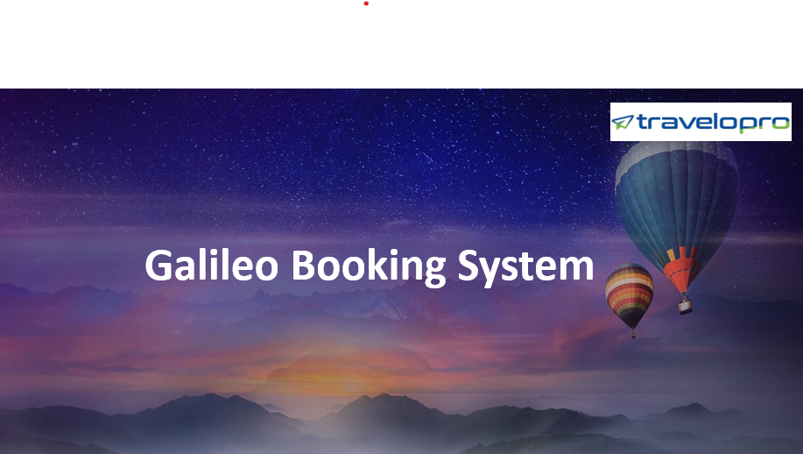

Galileo Booking System
Email id : contact@travelopro.com
Phone No : 98455 66441

Slide 2
Travelopro is the best travel technology company, we provide Galileo Booking System for travel agents. Galileo GDS is a single platform that provides services like flights, rooms, car service, etc. Galileo gives a helping hand to the movement (travel) sector by giving a reservation system because it has an online reservation system.
Galileo Booking System stands with the lead position in airline reservation software and connected to almost all the leading airline companies. It also provides solutions to travel agencies by offering desktop solutions (search & book) and web services XML to connect to the core database. Galileo travel reservation system offers flights, hotels, cars, cruises, holiday packages among others.
Galileo is a trustworthy aggregator of travel inventory, committed to helping its clients in every situation and through them, growing decisions for travelers around the world.

Slide 3
Galileo is one of the world’s major computerized reservations systems utilized by the travel business. It gives authority to tour operators or OTA to make a booking of flight, booking seats, issue tickets, book cabs, and hotel convenience.
Travelopro gives a front-line Galileo Reservation System for flight booking, hotel booking, transport booking, holiday booking, vacation rentals, etc.
Galileo is one of the significant GDS including Amadeus and Sabre, which is fuelling a few travel booking systems. Galileo has been one of the most favoured CRS frameworks by travel organizations, OTAs (Online Travel Agencies), and TMCs (Travel Management Companies). The fundamental purpose of why Galileo is preferred is because of its advantage.

Slide 4
How can Galileo XML API Integration help travel management companies?
Galileo XML API Integration enables travel agencies and travel agents to book airlines, cruises, hotels, and rental cars. Flight API Integration is fully integrated with the Galileo API providing interactive functionality for travel agents.
A fully-featured travel booking system will be provided by Galileo XML API Integration. Galileo API helps to integrate GDS airline, hotel, and holiday booking systems with B2C and B2B travel modules.
Travelopro Galileo API provides you with access to reservations of airplane seats, hotel rooms, rental cars, and other travel industries. Our Galileo XML API Integration helps integrate all services in one place, which in turn enables travelers to discover the best deals available worldwide.

Slide 5
Travelopro Galileo API enables travel portals to get the best service providers by their side to display their efficient portal services, which in turn will also bring massive traffic to the website. Our Galileo API can be used for the availability and reservation of cars, hotels, airlines, and cruises. Galileo's Flight API Integration will help you connect with all of the leading airlines.
Our specialized team at Travelopro provides the best XML API integration, according to your necessities. We have a strong and secure mapping with static data and it will also help in escalating the volume of XML API integration.
The Travelopro travel supplier provides XML API Integration with a specialized team attached to perform the required tasks. Our team of Travelopro can help you with XML/API integration services with multiple suppliers available in the world market. We can also help you in implementing XML functionality for your portal, which would expand your business manifolds.

Slide 6
Our team of Travelopro offers dedicated support with maintenance and with regular updates related to the already implemented XML API. We have expertise in XML API Integration systems, including all types of different XML/JSON integration from different kinds of XML API Suppliers.
We are a reputed travel portal development company that has expertise in building a self-preservation framework for online travel agencies and travel management organizations. In most cases, Galileo GDS API is designed for the IATA operators who can operate it through web applications. We give the best-integrated framework to our customers by partnering with the greatest number of inventories identified with flight, hotels, auto rental, transport, voyage, exchanges and get-away, through the Galileo GDS framework.
We help you take your business to the topmost position and we take pride in providing the services exactly what an ideal travel portal requires.

Slide 7
Our Galileo API integration is one of the trusted and effective global distribution systems that enable the travel portals to offer well-organized services in one single place. It also helps the travel agencies to display their extraordinary services to bring a huge surge of traffic.
This system integrates all the services in one place, helps travelers to find the most convenient deals available across the globe.
Travelopro will design, develop, host, and deliver automation systems to the airline and travel industries including the most recent airline reservation systems which offer trendy, versatile reservations and inventory management solutions for airlines which include call centers, travel agencies, and the internet ticket sales and real-time bookings.

Slide 8
Our Services
Galileo Flight Booking System
Galileo Flight Booking System is a web-based Flight Booking Engine with the provider Galileo. Our Galileo Airline Booking System is the best option for online or B2B Travel Agencies, at Travelopro we are experts in Galileo integration, Galileo GDS API integration, Galileo API XML integration, Galileo web services development, Galileo airline reservation system development in the online reservation.
Galileo Hotel Booking System
We provide an end-to-end online hotel booking portal to travel agents by integrating with popular GDS providers. We understand travel agent's needs and issues and work with the GDS provider's technical team to provide end-to-end solutions. Hotel reservation systems allow visitors to search for the availability of rooms and book rooms that meet their budget and quality.

Slide 9
Galileo Car Booking System
Travelopro develops customizable car booking systems for rental car companies, car rental agencies, cab hiring businesses & taxi operators. Our Car Booking Engines primarily helps in managing reservations, tracking available vehicles, automatic maintenance and servicing notifications, checking vehicles in and out, etc. We have been providing car rental software solutions for the past few years. We have worked with several rental car companies across the globe.
Galileo Bus Booking System
Travelopro provides real-time bus ticket booking software solutions for travel agencies. We have designed a comprehensive online bus booking system as per the client’s requirements that would save both time and money. Our bus booking software has all the updated features including e-ticket booking, booking cancellation, advance booking with expected dates, etc.

Slide 10
Galileo Sightseeing Booking System
Travelopro is a travel technology company; we develop sightseeing booking engines, online ticket reservation systems, online travel agency software, travel management software, travel agent software, online reservation system, ticket booking engine, travel portal development for travel agencies and tours operators across the globe. We integrate with all the major suppliers including GTA, Tourico, HotelBeds, Miki Travel Limited for the sightseeing booking engines.
Galileo Transfer Booking System
Our Online Transfer Booking System empowers travel companies, travel agencies, travel agents, and drivers to manage transfer bookings effectively and boost online booking. Using this Transfer Booking System, the travel agent enables the driver to collect the inventory of transfers from multiple sources to present their travelers with the best prices.

Slide 11
Features of Galileo Booking System
Flight XML API Integration (International & Domestic)
Hotel XML API Integration (International & Domestic)
Bus API Integration
Car API Integration
Manage Holiday Packages
Agent Registration
Sale Report
My Booking
Hotel Booking CRM
Add Fund / e-Wallets for Travel Agent
SMS API Integration
Quick View Booking

Slide 12
Chat API Integration
Discount Coupons for Agent / Client
Booking Management Module
Special Offer / Deals
Trip Advisor plugin i=Integration
Payment Gateway Integration
Agent Login
Customer Login
Markup Management Module
Discount Management Module
User Management Module

Slide 13
How can Travelopro help?
Travelopro is a leading travel technology development company. We can integrate the Galileo booking software to provide unsurpassed travel software to your travel management company.
Our developers will integrate the Galileo GDS to access the inventory for everything travel-related like airline flights, hotels, cars, and cruises. This is possible due to the internet services by Galileo.
Travelopro will integrate Galileo API which will enable you to reach a maximum number of travelers and business partners.
The integration will increase your business revenue, improve operational efficiency and boost business productivity. It will reduce your operating cost, help you grow, and capture new market opportunities in real-time.

Slide 14
The Galileo API Integration allows you access to high-speed providers, low-cost or economical global carriers in conjunction with input from multiple sources using a single API. Today, the Galileo booking software plays a vital role in the online reservation system. This system offers XML services and desktop solutions, linked to the primary database.
When we develop your travel portal, it will offer seamless online booking and an online travel management tool with Galileo Software Integration. The portal will pool in real-time information. This will provide live availability information for flights and fares of all airlines, including low-cost carriers in the domestic and international market, hotels, and car hire.

Slide 15
Benefits of Galileo GDS Integration & OTA Software Setup
Deploy full-scale travel booking platform with GDS Galileo and offer flights, hotels, car rental, transfers, sightseeing, rails, and cruise.
Revolutionary GDS booking system lets you engage B2C users and B2B sub-agencies to make more sales. Intuitive UIs and best-in-class features bring the edge.
Use your own domain name, download the Galileo software platform and connect through web services. Sell your travel content and deals under your brand.
Our cloud-based IBE (internet booking engine) is 1/2 the cost of a custom travel booking software with equal features. You spend less time managing technology and concentrate on core business.

Slide 16
Our online reservation system is 100% mobile-ready. Your travel booking website will look and perform equally well on desktops, tablets, and mobile phones with no extra coding or design work.
It offers payment gateway integration of your choice. Sell online deals on your website and receive payments directly into your account.
Integrate your online booking engine with leading enterprise resource planning suites like NetSuite, and Microsoft Dynamics to use top CRM functionalities.
Analyze and gain insight into your travel software system growth. See which sectors are selling more and tweak marketing campaigns according to that.
Travel engine is developed with high-end technology to deliver the highest quality operations. We deploy the booking platform on a dedicated server or AWS.

Slide 17
CONTACT US:
For more details, please visit our website:
https://www.travelopro.com/galileo-booking-system.php
Email id : contact@travelopro.com
Phone No : 98455 66441

