Slide 1

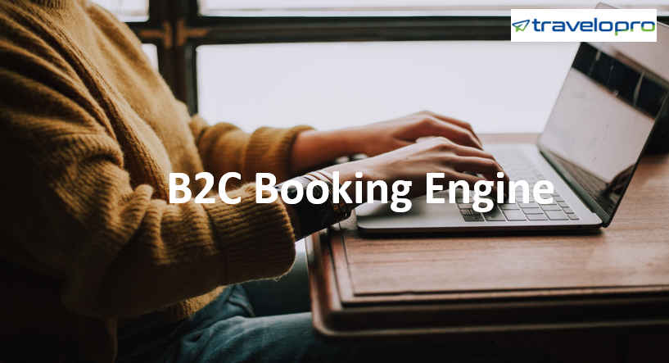
B2C Booking Engine
Email id : contact@travelopro.com
Phone No : 98455 66441

Slide 2
B2C Travel Portal is online travel booking portal which give online search and book functionality with flight, hotel, tour, transfer and package module to entrust global B2C consumers to search and book online. B2C Travel Portal is key component for a Travel Website. It is travelling portal for retail sales entrust business to sell more products and increase revenue.
Travelopro provides B2C travel portal software to implement Online Travel Agencies to become a brand and serve their customers most adequate Internet Booking System by Travelopro offers rich tools that boost the booking process clean and faster with acceptable UI for all customers. B2C booking engine achieve the branding for company using software for travel website, it grants company to sell any services in travel directly on company’s portal.

Slide 3
Travelopro afford all services such as flight booking engine, hotel booking engine, package booking engine, excursion bookings engine, transfer booking engine, cruise booking engine, car booking and many more accelerate feature available with it.
Under our booking engine any payment gateways can be added as per your proffered; you can also add various payment gateways to collect payments in various currencies such as USD or GBP etc. Many more tools are available to connect with customers such as live chat, client and admin delivery feedback options to connect with customer.

Slide 4
Features under B2C Booking Engine
Responsive design with HTML5 and CSS3
Accessible booking process with minimum & easy steps
Multi-Lingual & multi-Currency website
Automated Emails/SMS for Vouchers/E-tickets details
Flight, Hotel, Packages, Transfer, Sightseeing, Car, Cruise & Others
Extranet for own contract management
Dynamic package Flight + hotel
Package with extranet
Multiple GDS connectivity
Multi-product sales
Integration to Multiple Payment Gateways
Cross sell options for products

Slide 5
How can Travel Agents benefit from a B2C Booking Engine?
Travelopro is a prominent name in the B2C travel portal development. At Travelopro, we are providing cost-effective as well as inventive technological solutions for your B2C booking engine. We offer an entire B2C travel portal solution to integrate to different APIs like hotels, flights, cars, and online travel sales channels.
We design and develop a sophisticated internet-based reservation solution with XML and API integration to establish solutions to tour operators, travel agents, and startups. Travel B2C portal is an online booking portal that grant users or travel agents to sell hotels, flights, airport transfers, packages, and other travel products.

Slide 6
With the expanding pace of travel industry, travelers expecting a convenient and technologically advanced travel portal. It is important to recognize every condition of customers to ensure complete develop of travel portal. Travelers choose a portal with the entire solution to their travel problems at one place and customer contentment is the key to success of business, it helps you grow.
B2C travel solution is key to all your problems. It boosts you to display all the travel related searches at one website where customers can conduct a shove free search. B2C travel solution is a reasonable and most adequate software solution. Effectively establish your online presence with Travelopro tailored B2C travel solution. We boost you to create a functional and flexible booking system for website.

Slide 7
Mobile | Any Device Compatibility
Easy Refund Policies
Maximize efficiency
Easy to book tickets
Saves time and money in operations
Multi-currency support
Multilingual support
User-friendly interface

Slide 8
What are the Advantages of Having a B2C Travel Portal?
Interactivity
Any B2C travel portal helps you take benefits of the habits, which are deep-rooted in today’s culture. Travelers have the routine to share their opinions and impressions online. Think interactivity. If your customers are communicating themselves online, you can support this style for the advantage of your business.
It Helps You Know Your Customers
The B2C travel portal development can assist you in analysing customer’s data. You will have approach to various information levels; who have visited the website, when, which products get sought as well as how they are purchased, what dispirits the prospects from making the purchase, etc.

Slide 9
Broad Service Range
Travel portal development provides a superior and custom-made customer experience. This can support customers through the journey, not only between departure and booking but also through the stay.
Put as briefly as possible to have people to your site, you need to provide them what they desire or want and that’s the reason why you need to convert your site into a helpful travel source.

Slide 10
Why Choose Travelopro for your Online Travel Booking Portal?
Travelopro afford the best online travel booking portal for travel agent and tour operator. Hotels, Flights, Tours, Transfers, Train, Car Rental all in one Packages. Travelopro develops platforms & solutions to empower businesses to leverage the immense capabilities of the Internet.
Travelopro established itself to become as market share in travel industry, when it comes to provide solutions for creating & managing online booking businesses. Today Travelopro is one of the fastest growing online ticket booking solutions in the SaaS and enterprises space. Our experienced developer develops the online travel booking portal with best travel technology solution based on client requirements.
B2C is an online travel booking engine which works across the global market and as the name suggest B2C is precisely done between business and consumer.

Slide 11
B2C booking engine platform is a convenient interface where customers can also book as guest users in it.
Eventually, it boosts the owner for developing their business online to achieve more booking of hotels, thus gaining more profit which in turn build up your business in travel industry. Likewise, in B2C booking engine it has the direct connection between business to consumer who are the eventual consumers of brands and services.
B2C Booking Engine offers Booking Specials, Tours Package, End moment offers, accessible and elementary reservations for hotels and safest payments options for B2C users.
This excellent booking engine platform lets you grab B2C customers to make more sales. Accomplished checklist, impulsive UIs and finest of its category bring the edge.
Totally mobile ready. Your travel website will peak and execute consistently well on work stations, mobile phones with tablets no extra coding or design work.

Slide 12
B2C - Online Reservation System.
Best solution for your website.
B2C - Online Booking Engine
Flight Booking Engine
Hotel Booking Engine
Cars Booking Engine
Transfer Booking Engine
Sightseeing Booking Engine
Mobile Apps Booking Engine

Slide 13
What’s in it for you?
Our online B2C Booking System offers the right tools that make the booking process abrupt and elementary for all kinds of clients – corporate or end-customers. It is must-have software for travel companies worldwide as it boost them increase their profits by escape paying commissions to sales agents. Providing B2C travel services on your company website designate everyday travelers to serve as their own agent as they get approach to wholesale pricing commonly reserved only for travel agents.
B2C Travel portal development is an adequate way of reaching your costumers and increasing sales and revenue of your company. Travel portal open your continuation to global market and costumers.

Slide 14
We afford you B2C travel portal development solution which means business to business and business to client. For more business growth it is necessary to expand it across the globe, it can contribute you a better ratio of customers. We are having a specialist and professional team to develop customized B2B and B2C travel portal for your organization.
Our travel portal includes GDS / third party API Integration for b2b flight booking portal, hotel booking and car booking services. We afford all kind of travel portal solutions for B2C travel agency globally.

Slide 15
Our B2С Module is Ideal for
Tour Operators
Travel Agencies
Wholesalers
Corporate Clients
Distribution Networks
Vacation Rentals

Slide 16
How we will help?
Travelopro is a feature-rich B2C booking engine connects with eye catching convenient designs. Our system is developed in tight cooperation with you allowing us to understand the direction business needs to take to develop. Our system is designed for companies aiming to increase profitability by selling inventories directly to customers.
Travelopro will grant your customers to compare and book flights, find and book hotels at best rates, and rent cars from global and local suppliers. Customers can book domestic as well as international flights and hotels, based on the requirement you define.
We have an XML connection with 100+ travel wholesalers, giving you a large range of suppliers that you can associate with.

Slide 17
You get complete mark-up control and you can manage commissions too, all in a perceptive user interface.
Travelopro booking engine perform the key-element of travel website software, grant direct sales of travel products on company’s travel portal. "Showcasing" B2C travel offers on the company’s website can be beneficial in many ways, especially when it implies a probability to manage and build up own travel products
Travelopro lets you to create "n" number of travel agent. Through their committed log-in page Travel Agencies have approach to all services and their devoted rates. They can send quotes to their clients with minutiae of rooms, cancellation policy and pricing, as well as save their advice in the system, run reports and keep track of their commissions. Here’s what can be accessible through the online booking engine for travel agencies.

Slide 18
Our B2C booking software grants selling travel products directly to millions of globetrotters.
Our product encourages smooth operation of the reservation engine, fast search and stable work under heavy load.
Moreover, it accessible gets integrated with the existing software system and is available on all major Global Distribution Systems including Amadeus, Travelport and Sabre.

Slide 19
CONTACT US:
For more details, please visit our website:
https://www.travelopro.com/b2c-booking-engine.php
Email id : contact@travelopro.com
Phone No : 98455 66441

