Slide 1

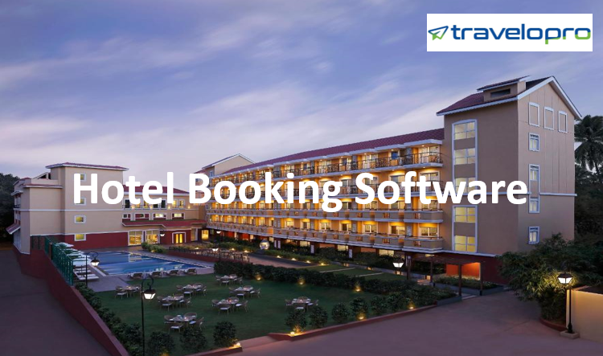
Hotel Booking Software
Email id : contact@travelopro.com
Phone No : 98455 66441

Slide 2
Upgrade Your Hotel Business with Our Customised Hotel Booking Software Solutions
Travelopro provides Hotel Booking Software to the travel industry that enables your guests to book rooms directly from your hotel's website. Our Booking Engine is mobile-optimized allows visitors to book rooms from their smartphone or tablet.
Get more commission-free direct bookings and improve more top-line revenue per booking from Travelopro hotel booking software. Our online hotel booking system empowers hoteliers to manage and control their hotel property details.
Travelopro online hotel web booking engine assists you to customize as per business requirements. Travelopro Web-based hotel management software helps you simplify your hotel operations and makes it more efficient.

Slide 3
Intuitive & customizable hotel website booking system at Travelopro allows you to attract direct bookings and hence results in a less cancellation rate. A seamless guest experience begins with a simple and powerful Hotel Booking Software, designed to deliver more direct bookings.
A Hotel Booking System helps in managing the day-to-day operations of a property, thereby making the business of running a hotel easier.
Travelopro allows hoteliers to work more efficiently by simplifying their operations. It automates all the functions of the property and increases overall efficiency; hoteliers can use the time saves to focus on ways to increase revenues.
Convert the visitors into customers with a powerful direct booking engine that is tailor-made for your brand and perfect for group bookings & Hotel Chains.

Slide 4
A Hotel Reservation System works by accessing secure online reservations made through a hotel’s website. A hotel booking system is a software application that is implemented by hotels to allow guests to make secure online reservations.
Hotel Booking Software is a necessity for today’s accommodation providers, both large and small. Guests can check the availability and book their stay directly from your hotel's websites. Travelopro integrates any third-party hotel software.
Travelopro is designed to provide solutions to small and mid-market hotels and hotel chains, motels, resorts, boutique hotels, business hotels, service apartments.
Travelopro is a robust web-based Hotel Management System that offers next-gen capabilities needed by hotels to simplify reservations, improve operating efficiency, and maximize revenue.

Slide 5
Travelopro enables real-time integration with all major Online Travel Agents (OTAs) and Global Distribution Systems (GDS) to expand your market reach, increase occupancy rates, and eliminate booking errors.
Travelopro is a booking engine integrated with a hotel group's website, which allows the website visitors to book multiple hotels at once with the group and create a single itinerary directly from the website.
The multi-property booking engine allows the systems to show its live rates and availability of all its locations at a single place, such that visitors can make a booking whenever they wish to. This helps the system to acquire direct bookings and increase revenue.
Our multiple hotel room booking systems can help you offer a valuable package to your guests through our website. Our hotel booking engine offers your guests a quick and smooth booking experience.

Slide 6
How does our Hotel Reservation System grow your business?
Travelopro is a hotel reservation system and property management system that works for all types of accommodation: hotels, motels, hostels, B&Bs, lodges & guest houses. Your bookings are easily accessible anytime and anywhere in the world.
Travelopro aim is to be providing the most cost-effective and user-friendly hotel reservation system. A comprehensive Web-based Hotel Management Software which is reliable, secure, and enables hoteliers to manage their operations from anywhere.
Convert your hotel website into a hotel marketplace and work as an online travel agency (OTA). Allow multiple vendors, hoteliers, or property owners to list their properties/ hotels on your website and earn commission on their bookings. Take your business to the next level.

Slide 7
A user-friendly web-based booking engine can help you increase your hotel room bookings online to a great extent. Travelopro is suitable for hotels, B&Bs, resorts, guest houses, hostels of any size.
Travelopro is a powerful and tailored hotel booking system that offers the ability to fully customize it according to your requirements. Travelopro is simple and intuitive and gives your guests the ability to make instant bookings right from your website or mobile app.
One of the most diverse in the world is the hotel industry. Travelopro develops bespoke hotel booking solutions for hoteliers, travel agencies, tour operators, and travel management companies.

Slide 8
Our online hotel booking system is best suitable for Individual hotels and groups with a chain of hotels. This is a perfect solution for Hoteliers with a single hotel or chain of hotels, tour operators, and travel agents who want to have their own booking system and create their own hotel network using our customizable booking solutions.
Hotel Booking Software that allows hotel, motel, resort, property owners to take full advantage of the power of the Internet while increasing the flexibility to maximize revenues. Hotel Booking Software is work on your website.
Travelopro provides the Hotel operator with full control over online reservations. Online inventory of dynamic rooms while saving money and optimizes the potential of your website.

Slide 9
Travelopro develops a hotel booking system that supports various B2B, B2C, and B2B2C vendor modules including the CRS booking engine, extranet system.
Travelopro provides comprehensive descriptions including room types, images, facilities, ancillaries of over 700,000 properties from the global market.
Travelopro is a leading Travel Technology Company that offers the best hotel software which is the right fit for your business requirements. Our hotel booking engine is user friendly and can easily integrated on your website and provide error-free bookings for a hotel room for tourists.
We offer Hotel Booking System which is a complete Hotel Management System that works with all types of accommodation - Hotels, B&BS, Hostels, and Lodges to manage hotel bookings easily from anywhere at any time.

Slide 10
Why hotels need an online hotel booking software?
Hotel Booking System is a software system that is easily integrated and allowing guests to book hotels online directly and make secure online reservations. It also provides additional hotel management features to hoteliers.
Our online hotel booking system empowers travel companies, travel agencies hoteliers to manage hotel bookings effectively and boost online sales. Hotel Booking Engine is the most important part of the Hotel Booking System.
It is integrated with the Hotel API so Travel Company can provide the best search results of hotels for their customers. Our hotel management system provides a technology that allows you to accept direct bookings and increase business profitability.

Slide 11
It is a complete hotel management software solution to convert business goals into successful leads to maximize profit. Also, we develop an advanced Hotel Reservation System with Hotel Booking XML functionality which enables the travel and tourism industry to provide an online hotel booking facility for a smooth hotel booking experience.
Hotelier can easily manage the rate, inventory; customize promotion, payment method, content, reports, etc. using Hotel Booking Software. Hotel Booking Software can turn its hotel booking website into a revenue-generating tool to increase Hotel Booking using Hotel Booking System.
Booking Engine for hotels is a feature-packed tool that allows you to make direct bookings through your own website. The online hotel booking system is completely customized and flexible and is designed for all kinds of accommodations.

Slide 12
Hotel Booking Engine is connected with the top hotel API's and is utilized to provide the best hotel search results. The hotel reservation system is becoming popular as it enables the travel and tourism industry to provide bookings through the internet across various destinations globally. Hotel Booking Software is a perfect strategy for travel agencies.
Global Travel Companies are offering their customers to choose top hotel rooms, nationally as well as internationally. Travelopro is a specialized Hotel Reservation System providing Hotel Booking Engine at commendable rates.
Our hotel booking system provides customers globally with an integrated hotel reservation software. Our hotel reservation engine offers travel agencies, travel companies to manage their online booking of hotel effectively.

Slide 13
Our Hotel Booking Engine is feature-rich, robust, and scalable and provides web-based OTA to the travel companies. The hotel reservation software allows the companies to have booking globally as this software we connected with top hotel inventory to provide the best deals to global clients.
Hotel API Integration is a web-service providing online functionality of searching and booking hotels. We strive to build value through our cutting-edge technology solutions for hotels, clients and travelers to develop a seamless booking experience.
Our Hotel Management System Can display real-time data for the availability of rooms to the admin. Our powerful and specialized Hotel Booking Software Solution which have the ability to fully customize it according to your requirements.

Slide 14
Our Hotel Extranet System allows your travel company to connect directly to the specific Channel Managers used by the hotels you desired to have in your inventory, in order to obtain the updated dynamic rates and the availability.
Today, most hotel bookings are made through online booking platforms (OTAs). With Travelopro you can easily reach millions of potential guests. Travelopro hotel booking engine can be simply added to your existing website enabling guests to book rooms directly from your hotel’s website.
Hotels reservation system aggregates hotel content into a single API system from global hotel suppliers, consolidators, hotel chains, independent hotels, and Online Travel Agencies (OTAs).

Slide 15
Our Hotel Booking Software includes the following features:
Display any number of Categories of rooms
Display Different views of hotel rooms in a more professional manner
Room Amenities
Display Rates
Best Offers
Availability of rooms
Option to book the rooms
Online payment option
Instant invoice sending facility to customer after successful booking
Unique booking number generation
View, Modify & cancellation of bookings

Slide 16
CONTACT US:
For more details, please visit our website:
https://www.travelopro.com/hotel-booking-software.php
Email id : contact@travelopro.com
Phone No : 98455 66441

