Slide 1

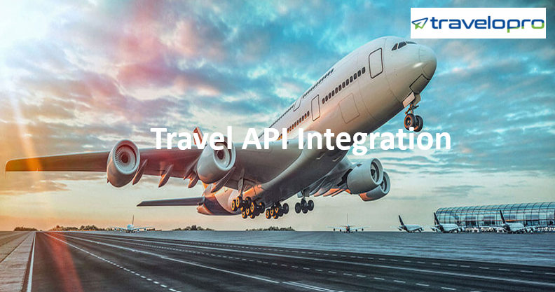
Travel API Integration
Email id : contact@travelopro.com
Phone No : 98455 66441

Slide 2
Travelopro is a leading Travel Portal Development Company all over the world. And we offer effective solutions for travel portal development for small to mid-size travel businesses with cost-effective and exceed your expectations.
Our Travel Portal Development Solutions delivers measurable results with maximizes your company’s revenue from our creative and professional. We offer a broad range of services serves as additional support to Travel Portal Development, White Label portals, software, B2B / B2C Travel Portal, XML API Integration, and various GDS APIs such as Amadeus, Sabre for flights, hotels, car rentals, transfers, sightseeing, and holiday packages.
We develop White Label Solutions| White Label travel software with all features including booking engines, XML & API integrations, contracted inventory, agency management, and back-end accounting automation, managing reservations, create invoices, track payments, publish catalog online, etc.

Slide 3
And our white label Travel Portal serves the needs of travel agents who can continue their business in a more effective way to reach their target audience with ease and perfection. Our White label solution allows you to build your online travel agency completely under your brand without any redirection. By combining our best travel API with your software solution, you as a travel service provider may offer outstanding travel related services like bus reservation, flight reservation and hotel reservation to your potential guests.
Apart from Travel API services we also offer various API integration services including airline services, holiday selection, hotel booking, hotel booking, cruises booking, cars hiring systems and bus central systems. Our best travel APIs & Reservation engine serves as a single point of access to numerous resources, across all product categories, and increases the huge time and cost savings to travel Companies looking to develop their applications Our API integration services support you combine list with third-party applications.

Slide 4
We can also use data from a broad range of third-party sources. We have a lot of experience processing with demand-side platforms that combine popular GDS /Consolidator APIs with Amadeus / Travelport, Galileo, Sabre, etc. Increase your customers' choices to flight XML API reservation, hotel XML API reservation, car XML API reservation, insurance and many more with access to both GDS and external content with our XML integration white label services.
This solution will be valid and scalable to help your online business strategy. We offer you access to a large range of global and local bookable products which your customers’ requirements. We provide the best choice of Hotel Reservation, Flight Reservation System and XML API dealers from hotels, cars, cruises, tours, and destination content to make your business grow through white label connections.

Slide 5
And our API makes connecting to multiple GDS and consolidators for rates and availability directly on your website easier than ever before. We respond rapidly to the dynamic hotel, rental car, and flight and vacation package data.
The API makes it possible to take all of the products and their processes directly onto your website fixed data centers supply fast, reliable data provide to your applications.

Slide 6
Role of Travel API Integration in Booming Travel Business
Our best travel API allows you to integrate third-party Wholesaler inventory into the booking engine on your site. So, when a customer searches to book a flight on your site, they won’t be redirected to another site and the payment will be collected by you.
The need for Travel Booking API Integration: Travel Booking API Integration has many benefits because it is the best way to attract more customers. When you have a Travel Booking Company, you need to consider the Travel Booking API suitable for the ticket bookings at various locations. To experience ultimate success in your Flight booking related business you must hire our company we are the trusted Travel Booking API provider in India and offer the best possible solution to boost your business online.

Slide 7
We carry valuable best travel API solutions for the reservation that support your website with the user-friendly feature.
Best Travel API Provider: API stands for Application Programmable Interface and it allows users to operate an existing product to serve their interests. APIs are time savers as once the database is created then it can be utilized as many times.
Travel Technologies Solution: Hotel API is one of the best travel API solutions, that helps the hotels provide the best and most favorable search results to the travelers so that they can seal the deal with the portal and book their itinerary with the deal. With the help of this software solution, the portal gets the real-time search data and gets to know about the requirement of the travelers regarding the hotel booking.

Slide 8
API Integration is the end-to-end process of fetching data from best travel API providers and displays it to the other website. In Hotel API Integration, the developer will connect the API with the provider and display the required data into the other website. The website will be designed and developed according to the client’s requirements.
Users will visit your website. Then he will search for hotels with the fields like Source, Destination, Check-in Date, Check-out Date, Rooms, Number of People, with child or infant. Then the user can view the hotel listing page with filters like By Hotels, Ratings, Price, Area, Property Type, Amenities.

Slide 9
Let Your Travel Business Flourish with Our Top-Notch API Integration Services
Hotel Booking Solution: We develop a full-scale online hotel reservation system to run your hotel business smoothly. Let us know your information hotel booking system needs and we will offer you the solution accordingly, which will save your money and time both. We can develop a supreme hotel booking system best match to your requirement with hotel GDS / white label API integration service.
Car Rental Booking System: Grow your car rental business with our supreme car rental booking system. The service offers a search and booking platform for car rentals. It permits travelers to shop for rental cars and complete bookings.

Slide 10
Add & manage cars, instant invoicing systems, manage prices, optional extras, and online payment facilities, manage cities and locations and many more for car rental companies to run their car rental business online.
Car Booking API: Our Car Booking API is the best travel API and it’s directly connecting you to all the data you need to build an innovative website or android or IOS app.
Your customers will be able to take the benefits of the best fares on cars from global suppliers.
Flight Booking System: We are specialized in flight booking system development; we understand the requirement of our clients and develop the supreme solution as per their exact requirements.
We provide the best travel API for airlines GDS integration services to global travel companies. With our flight booking system, boost your online ticket sales compare to direct flight booking.

Slide 11
Flight API Integration: It is a software solution that combines all the flight-related searches at a place and as a result, shows the most beneficial choices available for passengers.
It decodes the real-time search data and sends the requirements of the travelers to the service providers. The airlines, in response to the query, inform the customers about the best options, deals, and discounts to the travelers. In this way, the travelers can get what they are looking for and the portal can get a great response for their business.
Travel Portal Solution offers the most successful Flight API Integration Solution that could support your business grow.

Slide 12
We offer you with the permit to our flight API, and once it is combined into your website, it will permit your customers to access our list. GDS, XML, API.
Web Service Integration Solution: API/XML integrations empower the travel business. Most of the Travel Content Providers reveal the content over API or Web Services XML/JSON feed which can be used by the Online Travel Business to combine on to their reservation engine to sell the related travel products to their users.

Slide 13
Why Travelopro ?
Global wholesale pricing
Access to 12 million+ net airline fares for both domestic and international travel
Customer-centric approach
Professional, highly experienced Team
Dedicated client relationship
Plenty of worldwide Consolidator content
Accessible senior management
Travel technology experts with over 100 years of combined experience helping online travel agents grow.
Access Travelopro’s best fares and content seamlessly with the option to build your own customized travel search, booking, and e-ticketing capabilities.

Slide 14
CONTACT US:
For more details, please visit our website:
https://www.travelopro.com/best-travel-API.php
Email id : contact@travelopro.com
Phone No : 98455 66441

