Slide 1
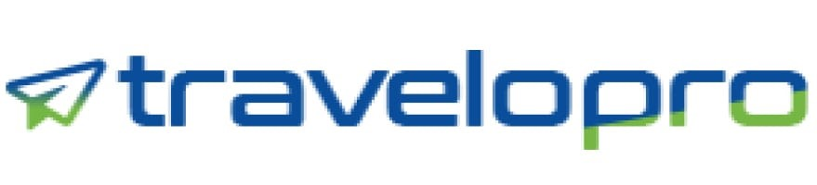
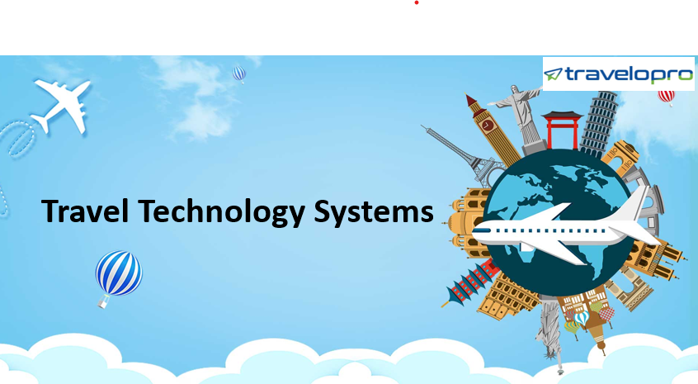
Travel Technology Systems
Email id : contact@travelopro.com
Phone No : 98455 66441

Slide 2
Overview Of Travel Technology And its Importance
Travel technology companies play an essential role in the modern travel ecosystem, enabling travel agencies, airlines, hotels, and other stakeholders to operate more beneficially in a rapidly evolving digital landscape.
Travel Technology Systems comprises a range of cutting-edge solutions that make traveling more convenient and efficient. These systems include online booking platforms, mobile applications, and self-service kiosks that enable travelers to access data, book flights, hotels, and other travel services, and manage their bookings.
Travel technology systems have empowered travelers to plan and book their trips with ease, eliminating the need for intermediaries and making travel more accessible than ever before.

Slide 3
Through technology, you can book a flight or train ticket, reserve a hotel booking effortlessly, and make your travel simply superb and fun-going. All thanks to travel technology and travel technology companies that have made things much easier and easier-going tasks.
The innovative online travel technology platform continues to provide travel industry users with the most up-to-date and dependable online travel portal solution, including customized online booking engines, travel agency accounting software, quality services, and much more.
One important change is the shift from manual processes to automated systems. Advanced tools such as Computer Reservation Systems (CRS) and Global Distribution Systems (GDS) have empowered travel agents to streamline bookings, making the complete process more efficient and error-free.

Slide 4
Are You Looking for A Best Travel Technology Solution to Make a Mark In The Travel Industry?
Making a partnership with the right travel technology company helps you streamline your travel business in the best way. Are you still wondering which travel technology company can make a difference to your business? Then, we can help you. Travelopro is a reliable technology partner, and it is specialized in travel technology.
Travelopro, a travel website development company making technology solutions for travel businesses and technology solutions for tour and travel agencies, aims at helping travel agents from all across the world to generate more business and become accessible to their clients by means of a virtual interactive medium.
Travelopro is the provider of the leading travel technology systems for tour operators, online travel agents, and wholesalers.

Slide 5
We work with some of the most recognized and renowned brands in the travel industry, giving them cutting-edge and scalable solutions in an ever-changing market.
We render out great travel technology solutions for clients, including flight booking, hotel booking, tour operator software, and travel agency software for travel management companies. We also aim to improve the customer travel experience and boost bookings in a short time.
We develop the best travel technology module supported with advanced travel technology to help travel agencies automate the travel process and allow customers to make online bookings for hotels, flights, tours, and transfers to maximize bookings and revenues.
It has become important to have an established business online to cater to more and more clients who are willing to spend and travel the world. Travelopro is your best companion when it comes to building travel packages and providing your clients with the fastest, most efficient, and most productive service.

Slide 6
Our Travel Tech Solutions are built with strong functionality of Trip Builder, Itinerary Creation, Package Customization, Third-Party Supplier Integration, GDS Integration, Payment Integration, Dynamic Packaging, Build Package Quotation, Reservation & Inventory Management, Markup Management, Hotel XML IN, Hotel XML Out, Channel Manager Integration, Finance Management, MIS Reporting, Multi-language, Multi-currency, and Mobile-Friendly Website.
At Travelopro, we understand the importance of technology in the fast-changing industry of travel. From online booking platforms and mobile apps to detailed reporting and automated savings tools, we provide everything you need. We take time to understand each client’s unique needs and requirements and ensure they are matched with the right solution for their business. It is our access to the best travel technology that provides our customers the advantage when booking travel.
We have an expert API integration team and professionals to implement APIs from leading GDS providers such as Amadeus, Sabre, Galileo, and more.

Slide 7
Which Are The Best Travel Technology Solutions For Your Travel Business?
Travelopro is a leading travel technology company that delivers cutting-edge travel technology solutions for travel industry businesses. Our goal, as a global leader in travel technology software, is to equip the travel industry with innovative software solutions that foster creativity, enhance productivity, and provide outstanding client experiences.
We work hard to be at the leading edge of travel technology, creating industry standards and paving the way for the creation of advanced software solutions that take into account the particular possibilities and problems faced by the travel and tourist industry.

Slide 8
Travel Agency Software
Tour Operator Software
B2B/B2C Booking Engine
Travel Portal Development
XML API Integration
CRM Software for Travel Companies
Flight Booking System
Hotel Booking System
Car Booking Engine
Cruise Booking System
Tour Booking Engine
Mobile Apps

Slide 9
Travel Agency Software
Travelopro is a renowned travel technology company that offers innovative travel agency software solutions that streamline travel bookings, payments, and other tasks. Our software improves efficiency, productivity, and customer satisfaction for travel agencies. Our travel agency software is amalgamated with the best providers of global inventory in Flight, Cruise, Car rentals with ease and experience. We have a selection of packages to fit the travel booking agencies based on their interests and budget.
Tour Operator Software
Travelopro's Tour operator software is a one-stop solution for managing a travel business and growing your travel business. Our travel technology company provides state-of-the-art Tour Operator Software for managing bookings, itineraries, and financials, streamlining operations, and enhancing customer experience.

Slide 10
B2B/ B2C Booking Engine
Travelopro helps you with B2B, B2C, and B2B2C travel portal designs, development, and marketing by SEO/SMO services. For more business growth, we offer you a B2B and B2C travel portal development solution, which means business to business and business to customer. It can give you a better turn-around ratio of customers. Our B2C and B2B travel portal development services are designed to help the OTAs and TMCs at several verticals to sell across various channels, expand their distribution network, and sell their online travel offerings.
Travel Portal Development
Travelopro delivers cutting-edge, modern travel portals designed to improve your digital footprint and enhance your customer’s experiences. Our in-house teams are experts in delivering data-driven, engaging websites that are precisely matched to you, your brand, and your business objectives. Our design team will work with you to transform your business into a dynamic and user-friendly website.

Slide 11
XML API Integration
Travelopro offered XML API integration services with a specialized team attached to perform the required tasks. We can assist you with XML API integration services with multiple suppliers available in the world market. Additionally, we can assist you in implementing XML-out functionality for your portal, which would grow your business manifolds.
Our Travel API allows the application to access and retrieve data from various travel suppliers, such as airlines, hotels, car rental companies, and tour operators. By integrating our travel API, businesses can offer a wide range of travel services and information to their customers. We integrate all your cloud/on-premise applications and databases for higher efficiency.

Slide 12
Our services
Include no hidden costs.
Supports cloud-to-cloud, cloud-to-ground, and ground-to-ground integrations
It helps you preserve and increase the value of your existing IT investments.
Include customizable interfaces and workflows.
Smoothly integrate your existing CRM, accounting, HRMS, or reservation systems.

Slide 13
CRM Software for Travel Companies
In this time, Travelopro is a superior travel software development company that gives the best travel CRM software for travel companies to automate day-to-day operations such as lead management, responding to queries, follow-ups, automated email to raise business leads, and sales efficiency. We ensure our clients create unbreakable customer relations. Our comprehensive platform empowers you to:
Unify Customer Data
Personalized Experiences
Streamlined Communication
Enhanced Sales & Marketing
Improved Operational Efficiency
Lead Management

Slide 14
Flight Booking System
Travelopro excels in the field of flight booking software for worldwide clients, with a broad range of inventory in the GDS and LCC flights and many flight API suppliers globally. So, we serve different geographies with domestic and international flight booking comfortably. Our flight ticket booking is straightforwardly connected to the GDS and leading LCC and full-service domestic carriers, in which the data is fetched and the result is displayed. Users will search the segments, choose the desired option from the results, and finally generate PNR after paying through Payment Gateway.
Hotel Booking System
Get Travelopro hotel booking software. It is advanced and helps you provide an excellent guest experience. It also speeds up revenue generation. Our hotel booking is directly connected to more than 700,000 inventories in which the data is fetched and the result is displayed.

Slide 15
Car Booking Engine
Travelopro provides customizable car booking software for rental car companies and car rental agencies. Managing reservations is quite easy by using car booking engine software, tracking availability of different vehicles, maintaining vehicles in and out, etc. Our car booking engine and car rental booking software offer the ability to manage and book cars online, the ability to manage their own car inventory for car rentals, and also allow travel agents to compare different possible rate options.
Cruise Booking System
Travelopro is a state-of-the-art travel technology company that offers the best travel technology solutions to its customers worldwide. Our integrated cruise booking software is the result of our constant efforts. At Travelopro, we work hard to handle travel companies and cruise suppliers better. Through our smooth booking engine, we eradicate the booking complexities for the end-customer. We help our clients increase their revenue generation.

Slide 16
Tour Booking Engine
Travelopro supports tour operators to define their own holiday packages and sell online through B2C and B2B web portals. Our cutting-edge back-end system encompasses a comprehensive CMS (content management system) for travel professionals, home-based travel agencies, and tour operators that enables customers to configure a package involving flights, hotels, sightseeing, day activities, terms, policies, etc. and its visibility preference on websites.
Mobile Apps
As travel technology solutions providers, we can develop mobile apps for travel and hospitality businesses, which can provide customers with convenient access to booking and reservation information, as well as other features such as maps, itineraries, and reviews.

Slide 17
Why Is Travel Technology Software Integral?
Travel technology software is crucial in today’s fast-paced, highly competitive travel industry. Here’s why:
• 𝗦𝘁𝗿𝗲𝗮𝗺𝗹𝗶𝗻𝗲𝗱 𝗢𝗽𝗲𝗿𝗮𝘁𝗶𝗼𝗻𝘀: Travel technology software automates and simplifies numerous processes, from booking management to customer support. This reduces manual effort and minimizes errors, ensuring streamlined operations and enhanced efficiency.
• 𝗥𝗲𝗮𝗹-𝗧𝗶𝗺𝗲 𝗗𝗮𝘁𝗮 𝗔𝗰𝗰𝗲𝘀𝘀: With travel technology software, travel agencies and tour operators can access real-time information about flight availability, hotel bookings, and travel packages. This enables them to provide up-to-date data to customers, which is critical for making informed decisions.

Slide 18
• 𝗘𝗻𝗵𝗮𝗻𝗰𝗲𝗱 𝗖𝘂𝘀𝘁𝗼𝗺𝗲𝗿 𝗘𝘅𝗽𝗲𝗿𝗶𝗲𝗻𝗰𝗲: Personalization is key in the travel industry, and technology helps achieve this. Travel software can store customer preferences, history, and feedback, allowing agencies to customize their services and offers, thus enhancing customer satisfaction and loyalty.
• 𝗖𝗼𝘀𝘁 𝗘𝗳𝗳𝗶𝗰𝗶𝗲𝗻𝗰𝘆: By automating repetitive tasks such as invoicing, itinerary creation, and booking confirmations, travel technology software decreases operational costs. It also enables businesses to handle resources more effectively, contributing to overall profitability.
• 𝗚𝗹𝗼𝗯𝗮𝗹 𝗖𝗼𝗻𝗻𝗲𝗰𝘁𝗶𝘃𝗶𝘁𝘆: Travel technology software combines travel agencies with global distribution systems (GDS), airlines, hotels, and other service providers.
• 𝗦𝗰𝗮𝗹𝗮𝗯𝗶𝗹𝗶𝘁𝘆: As travel businesses expand, so do their operational needs. Travel technology software is scalable, meaning it can smoothly adapt to increasing demands without the need for remarkable additional resources or manual intervention.

Slide 19
How Our Travel Technology Solutions Help You?
Drive Business Growth: By utilizing the newest technology solutions tailored for your travel business, we help you grab new opportunities and reach untapped markets. From streamlined booking processes to personalized customer experience, our solutions enhance revenue and improve operational efficiency and brand visibility. With our solution, your travel business can engage more travelers and ensure sustainable growth in this travel industry.
Achieving ROI: Investing in technology is a strategic choice. Our technology solutions help you maximize your ROI by streamlining processes, reducing overhead costs, and increasing revenue growth. With analytics tools and performance indicators, you can track performance, identify opportunities for improvement, and achieve a higher ROI on your technology investment, fueling the growth and success of your travel business.

Slide 20
Operational Inefficiencies: We simplify your business processes, from booking management to financial reporting. Our professionals use technology solutions and automate repetitive tasks, eliminating errors and improving collaboration so that it frees up precious time and resources to concentrate on what really matters in expanding your travel business.
Helps to Stay Competitive: We use the newest technological advancements and give you the tools and insights needed to outshine competitors. From dynamic pricing algorithms to predictive analytics, our solutions empower you to adapt quickly to market changes, optimize your products, and grab growth opportunities. It helps you set new standards for excellence, ensuring your business remains competitive.
Improve Customer Experience: We designed solutions that elevate the traveler’s journey from initial inquiry to post-trip feedback. With simple booking interfaces, tailored AI-driven recommendation engines, and smooth communication channels, you can provide the greatest service that delights your travelers and encourages them to return for more.

Slide 21
Travelopro - YOUR ONE IDEAL TRAVEL TECHNOLOGY PARTNER
In this advanced era, it has become necessary to have proper and right travel technology solutions. Travelopro offers you a one-stop travel shop with all the products and new features. Our travel technology can help your customers to easily plan, book, and purchase travel products, including real-time access to the products. Travelopro offers many modules to satisfy the needs of our clients.
Travelopro is a travel technology solution provider of future-proof products for end-to-end automation of the travel business worldwide. Under one roof, we provide a plethora of travel services to our customers, tour operators, travel vendors, self-employed hotels, and car rental companies. We help automate companies and streamline employees, corporate, B2B, B2C, and mobile booking specifications.
As a leading global travel technology company, Travelopro excels in delivering robust travel software solutions aimed at enhancing travel management.

Slide 22
We offer comprehensive, end-to-end online travel technology solutions catering to a broad spectrum of clients, involving travel agents, large travel corporations, TMCs, OTAs, and corporate houses. Travelopro is your preeminent destination for robust travel software solutions.
We team up with our clients to offer the most effective travel technology solutions, such as white label solutions involving B2B, B2C, and B2B2C, travel API/XML integration, GDS integration, tour CMS, hotel extranet, and many more.
Our state-of-the-art suite of travel technology solutions streamlines the process of searching, booking, and managing travel. With Travelopro solutions by your side, navigating through millions of travel options, including flights, hotels, and cruises, becomes effortless, both locally and globally. Whether you are a brand-new travel business, OTA, or well-established host agency, we have the solution for you.

Slide 23
We are promised to give cutting-edge technologies and easily accessible Internet booking engines to make your travel company the first preference of the travelers. We have revolutionized the travel portal development industry through our innovations and superior services.
With years of expertise in the travel technology sector, we specialize in delivering an advanced suite of technology solutions that are designed to address your particular challenges, from technology adoption to customer acquisition.
Our goal, as a worldwide leader in travel technology software solutions, is to equip the travel industry with cutting-edge software solutions that foster creativity, improve productivity, and provide excellent client experiences. We work hard to be at the forefront of travel technology, creating industry standards and paving the way for the creation of innovative software solutions that take into account the particular possibilities and problems faced by the travel and tourist industry.

Slide 24
With the travel industry getting to be progressively competitive and digital, Travelopro gives an important edge for travel companies looking to remain ahead of the curve and succeed in the showcase without getting into the bother of the entire part of paper work. It provides dynamic pricing devices that permit travel companies to alter costs in real-time based on supply and request. This implies that their accomplices can offer pioneering travel technology beneath their own brand, improving their services and coming to more customers.
In order to manage your travel services from various parts of the world, we provide you with travel portal software, travel portal development, and travel booking engine software. Since we are your partner in travel technology, we are the suitable spot to partner with you on your project as expert travel website designers and experienced developers.
With decades of industry experience, our expertise lies in building robust travel software solutions, mobile travel applications, travel portal design, and enterprise applications that drive growth and achieve scale.

Slide 25
Benefits of a Travel Technology Company
A travel technology company offers various benefits that make travel planning and management easier, more cost-effective, and more enjoyable. From personalized experiences and real-time updates to easy payments and enhanced safety, these companies provide profitable services that serve the needs of modern travelers.
Real-Time Updates and Support: Travel plans can change unexpectedly due to several factors such as weather, delays, or personal reasons. A travel technology company gives real-time updates and support, ensuring that travelers are always informed about any changes. This real-time assistance can be useful in managing travel disruptions effectively.
Easy Payment Options: A Travel Technology Company offers various payment options, including credit cards, digital wallets, and net banking. These secure payment gateways ensure that transactions are safe and convenient.

Slide 26
Easy Booking and Reservations: One of the primary benefits of a travel technology company is the ease of booking and reservations. These companies provide online platforms where travelers can book flights, hotels, and other travel services with just a few clicks. This convenience saves time and effort, making the travel planning process smooth.
Cost-Effective Solutions: Travel technology companies often offer the best prices and exclusive deals. They use advanced algorithms to compare prices from multiple service providers, ensuring that travelers get the best possible rates. This cost-effectiveness is a remarkable advantage for budget-conscious travelers.
Personalized Travel Experiences: A travel technology company can customize travel experiences to meet individual preferences. By using data analytics and customer insights, these companies can recommend personalized itineraries, activities, and accommodations. This customization increases the overall travel experience, making it more enjoyable and memorable.

Slide 27
CONTACT US:
For more details, please visit our website:
https://www.travelopro.com/travel-technology-systems.php
Email id : contact@travelopro.com
Phone No : 98455 66441

