Slide 1

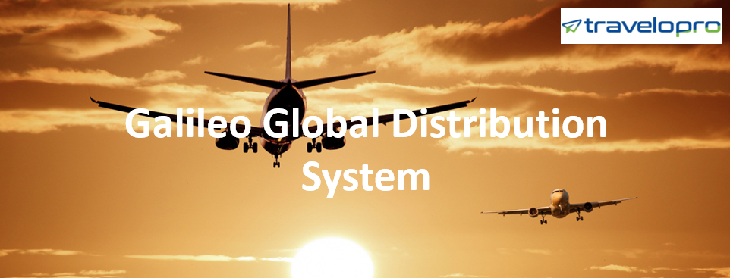
Galileo Global Distribution System
Email id : contact@travelopro.com
Phone No : 98455 66441

Slide 2
What is Galileo Global Distribution System?
Galileo is a Global Distribution System (GDS), also known as a CRS (Computer Reservation System) in the travel industry. It is owned by Travelport and is part of the entire portfolio, which includes the Apollo and Worldspan systems. The Galileo GDS allows you to book hotel rooms, airline tickets, rail tickets, cruises, and car rentals.
The primary advantage of the Galileo GDS system for hotel owners is the ability to distribute hotel rooms to travel agencies and clients on a global scale. Galileo has 600,000 hotels/properties worldwide. It offers affordable rates in real-time on your online travel booking platform and apps. Thus, travel agencies can easily book hotel rooms for customers.

Slide 3
Galileo assists car rental companies in making their fleets and services available globally via Travelport developers for integration into their own travel APIs, applications, and websites. Travelport enables the global travel market by linking buyers and sellers through an agency, online, and corporate travel channels.
Using NDC-XML communications, Galileo assists airline service operators in managing and communicating fares. Galileo GDS is one of the most widely utilized GDSs, with almost 2,34,000 direct connections to 6,50,000 hotel properties in 180 countries worldwide.
The Galileo GDS system provides access to low-cost airlines, high-speed rail providers, and multi-source content from across the globe using a single API, which may help you eliminate the clutter of several programming interfaces while saving time and money.

Slide 4
B2B and B2C travel software provided by Travelport's Galileo Distribution System are becoming increasingly popular in regions such as India, Mexico, the United States, Europe, South Africa, and Malaysia. Galileo is the industry leader in airline reservation software, with connections to practically every major airline.
The Global Distribution System (GDS) is the primary reservation tool for travel agents. The Global Distribution System is a network that allows travel agencies and their customers to access travel data, search for and compare reservation options, and book travel.

Slide 5
The Galileo Global Distribution System is now widely used in:
Flight Booking System
Hotel Booking System
Car Rental Booking System
Cruise Booking System
Holiday Packaging System
B2B Online Booking Engine
B2C Online Booking System
Corporate Booking Module
Single or Multiple interfaces

Slide 6
Importance of Galileo Global Distribution System For Travel Agencies And Tour Operators.
Travelopro is a leading Travel Technology Company that offers global distribution systems (GDS) and integrates the Galileo GDS API into a travel booking website. Integration of Galileo GDS Systems will assist you in lowering the company's operating costs by decreasing workload and enhancing productivity.
We provide B2B, B2C, and B2B2C booking engines and the ability to integrate multiple inventory suppliers into a single booking engine for hotels, flights, packages, excursions, car rentals, transfers, and buses. This GDS simplifies your easier for you with its customer management, back-end system, business rules, access to third-party systems, and CRM.

Slide 7
Our Galileo integration services will meet all of your requirements. Our Galileo Travel Software provides you access to live inventory, cancellation options, and many payment channels, allowing you to make your website a one-stop shop for all of your customer's hotel needs. Our advanced technology solutions maximize the demands of travel agents.
The booking tool simplifies business consolidation and is more suited to client demands. Galileo Reservation System has the most advanced travel domain. It is a powerful software that delivers topline services with GDS integrations.
Travelopro integrates global distribution systems, like Galileo GDS to travel agents all around the globe. It serves travel agencies, tour operators, hotel providers, etc. Galileo API is one of the most effective GDS solutions.

Slide 8
Galileo GDS system commands lead positions in airline reservation software and are connected to practically all the leading airlines. Galileo provides solutions to travel agencies by offering desktop solutions (search & book) and web services XML to connect to the core database.
We make technology accessible and affordable to a large number of travel businesses worldwide by providing innovative, popular, and simple-to-use travel booking platforms. We have vast expertise in the travel sector and strive to provide the highest level of service and technological solutions to help you thrive in your business.
Through web services, we integrate the Galileo GDS system for IATA agents. Our Galileo GDS integration team creates the best-integrated system by incorporating the maximum number of possible inventories required to book flights, hotels, vehicles, and cruises through the Galileo GDS system.

Slide 9
Our Galileo GDS-based flight booking and reservation engines provide low-risk implementation and support for flight search, booking, and ticketing utilizing all major GDS, particularly Galileo, such as Amadeus and Sabre.
Travelopro GDS XML API web services can be integrated directly into your website using our booking engine platform, allowing you to maintain your site’s identity and original design and branding. Travel booking software linked to Travelport UAPI is in great demand among global travel companies.
Our travel portals are a full-fledged web-based online booking system designed for the growing business needs of travel management companies, destination management companies, travel aggregators, B2B B2C travel agencies, and tour operators.

Slide 10
How can Galileo XML API Integration help Travel Management Companies?
Galileo API helps travel portals to attract the top service providers to promote their efficient portal services, resulting in significant traffic to the website. Galileo's Flight API Integration will enable you to connect with all major airlines.
When it comes to Galileo XML API Integration, we ensure that you receive one of the most trusted and reliable online flight booking systems to automate airline, hotel, and vacation booking for your users.
Furthermore, while integrating Galileo, an automated central reservation system, into a travel portal, our developer ensures that all of our clients benefit from the worldwide reach and a user-friendly booking system.

Slide 11
Galileo Global Distribution System processes the highest number of transactions on a day-to-day basis. Galileo has become the world-leading GDS system and travel content aggregator.
A fully functional Galileo travel system/Galileo software consists of the Galileo travel reservation system for air booking, Galileo hotel booking, travel packages, Galileo bus booking, Galileo rail booking, Galileo cruise booking, insurance, and the Galileo CRS system. Galileo XML API Integration facilitates the integration of all services in one location, allowing travelers to discover the best deals available globally.
Galileo GDS provides access to a wide range of content and capabilities via web services APIs and desktop applications. It is intended to complement your existing API solutions for rapid and low-risk implementation.

Slide 12
The integration will increase your revenues, operational efficiency, and productivity. It will help you develop and capture new market opportunities in real-time while lowering your operating costs.
The Galileo XML API integration consolidates worldwide travel data from several providers into a single platform. It assists visitors in locating the best discounts on all aspects of travel. It covers booking flights, cruises, hotel rooms, rails, and rental vehicles all around the globe.
With the integration of Galileo Software, it will provide smooth online booking and an online travel management tool. The portal will collect real-time data. It delivers live availability information for all airlines' flights and rates, including low-cost carriers for domestic and international markets, hotels, and car rental.

Slide 13
Benefits of Galileo Global Distribution System
Maximum buyer outreach
Increase in the revenue and efficiency
Increased productivity
Lowering operating cost
Real-time access to inventory and contents
Sales enhancement
Customized solution
Can be integrated into any central reservation system or travel CMS
Can provide individual identity to travel agents.

Slide 14
Are you looking for a fully-featured Travel Booking System?
By designing and developing a flexible travel booking system, Travelopro can assist you in transforming your independent business into a global travel brand. We have been in the industry for many years and have developed multiple travel portals and online hotel booking systems for well-known DMC clients. We offer a full range of GDS software development services.
Galileo is a globally recognized system that helps travel agencies, companies, and suppliers enhance their efficiency and revenue. Galileo is an excellent travel solution for increasing visibility and distribution among global travelers.
At Travelopro, we offer the best GDS integration services, which has resulted in a high level of satisfaction for many clients in the travel industry. With our years of experience, we can analyze your business's specific requirements.

Slide 15
Our GDS integration solution offers an effective platform for travel agents to manage their reservations. We can add features like price comparison tools, dynamic pricing engines, trip packages, transfer management, insurance choices, and mobile ticketing to your Travel Booking software.
We have expertise in XML API Integration solutions, which include all types of XML/JSON integration from various XML API Suppliers. Our online travel portals provide access to agents and agencies, travel content mapping, central booking management dashboards, and commissions management.
Travelopro Integrate leading Global Distribution Systems (GDS) such as Sabre, Amadeus, and Worldspan by Travelport to build a powerful, feature-rich online travel booking portal.
Our developers have expertise in developing online booking platforms that smoothly connect with tour operators' and OTAs' new or existing websites, including modules for scheduling, calendars, payments, CRM, and business data.

Slide 16
We create Property Management Systems (PMS) and Central Reservation Systems (CRS) that work with open distribution channels, GDSs, extranets, and online booking tools (OBT). Our Travel Agency Booking Software gives your sub-agents access to your live inventory, allowing them to make bookings and deliver quick confirmation to their end consumers. You can handle agent markups, margins, credit limits, commissions, and other business rules on a single platform.
We provide an online travel booking portal for travel agencies and tour operators to enhance bookings while increasing brand awareness and completing their business goals. We specialize in travel portal solutions, development, and integration of various GDS's XML, APIs, testing, and deployment to client domains, and technical and customer support.

Slide 17
CONTACT US:
For more details, please visit our website:
https://www.travelopro.com/galileo-global-distribution-system.php
Email id : contact@travelopro.com
Phone No : 98455 66441

